Slide 1
Six Sigma Green Belt Training
Contains DMAIC full-process explanations, MINITAB practical operations, case analysis, and exam question banks. It is suitable for internal corporate training and personal study, and is essential for preparation for Green Belt certification.
QTank
Knowledge No. 6.1.1 · DMAIC project path
qtank.org

Slide 2


Table of contents
CATALOGUE
  Six Sigma Management Overview
  DMAIC methodological framework
  Project definition and charter development
  process mapping technology
  data collection plan
  Application of basic statistical tools
  root cause analysis techniques

Slide 3
Table of contents
CATALOGUE
  Experimental design basics
  Improve plan implementation
  Control plan establishment
  Project results maintained
  Six Sigma software tools
  Green Belt Certification Requirements
  Industry application case library

Slide 4

01
Six Sigma Management Overview

Slide 5

Six Sigma development history and core concepts
Motorola first
General Electric Promotion
Lean Fusion
Six Sigma was proposed by Motorola engineer Bill Smith in 1986. It was originally used to solve the problem of product quality defects. Through statistical methods, the defect rate was reduced to less than 3.4 parts per million, becoming a quality management milestone.
In the mid-1990s, General Electric CEO Jack Welch elevated Six Sigma to the core of corporate strategy. Through all-employee training and project practice, cumulative revenue exceeded US$10 billion, establishing its status as a global management methodology.
After 2000, Six Sigma and lean production were combined to form "Lean Six Sigma", which integrated the dual advantages of reducing variation and eliminating waste, and further expanded to applications in services, research and development and other fields.

Slide 6
Cost of quality and the economic impact of process variation
Defect rate and customer churn
long term financial benefits
The number of defects per million operations dropped from 6210 (4σ level) to 3.4 (6σ level), significantly reducing customer complaint rates and increasing brand loyalty and market share.
Motorola's cumulative cost savings during the 10 years since it implemented Six Sigma exceeded US$14 billion, verifying its positive cycle logic of "quality improvement - cost reduction - profit growth".
1
2
3
4
High proportion of hidden costs
Economic losses from process variation
Hidden costs such as rework and scrap caused by quality defects in traditional 3σ-4σ level companies account for 15%-30% of sales, while Six Sigma companies can control this to within 5% through process optimization.
Variations in the production process will directly increase raw material waste, equipment downtime and manual debugging costs. Six Sigma uses the DMAIC method to systematically reduce variation and achieve cost savings.

Slide 7


The role of green belts in Six Sigma organizations
Project execution main force
Cross-department collaboration bridge
As the core executor of Six Sigma projects, Green Belts are responsible for data collection, basic statistical analysis and implementation of improvement plans. They need to master MINITAB and other tools to complete 80% of daily improvement tasks.
Green belts need to coordinate with black belt masters and front-line employees to translate Six Sigma methodology into specific operational steps to ensure that improvement measures are implemented in production, service and other links.
cultural communicator
By participating in the DMAIC project, Green Belt promotes the concept of data-driven decision-making within the department and promotes the company to form a quality culture of continuous improvement.

Slide 8
02
DMAIC methodological framework

Slide 9


Define key tasks and outputs during the phase
Clarify project scope and goals
By formulating a project charter, defining the boundaries and core indicators (such as CTQ) of process improvement, we can avoid resource waste and direction deviation and ensure that the team reaches a consensus on the problem.
Identify customer needs
Use VOC (Voice of the Customer) analysis and SIPOC diagram (Supplier-Input-Process-Output-Customer) tools to accurately capture key quality characteristics and provide a benchmark for subsequent measurements.
Establish a team collaboration mechanism
Cross-functional teams need to clarify the division of roles and form a project charter document to reduce later communication costs and improve execution efficiency.

Slide 10



Measurement Phase Tools and Techniques
Data collection plan design
Identify key input/output variables (KPIVs/KPOVs) and develop sampling strategies to ensure data representativeness and reliability.
The core of the measurement phase is to quantify the current status of the process through data, verify improvement potential, and provide scientific basis for root cause analysis.
Measurement Systems Analysis (MSA)
Evaluate the repeatability and reproducibility (GR&R) of the measuring tool to eliminate the interference of measurement errors on the results.
process capability analysis
Calculate the Cp/Cpk indicator, quantify the sigma level of the current process, and identify the gap with the target value.

Slide 11
Analysis-Improvement-Control Phase Connection Logic
01
02
03
The analysis phase drives the direction of improvement
Improve Phase Verification Solution
Control stage solidification results
  Root cause locating tool: combines fishbone diagram, hypothesis testing (such as t-test, ANOVA) and regression analysis to identify key influencing factors and avoid superficial improvements.
  Failure Mode Analysis (FMEA): Assess potential failure risks and their effects, prioritize high-risk factors, and provide prioritization for improvement plans.
  Design of Experiments (DOE): Optimize parameter combinations through factor experiments to verify the effectiveness of the plan and ensure that improvement measures are quantifiable and replicable.
  Pilot implementation and cost assessment: Test the solution in a small-scale process and simultaneously analyze ROI (return on investment) to ensure financial feasibility.
  Standardized document update: Revise SOP (standard operating procedure) and embed improved operating specifications to prevent process regression.
  Establish a monitoring mechanism: deploy control charts (such as X-bar R charts) and SPC (statistical process control) tools to continuously track fluctuations in key indicators.

Slide 12
03
Project definition and charter development

Slide 13



Problem statement and project scoping
01
SIPOC tool application
02
Quantify problem pain points
Clarify process boundaries by drawing a SIPOC diagram (supplier-input-process-output-customer), focus on 1-3 key steps, and avoid scope creep. For example, in the credit approval process, the core steps from credit report acquisition to payment proofreading need to be defined.
To identify the most prominent defects or waste in the current process, such as "customer waiting time exceeds 48 hours accounting for 25%", high-frequency problems need to be analyzed in conjunction with the Pareto chart.
03
Constraint confirmation
04
Resource investment assessment
By clarifying the basic elements that cannot be changed (such as core equipment and process framework), green belt projects are usually limited to the optimization of existing processes rather than disruptive transformation.
Determine the number of hours the team can devote per week (8-12 hours recommended) and the project cycle (3-6 months) to avoid project stagnation due to insufficient resources.

Slide 14



Stakeholder analysis and VOC conversion
Role matrix construction
Customer demand stratification
Identify directly affected internal departments (such as production, quality inspection) and external relevant parties (suppliers, end customers), and determine communication strategies through a power/interest matrix.
Convert VOC (voice of customers) into CTQ (critical quality characteristics), such as converting "quick response" into a measurable indicator of "complaint handling rate ≥ 95% within 24 hours".
Balancing Conflicting Needs
When the needs of different stakeholders are conflicting (for example, the Finance Department requires cost reduction vs. the Quality Department requires stricter inspections), the QFD (Quality Function Deployment) tool is used for prioritization.

Slide 15

Project goal setting and financial benefit estimation
SMART goal setting
Quantify the vague "quality improvement" goal as "reduce the welding defect rate from 5.2% to less than 1.5% within 6 months, and increase CPK to 1.33", and set a process stability goal (increase MTBF from 45 hours to 80 hours).
financial revenue model
Using the COPQ (cost of defective quality) calculation method, it is estimated to reduce scrap (annual savings of ￥1.2 million), reduce rework (￥800,000) and reduce customer complaints (￥500,000). The total revenue is estimated to be ￥2.5 million/year.
resource requirements planning
It is clear that 1 black belt (30% time), 2 green belts (full-time), and a budget of 150,000 (including new testing equipment) need to be invested. The return period of investment is calculated as 4.2 months, and a detailed resource Gantt chart is prepared.

Slide 16
04
process mapping technology

Slide 17

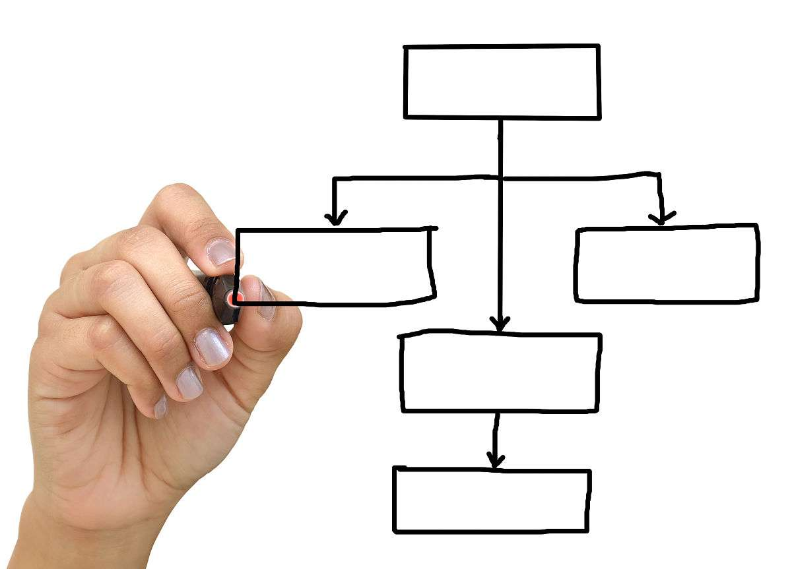

SIPOC high-level flow chart drawing
process boundary definition
Visualization of key parameters
Clarify the starting point and end point of the core process, focus on key value creation links, and avoid including secondary activities in the scope of analysis. For example, the production process can start from the storage of raw materials and end with the inspection of finished products to ensure the simplicity and pertinence of the flow chart.
Mark CTQ (critical quality characteristics) parameters next to the process steps, such as temperature control range, processing accuracy requirements, etc., so that the quality control points are clear at a glance and facilitate data collection in the subsequent measurement stage.
Cross-department collaboration annotation
Use different colors or symbols in the flow chart to distinguish the responsibilities of each functional department (such as procurement, production, quality inspection), and especially mark the input and output standards of the handover link to reduce defects caused by poor communication.

Slide 18
Value stream analysis and identification of non-value-added activities
01
02
Value added time ratio calculation
Troubleshooting the seven wasteful systems
Record the actual processing time and waiting time of each process through time observation, calculate the proportion of value-added activities (usually the manufacturing benchmark value is 25%-35%), and expose hidden process waste.
Use the seven categories of waste framework defined by the Toyota Production System, including overproduction, waiting, transportation, overprocessing, inventory, movement, and defects, to examine the non-value-added links in the process one by one. For example, it was found that 30% of the products were reworked due to improper packaging after quality inspection, which is a typical waste of defects.
03
04
Separation of information flow and logistics
Bottleneck process positioning technology
Independently draw material flow and information transmission paths, paying special attention to inventory backlog problems caused by delays in information systems such as order processing and production plan release.
Use takt time analysis (Takt Time) to compare the process cycle time to identify key equipment or workstations that restrict the overall output. For example, a stamping process cycle exceeds the takt time by 15 seconds, forming a bottleneck in the entire process.

Slide 19



Comparison of current state and future state processes
gap analysis techniques
Use the SWOT matrix to compare the difference between the current situation and the target, quantify the gap in key indicators, such as a 30% reduction in cycle time or a 50% reduction in defect rate, and clarify the direction of improvement.
Process Reengineering Method
Apply ECRS principles (eliminate, combine, rearrange, simplify) to design future processes, such as eliminating redundant quality inspection steps or merging similar process links.
Risk prevention measures
For possible variation points in the future process (such as the risk of debugging new equipment), formulate a control plan in advance, including the design of error-proofing device (Poka-yoke) and SPC (statistical process control) monitoring plan.

Slide 20
05
data collection plan

Slide 21
Measurement System Analysis (MSA) Implementation Key Points
Determine measurement system performance standards
Before implementing MSA, it is necessary to clarify the core indicators of the system such as stability, deviation, linearity, repeatability and reproducibility to ensure the consistency and reliability of the measurement results. For example, GR&R analysis is used to evaluate the proportion of variation caused by equipment versus personnel.
Choose appropriate data type analysis methods
For continuous data, the mean-range method or ANOVA is used for analysis, while for discrete data, the Kappa statistic is used to evaluate inter-rater consistency to ensure that the method matches the characteristics of the data type.
Implement error level determination and improvement
Develop countermeasures based on the error proportion (<10% acceptable, 10%-30% need improvement, >30% unusable), such as calibrating equipment, standardizing operating procedures, or increasing the number of measurements to reduce random errors.

Slide 22
Data stratification strategies and sampling techniques
Stratification principles based on process characteristics
Stratify data by key factors such as time shift, equipment model, operator, etc. to identify potential sources of variation. For example, in production line analysis, batch data of different machines or raw materials need to be distinguished.
Combined application of random sampling and systematic sampling
Simple random sampling is suitable for uniform processes, while periodic problems require systematic sampling (such as 5 items per hour) to ensure that the sample covers all potential variation patterns.
Statistical basis for sample size calculation
The minimum sample size is calculated based on the confidence level (usually 95%), allowed error and population variance. 30 sample points are commonly used for continuous data, and attribute data must meet the condition of np≥5.
Steps to implement stratified sampling
First define layer-level variables (such as process parameter range), then allocate the sample size of each layer proportionally, and finally perform sampling for each layer independently to ensure that each layer of variation is fully represented.

Slide 23



Data collection form design and validation
Logical verification rules
Embed automatic verification formulas (such as extreme warning value alarms), trigger a mark when the data exceeds the historical 3σ range, and intercept abnormal data in real time.
Field structured design
Pre-run tests
Contains required fields such as measurement values, timestamps, operator IDs, equipment numbers, and environmental conditions. Set drop-down menus and numerical range limits to reduce entry errors.
Conduct a small-scale trial filling before formal collection to evaluate the ease of use of the form and correct ambiguous statements to ensure that all participants have a consistent understanding of field definitions.

Slide 24
06
Application of basic statistical tools

Slide 25

Descriptive Statistics and Graphical Analysis
measure of central tendency
The center position of the data is described through indicators such as mean, median, and mode. The mean reflects the average level of the data, the median resists interference from extreme values, and the mode displays high-frequency values.
Dispersion analysis
Use standard deviation, range, and interquartile range to measure data volatility. The smaller the standard deviation, the higher the stability of the process, and the range reflects the range of data distribution.
Graphical tools
Use histograms to display data distribution patterns, box plots to identify outliers, scatter plots to analyze variable correlations, and Pareto charts to focus on a few key issues.

Slide 26




Normality test and data transformation method
Normality test method
Non-normal data processing
Outlier handling
Data stratification analysis
Use the Shapiro-Wilk test or Anderson-Darling test to determine whether the data obeys a normal distribution. A P value greater than 0.05 is considered normal.
Use logarithmic transformation for right-skewed data and square root transformation for left-skewed data. For complex distributions, you can try Box-Cox transformation to approach normality.
Identify outliers through IQR rules or Grubbs test, and decide to eliminate or correct them based on the business background to avoid analysis bias.
By re-testing normality after stratification by dimensions such as time and equipment, hidden patterns or special-cause variations may be discovered.

Slide 27

Calculation and interpretation of process capability index
Difference between Cp and Cpk
Cp only measures the ratio of process variation to specification limit, while Cpk also considers the mean shift, which more truly reflects actual capabilities. Cpk ≥ 1.33 is the industry benchmark.
Long-term and short-term capabilities
PPK is based on long-term data and includes inter-group variation, while CPK is based on short-term data and only includes intra-group variation. Comparing the two can identify sources of systematic fluctuations.
Non-normal process capability
When the data is non-normal, use the percentile method or Johnson transformation to calculate the equivalent Z value, and then convert it into a PPM defect rate to evaluate the risk.

Slide 28
07
root cause analysis techniques

Slide 29

Fishbone diagram and 5Why analysis method
Continuous questioning mechanism
The 5Why analysis method goes straight to the essence of the problem by continuously asking "why", such as "equipment shutdown" → "bearing damage" → "insufficient lubrication" → "failure to maintain as planned", and finally locates maintenance process defects. Be careful to avoid subjective assumptions and base each “Why” on objective evidence.
Structured problem decomposition
The fishbone diagram (cause and effect diagram) systematically identifies potential root causes and avoids missing key factors by decomposing the problem into six dimensions: people, machine, material, method, environment, and measurement. For example, the decline in production line yield can be analyzed from branches such as operator skills (people), equipment aging (machine), and raw material batches (materials).
Advantages of combining
After the fishbone diagram provides a comprehensive reason framework, 5Why can dig deeper into specific branches. For example, first list the possible causes of "welding defects" through a fishbone diagram, then perform 5Why analysis on the "current instability" branch, and finally locate the voltage regulator failure.

Slide 31


Slide 32
08
Experimental design basics

Slide 33

The difference between full factor and partial factor experiments
The trade-off between comprehensiveness and efficiency
Applicable stage differences
Data analysis complexity
Full factor experiments ensure that interactions are not missed by examining all factor combinations (such as 2^k design), but the number of experiments increases exponentially with the number of factors; partial factor experiments (such as 2^(k-p) design) significantly reduce the number of experiments by sacrificing high-order interaction analysis, and are suitable for preliminary screening of factors ≥ 5.
Full factors are mostly used in the detailed analysis stage when the number of factors is ≤ 4, while partial factors are used in the factor screening stage to balance information loss and cost through resolution (such as level III/IV design).
Full factors can directly analyze all main effects and interaction effects, while some factors need to rely on alias structure analysis and engineering experience to determine significance.

Slide 34
Central composite design application scenarios
Multi-stage experiment integration
Through the two-level full factor experiment (factorial point) + axial point (star point) + center point, the factor space is explored in stages, taking into account both linear and nonlinear effect detection.
Central Composite Design (CCD), as the core tool of the response surface method, is suitable for nonlinear relationship modeling and process parameter optimization, especially to achieve precise parameter adjustment in engineering optimization and product development.
Response surface construction
Supports quadratic model fitting, can generate contour plots and three-dimensional response surfaces, and intuitively display optimal parameter intervals (such as maximizing chemical reaction yield).
Industrial case
In the semiconductor etching process, CCD is used to optimize the combination of parameters such as temperature and gas flow to reduce the defect rate by more than 40%.

Slide 35
Response optimization and robust parameter design
Multi-objective optimization method
Variation reduction strategies
  Satisfaction function method: Convert multiple responses (such as intensity, cost) into satisfaction index, and achieve Pareto optimal solution through weight distribution. It is suitable for scenarios where conflicting indicators are weighed.
  Overlapping contour plot method: Overlay the contour plots of key responses to identify common feasible areas, such as the parameter window that meets both dimensional tolerances and surface finish in the injection molding process.
  Signal-to-noise ratio (S/N) application: In the Taguchi method, the S/N ratio (such as large characteristics and small characteristics) is used to select a factor level combination that is insensitive to noise factors (environmental fluctuations, material differences).
  Tolerance design: Combined with cost analysis, determine the allowable fluctuation range of key factors, such as robust interval design of bolt torque in automobile assembly.

Slide 36
09
Improve plan implementation

Slide 37



Poka-Yoke application
Physical error-proofing design
Digital error proofing system
Forced process control
Physical devices such as limiters and anti-fool pins are used to ensure that the assembly process can only be completed in the correct way. For example, guide pin clamps are used in circuit board assembly to prevent pin lengths from exceeding the standard and reduce the error rate to zero.
Combined with the MES system or scanning equipment to achieve automatic verification, for example, the pharmaceutical industry uses RFID technology to check feeding batches, eliminating human operational errors and reducing the error rate from three thousandths to zero.
Set sequence checkpoints in key processes. For example, the assembly line uses color numbers to indicate the sequence of steps to ensure that operators must complete the preceding actions before entering the next link.

Slide 38

Development of standardized operating procedures
Job decomposition and visualization
Measurement system standardization
Complex processes are broken down into standardized steps, supplemented by graphic explanations and video demonstrations, such as formulating valve pressure adjustment SOPs for filling production lines to reduce fluctuations caused by individual operating differences.
Unify the data collection method and tool calibration process. The case shows that a beverage factory eliminated the 2.1ml measurement error caused by differences in operator reading habits by standardizing the use of checkweighers.
Exception handling standardization
Continuous optimization mechanism
Establish a layered response mechanism to clarify the response measures at all levels from operators to engineers. For example, when a burr is found in the die-casting process and has not been processed, the error-proof pin triggers an automatic shutdown and notifies the responsible person.
Regularly review SOP effectiveness through DMAIC cycles, and identify deviation points based on SPC control charts. For example, a home appliance company updates plug assembly standards every quarter to keep the defect rate close to zero.

Slide 39
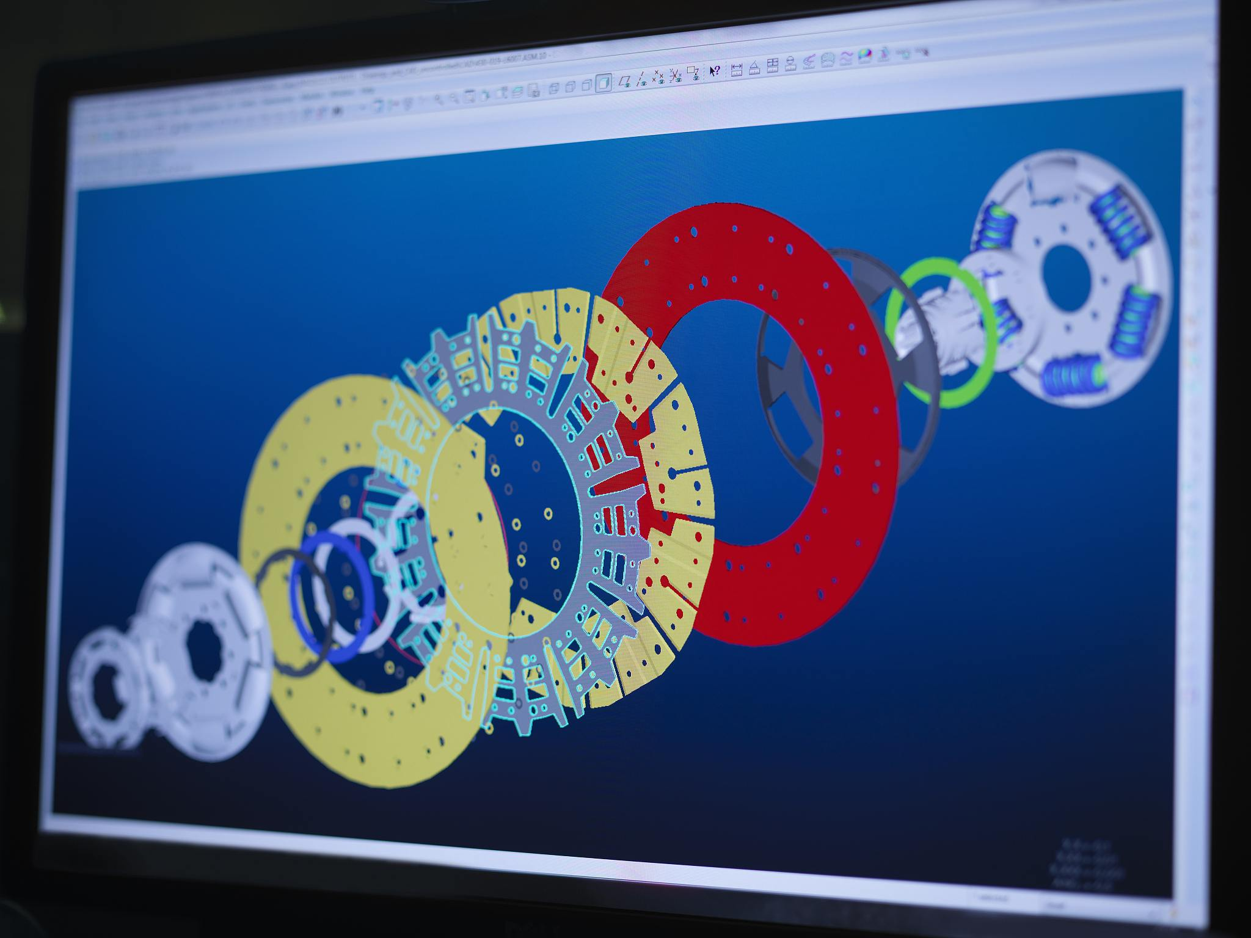

Change Management Resistance Coping Strategies
Data-driven consensus building
Use tools such as MSA analysis to present evidence of current problems, such as showing that measurement error accounts for 67% of filling fluctuations, prompting production managers to support process changes.
Progressive pilot verification
Select non-critical periods for small-scale testing, commit to controlling the scope of impact (such as 30 minutes of data collection every day), and reduce the team's resistance to the impact on output.
Results visualization and motivation
The improvement effect is displayed in real time through the electronic signage. For example, after the filling standard deviation was reduced from 3.2ml to 1.0ml, the annual cost saving data of 250,000 yuan was disclosed to strengthen the team's confidence.

Slide 40
10
Control plan establishment

Slide 41

Control Chart Selection and Discrimination Criteria
Control chart type selection
According to the data type (continuous/discrete) and process characteristics, select applicable control charts, such as Xbar-R chart (continuous data), P chart/U chart (discrete defect rate), I-MR chart (single value moving range). A comprehensive judgment needs to be made based on process stability and sample size.
Application of Discrimination Criterion
Based on Westgard rules or eight major discrimination principles (such as 1 point exceeding 3σ, 6 consecutive points increasing/decreasing, 8 consecutive points without C zone, etc.), abnormal fluctuations are identified through statistical probability. For example, the probability of 6 consecutive points of decline is only 0.13665%, and special reasons need to be investigated immediately.
Dynamically adjust strategies
Rules can be simplified for high Sigma level (>4σ) processes, while low Sigma levels need to be superimposed with multiple rules for strict control, such as combining 1-3S/2-2S rules to increase sensitivity.

Slide 42
Process control standardization documents
SOP writing specifications
Visual tool embedding
The document needs to clarify key input/output variables (KPIV/KPOV), measurement methods, sampling frequency and responsible persons to ensure operational consistency. For example, the inspection process needs to label the instrument calibration steps and allowable error ranges.
Integrate control chart templates, trend analysis tables, and historical data comparison modules into the document to facilitate real-time monitoring. The attached SPC software screenshot explains the data entry path.
01
02
Version control and training records
Cross-department collaboration terms
Establish a document revision log and associate the reasons for changes (such as process updates); synchronize and archive employee training signature pages to ensure that the executive level understands the latest requirements.
03
04
Define the interaction nodes of quality, production, and engineering departments, such as abnormal line shutdown authority, frequency of joint review meetings, etc., to avoid ambiguity of responsibilities.

Slide 43

Response plan trigger mechanism design
Graded response process
Classify the abnormality according to its severity (for example, a yellow warning requires analysis within 24 hours, a red warning requires immediate shutdown), and preset containment measures (isolate batches, 100% inspection).
Root cause analysis tools
After triggering the reaction, it is mandatory to use 5Why, fishbone diagram or hypothesis testing (such as t-test) to locate the problem. For example, equipment deviation needs to be verified, maintenance records or environmental factors.
Closed loop verification mechanism
After rectification, short-term capability studies (CPK>1.67) and at least 3 batches of stability monitoring are required to close the problem and prevent recurrence.

Slide 44
11
Project results maintained

Slide 45



Vertical and horizontal expansion methodology
process standardization duplication
The verified improvement plan is solidified through standardized operating instructions (SOP) to ensure that the same process can be quickly replicated in different production lines or departments. At the same time, a cross-regional promotion template is established, including key parameters, control points and risk plans.
Breakdown of hierarchical goals
According to the corporate strategy, the project results are decomposed into department-level and team-level KPIs, and implemented layer by layer through the PDCA cycle. For example, the defect rate target is converted into CPK value requirements for each process, and corresponding resource support is matched.
cultural penetration mechanism
Design a multi-dimensional publicity plan, including case library construction, internal benchmark visits, improvement story sharing meetings, etc., to integrate improvement methods into the daily operations of the organization and form a cultural inertia of continuous improvement.

Slide 46



Results audit and financial verification
01
Dual-track income accounting
02
Process stability audit
A dual verification mechanism is adopted to ensure the authenticity and integrity of the data, with both hard benefits (such as cost savings and production capacity improvements) led by the financial department and soft benefits (such as customer satisfaction and cycle shortening) assessed by the business department.
Monitor key indicators for 3-6 months through control charts to verify whether the improvement effect is stable. At the same time, check the implementation of control measures such as error-proofing devices and visual signboards to prevent regression.
03
Risk Hedging Assessment
04
tax compliance review
Analyze new risks that may be brought about by the improvement plan (such as supply chain changes, increased equipment load), formulate contingency plans and quantify potential losses to ensure that net benefits are in line with expectations.
The joint finance department confirms whether the cost savings involve tax adjustments, such as asset impairment due to inventory reduction, to avoid subsequent audit issues.

Slide 47


Knowledge transfer and best practice solidification
Three-dimensional training system
Design differentiated training content for the operation level (use of tool cards), management (data analysis), and decision-making level (strategic connection), and ensure the implementation of knowledge through workshops, sand table exercises, etc.
organizational memory building
Establish a project knowledge base, including complete DMAIC documents, failure lessons, and expert contact lists, and integrate it into the enterprise knowledge management system to support keyword retrieval and version control.
Qualification link
Incorporate Six Sigma methodology into the job competency model. For example, promotion to technical supervisor requires leading a green belt project to encourage employees to proactively apply and improve methods.

Slide 48
12
Six Sigma software tools

Slide 49

Minitab Basic Operation Guide
Data import and cleaning
Descriptive statistical analysis
Hypothesis testing and analysis of variance
It supports the import of multiple formats such as Excel and CSV, and provides missing value processing and outlier detection functions to ensure that the data quality meets the analysis requirements.
Quickly generate key indicators such as mean, standard deviation, quantile, etc., and intuitively display data distribution characteristics through visualization tools such as histograms and box plots.
Built-in t test, chi-square test, ANOVA and other tools help users verify the significance of data differences and identify key influencing factors.

Slide 50
Visual analysis dashboard construction
KPI visual layout
Customize the dashboard view to centrally display hard cost savings, project progress and other core indicators in the form of dashboards, heat maps, etc. to improve decision-making efficiency.
Interactive chart design
Automated data updates
It supports advanced graphics such as scatter plots, marginal plots, and multivariable plots, allowing users to deeply analyze data correlation through filtering and drilling functions.
Set up a scheduled refresh mechanism to ensure that dashboard data is synchronized with the source system and reduce manual maintenance costs.
Integrate multi-source data through platforms such as Minitab Engage to create dynamic dashboards to achieve real-time monitoring and trend analysis of key indicators (such as defect rate, cycle time).

Slide 51

Automated report generation tips
Templated report configuration
dynamic data link
  Preset standard report templates for each stage of DMAIC (such as project charter, analysis stage summary), support one-click generation of complete documents including charts and statistical results.
  Batch processing is implemented through Minitab macro language, and reports in PDF/PPT format are automatically exported, significantly reducing repetitive operation time.
  Dynamically associate the charts in the report with the original data to ensure that the charts are automatically adjusted after the data is updated to avoid manual modification errors.
  Integrate Python/R scripts to extend analysis functions and embed advanced statistical models (such as regression analysis, DOE results) in reports.

Slide 52
13
Green Belt Certification Requirements

Slide 53



Theory examination knowledge system
DMAIC methodology
Quality management standards
Master the core tools and techniques in the five stages of Define, Measure, Analyze, Improve, and Control, including project charter, SIPOC diagram, process capability analysis, etc.
Understand the integration of ISO 9001, lean production and other quality management systems with Six Sigma, and be able to identify process waste and formulate optimization plans.
Statistical Tool Application
Proficient in using basic statistical methods (such as hypothesis testing, regression analysis, variance analysis) and Minitab and other software for data processing to ensure the objectivity and accuracy of problem analysis.

Slide 55



Continuing professional development path
Advanced knowledge system
Accumulation of practical experience
  It is recommended to learn the DFSS (Design for Six Sigma) methodology, master the DMADOV process and QFD (Quality Function Deployment) tools, and expand the application capabilities of new product development scenarios.
  It is necessary to regularly participate in seminars held by authoritative organizations such as ASQ/China Quality Association and follow up on the latest standards of statistical process control (SPC) and Minitab software version updates.
  Lead or participate in at least 2 cross-department improvement projects every year. The project types need to cover diverse scenarios such as manufacturing process optimization and service cycle shortening.
  Establish an archive of project results, including case study reports, proof of financial benefits and team feedback records, as a practical basis for black belt certification.

Slide 56
14
Industry application case library

Slide 57

Solutions to typical manufacturing problems
Shorten injection molding cycle time
Through time research and regression analysis, home appliance companies found that low mold cooling efficiency was the bottleneck. After optimizing the cooling water channel design, single-piece production time was reduced by 22%, production capacity increased by 15%, and the CPK value improved from 0.8 to 1.33.
Reduce welding defect rate
An auto parts factory identified welding current fluctuation as a key factor through the DMAIC method. After improvement, the defect rate dropped from 8.7% to 2.3%, saving 1.8 million yuan in rework costs annually. Control charts were used to monitor parameter stability and improve the process sigma level from 2.1 to 3.4.
Resolving coating thickness variation
An electronic component manufacturer used hypothesis testing and DOE to determine the interactive impact of spraying pressure and conveyor belt speed. After establishing a parameter optimization combination, the thickness pass rate increased from 76% to 94%, reducing scrap losses by 3.5 million yuan per year.

Slide 58
Service industry process optimization examples
Improved timeliness of hospital inspection reports
E-commerce order error control
Using FMEA to identify 7 potential failure modes in sample circulation, redesigning the handover process and introducing barcode tracking, the on-time report issuance rate increased from 68% to 92%, and patient complaints were reduced by 53%.
Establishing a Poka-Yoke error-proofing mechanism to verify key fields, and cooperating with SPC to monitor the ordering process, the error rate dropped from 15/15 to 2/10,000, saving over 2 million yuan in return and exchange costs annually.
1
2
3
4
Bank loan approval speeds up
Hotel room service response
A commercial bank found through value stream mapping analysis that the data review process took up 45% of the time. After adopting parallel approval and electronic system transformation, the approval cycle was reduced from 7 days to 3 days, and customer satisfaction increased by 28 percentage points.
Through cause-and-effect matrix analysis, it was determined that unreasonable linen distribution routes were the main pain point. After optimizing the floor warehouse layout, the average response time dropped from 25 minutes to 12 minutes, and it won the annual Best Service Efficiency Award.

Slide 59

Cross-functional project collaboration experience
Quality-production joint research
Established a cross-department team including process, equipment and quality inspection personnel, and used quality function deployment (QFD) to convert customer CTQ into 32 measurable parameters, increasing the first pass rate of new products by 40% year-on-year.
Supply chain-finance collaborative cost reduction
Through cross-functional value stream analysis, the correlation between inventory turnover rate and purchase batches was identified. After establishing a dynamic safety inventory model, capital occupation was reduced by 19 million yuan, and the out-of-stock rate was simultaneously reduced by 18%.
R&D-market demand docking
The KANO model was used to analyze customers' implicit needs and 12 Six Sigma features were embedded in the product design stage, shortening the new product launch cycle by 30% and increasing customer premium acceptance by 22 percentage points.

Slide 60
thanks for listening
qtank.org
QTank
qtank.org

