Slide 1
5S and Visual Management in Practice
Systematically explains 5S implementation steps, red card operations, fixed-location management, and visual tools (kanban, line drawing, color management), with 5S checklist, improvement cases, and standardized manual templates attached.
QTank
Knowledge No. 7.2.1 · 5S and Visualization
qtank.org

Slide 2


01
5S Management Overview
02
5S implementation steps
Table of contents
03
Red card combat practice
CATALOGUE
04
Setting management method
05
Visualization tool application
06
Practical cases and challenges

Slide 3

5S Management Overview
01

Slide 4
The definition and origin of 5S
Origin of management philosophy
Terminology explanation
5S originated from Japan's Toyota Production System (TPS) and is one of the basic tools of lean production. It was originally proposed by the Japanese manufacturing industry to improve on-site efficiency, and later gradually developed into a global management method.
5S stands for Seiri, Seiton, Seiso, Seiketsu and Shitsuke. They are the acronyms of five Japanese words, corresponding to different on-site management principles.
01
02
cultural background
Global promotion
The core concept of 5S is deeply influenced by the Japanese "craftsman spirit" and emphasizes reducing waste and improving efficiency through detail optimization and environmental order, while cultivating employees' professionalism.
03
04
After the 1980s, with the popularization of the lean production concept, 5S was widely adopted by European and American companies, and variants such as 6S (increased safety) were derived, becoming a common standard in the manufacturing and service industries.

Slide 5
Core elements of 5S
Clear
Standardize (Seiketsu)
Habit
Distinguish necessary items from non-essential items and remove unnecessary items from the site.
Establish cleaning standards to keep equipment and facilities free of dust and pollution.
self-discipline
continued
Sort (Seiri)
Set in Order (Seiton)
Shine (Seiso)
Standardize (Seiketsu)
Sustain (Shitsuke)
position
maintain
Scientifically lay out the location of items to achieve quick access within 30 seconds.
Develop visual standards and form institutionalized and standardized management.
Key points of 5S management

Slide 6
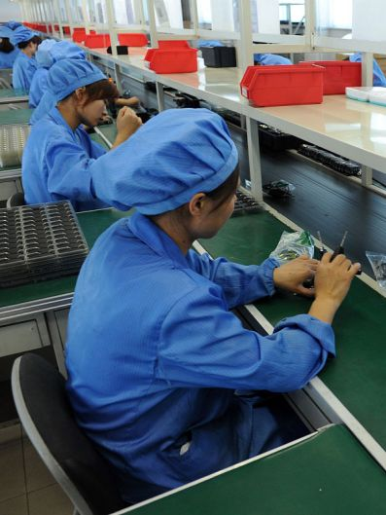
The purpose and importance of 5S
01
Improve work efficiency
5S management optimizes the working environment, reduces the time of searching for items, and improves work efficiency through the five steps of sorting, arranging, cleaning, cleaning and literacy. Employees can quickly find what they need, avoiding ineffective work and wasting time, making the work process smoother and more efficient.
02
Ensure work safety
5S management emphasizes the cleanliness and orderliness of the workplace and reduces the probability of accidents by eliminating safety hazards and sources of danger. For example, clear debris and oil stains in a timely manner to ensure smooth passages and prevent employees from having accidents during operations.
03
Improve product quality
5S management helps reduce contamination and errors in the production process and improve product quality. By keeping the working environment clean and equipment in good condition, we can reduce quality problems caused by environmental factors and improve product qualification rates and customer satisfaction.

Slide 7
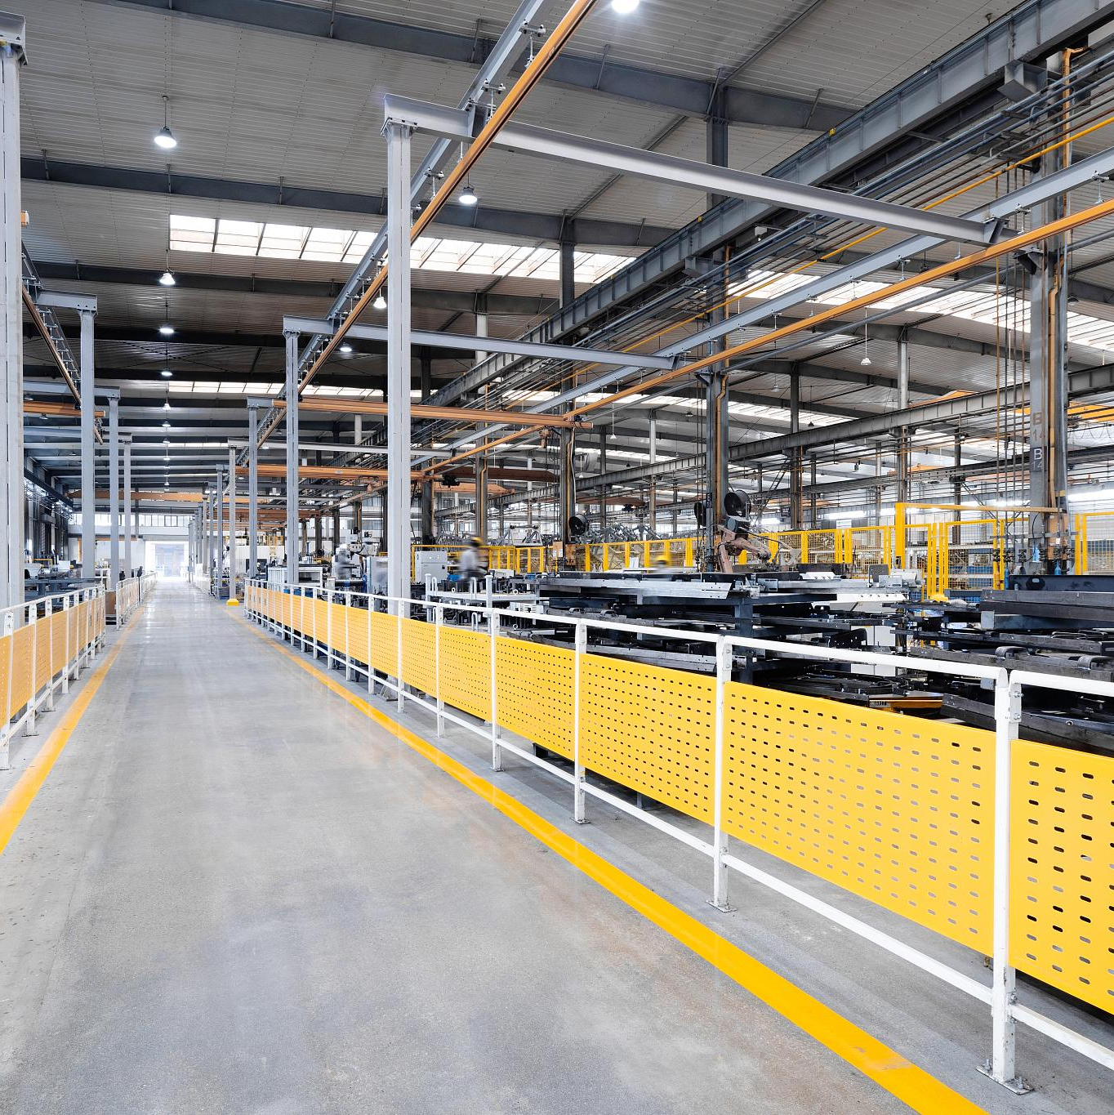
The purpose and importance of 5S
Shape corporate image
5S management helps create a clean, orderly and efficient corporate image and enhances the company's social reputation and brand value. A clean and orderly working environment can leave a good impression on customers and enhance their trust and loyalty to the company.
Reduce operating costs
5S management helps companies reduce operating costs by reducing waste, improving resource utilization and reducing maintenance costs. For example, through organization and rectification, we can reduce inventory backlogs and idle items and reduce inventory costs; through regular cleaning and maintenance of equipment, we can extend the service life of equipment and reduce maintenance costs.
Develop employee literacy
5S management not only focuses on the improvement of the physical environment, but also focuses on the improvement of employee quality. Through long-term 5S practice, employees can develop good working habits and self-discipline, improve personal quality and teamwork capabilities, and lay a solid talent foundation for the development of the enterprise.

Slide 8
5S implementation steps
02

Slide 9
How to implement finishing
Clear organization goals
Clear out non-essential items
Determine the specific goals of organization activities, such as reducing inventory, improving work efficiency, optimizing workplace layout, etc., so that organization work can be carried out in a targeted manner.
Clean up non-essential items by discarding, recycling, selling or moving them to other places for storage to ensure that only essential items are kept in the workplace.
Make a decluttering plan
Identity and positioning
Based on the sorting objectives, formulate a detailed sorting plan, including sorting time, personnel division of labor, required resources, etc., to ensure that sorting activities are carried out in an orderly manner.
Label the sorted necessities, clarify their name, quantity, storage location and other information, and set a fixed storage location for them to facilitate subsequent management and use.
Distinguish between essentials and non-essentials
Regular inspection and adjustment
Classify all items in the workplace to clarify which ones are essential and which ones are non-essential, to provide a basis for subsequent cleaning and disposal.
Regularly inspect the sorted workplace, and adjust the storage locations and markings of items according to actual conditions to ensure that the sorting results are maintained.

Slide 10
Implementation methods of rectification
Application of the Three Certainties Principle
Strictly implement fixed-point (fixed location), fixed-volume (specified containers), and quantitative (clear quantity) management, such as using layered material racks with maximum and minimum inventory labels.
trace management technology
FIFO first in first out
Draw tool outlines on the tool board to visualize missing parts, and use error-proofing to ensure tools can only be returned to their designated locations.
Use slope-type shelves or track designs for time-sensitive materials to ensure that materials are automatically circulated in the order they are put into storage to avoid expired waste.
03
02
04
Positioning and marking standardization
Visual management dashboard
Use landmark lines of different colors to divide passages, operating areas, and material storage areas. Yellow is the passage line, green is the safe area, and red is the prohibited area.
Set up a comprehensive signboard containing the item name, number, responsible person, and replenishment cycle, and a supporting indicator system to display abnormal status.
01
05

Slide 11
How to implement cleaning
Pollution source tracking map
Seven steps of self-maintenance
Create a dynamic heat map containing pollution sources such as dust, oil, debris, etc., and mark the occurrence frequency and severity level.
We will proceed in the steps of initial cleaning → pollution source countermeasures → setting standards → general inspection → independent inspection → standardization → full implementation.
Preparation of cleaning standard book
Visualization of cleaning tools
Detailed stipulations of cleaning tools, methods, cycles, standards (such as white glove inspection method) and acceptance personnel for each area.
Use a shadow board to manage cleaning tools and a color coding system (red oil stain brush, blue water stain mop, etc.).
Equipment cleaning checklist
Combine equipment cleaning with inspection, such as simultaneously checking 23 key indicators such as oil level and belt tension when cleaning machine tools.

Slide 12
How to implement cleaning
5S inspection scoring system
color management system
A score sheet containing 128 check points was designed, and on-site audits were conducted weekly by a cross-departmental team and the results were publicized.
The entire factory adopts unified color standards, such as blue for documents, yellow for safety signs, and green for qualified product areas.
Standardized operation video library
Record standard operation videos for each position, including detailed demonstrations of clothing and appearance, tool placement, and work procedures.
Code of Conduct Manual
Prepare a 5S code of conduct with pictures and texts, down to details such as the order of items in desk drawers and the angle of file labels.
Abnormal exposure platform
An electronic display screen is set up to display non-conforming items in real time, with comparison photos before and after rectification and root cause analysis.

Slide 13
How to implement literacy
01
5S medal incentive system
02
Improve proposal points system
A three-level certification system of bronze, silver and gold has been established, with corresponding badges awarded through quarterly reviews and linked to promotions.
Employees can earn points for every valid 5S improvement proposal they submit, which can be redeemed cumulatively for training opportunities or vacation rewards.
03
Scenario simulation training
04
5-minute walkthrough for morning meeting
Design emergency scenarios such as equipment failure and material shortage to test employees' ability to maintain 5S standards under pressure.
Daily morning meetings include a random item location test or a quick cleaning competition to maintain team sensitivity.
05
Cultural wall construction
06
Family 5S extension plan
Set up a cultural gallery to display 5S improvement cases over the years and the experiences of benchmark employees to strengthen the awareness of continuous improvement.
Provide home organization training courses to help employees extend 5S thinking to the home environment and form habitual inertia.

Slide 14
Red card combat practice
03

Slide 15
The meaning and purpose of red card combat
01
02
03
04
05
Problem visualization
stimulate awareness of improvement
Eliminate waste
Standardized management
Improve employee engagement
Red Card Operation is a management tool that visually displays waste, redundancy and unreasonable phenomena in the production site by identifying problem areas or items, thereby promoting improvement.
The red card logo can effectively stimulate employees' attention to problems and awareness of improvement, prompt the team to actively participate in on-site optimization, and form a culture of continuous improvement.
The core purpose of red card operations is to identify and eliminate various types of waste on site, including excess inventory, idle equipment, space occupation, etc., thereby improving overall operational efficiency.
Through the implementation of red card operations, standardized work processes and on-site management specifications can be gradually established to reduce efficiency losses caused by disorderly operations.
Red Card Operations emphasizes the participation of all employees. Through joint identification and solution of problems, it enhances employees' sense of belonging and responsibility and promotes teamwork.

Slide 16
Objects and processes of red card operations
start up
01
Set goals
02
Analyze needs
Looking for problems
Set standards
issue red card
battle planning
Comprehensively identify on-site problem points and record red card objects.
Clarify red card judgment criteria and rectification priorities.
Post red cards for non-conforming items and take photos for archiving.
implement
04
row plan
03
Make a plan
Divide tasks
Quick rectification
Check results
Assign red card rectification tasks according to areas of responsibility.
The responsible person must complete the rectification of the problem within the specified time limit.
Accept the rectification effect and cancel the qualified red card.
acceptance
05
Insufficient changes
06
Continue to change
Evaluate the effect

Slide 17
Implementation steps of red card operations
Preliminary training
On-site inspection and identification
Problem rectification and tracking
Before implementation, all employees need to be trained on red card operations to clarify the meaning, usage rules and operating procedures of red cards to ensure that the team understands and supports the activity.
The improvement team or management personnel will lead an on-site inspection, and red cards will be posted on areas that do not meet 5S standards or where there is waste, and a description of the problem and a rectification deadline will be noted.
The responsible department needs to complete the rectification of the red card problem within the specified time, and the improvement team regularly tracks the rectification progress to ensure that the problem is effectively solved.
Effect verification and standardization
Summary and motivation
Continuous optimization
After the rectification is completed, the improvement team needs to review the red card area to confirm that the problem has been eliminated, and incorporate effective improvement measures into the standardized document to prevent the recurrence of the problem.
Regularly summarize the results of red card operations, commend outstanding teams or individuals, and strengthen the enthusiasm of all employees to participate in improvement through positive incentives.
Red card operations should be used as a normal management tool, carried out regularly and combined with other visual management methods (such as Kanban management) to promote the continuous improvement of on-site management levels.

Slide 18
Setting management method
04

Slide 19
The concept and function of placement management
Definition and core
Improve work efficiency
Reduce error rate
Positioning management is an on-site management method that achieves efficient and orderly work in the workplace by scientifically planning the fixed location, labeling and storage methods of items. Its core is "things have their place, and everything is in its place".
By reducing the time spent searching for tools and materials and reducing non-value-added work time, employees can quickly locate the required resources and directly improve production efficiency.
Standardized placement and marking of items can avoid operational errors caused by mistaking or misplacing items, especially in multi-process collaboration.
Improve safety environment
Develop employee literacy
By delineating dangerous areas and clearly marking passages, we can reduce safety accidents such as tripping and collisions caused by messy stacking and ensure the personal safety of employees.
Long-term implementation of fixed management can subtly regulate employee behavior, form the habit of consciously maintaining work order, and promote the healthy development of corporate culture.

Slide 20
Implementation steps of location management
Current situation investigation and analysis
Through on-site observation and data collection, identify current pain points in material and tool storage, such as high-frequency movement paths, accumulation of redundant items, etc., and form a problem list.
Staff training and piloting
Organize special training to explain the setting rules, collect feedback through a 1-2 week trial run, and adjust unreasonable positioning points to ensure that the plan meets actual needs.
Regional Planning and Design
Divide functional areas (such as raw material area, operation area, and finished product area) according to the process flow and operation frequency, and design reasonable flow routes for items to ensure the shortest transportation distance.
Comprehensive promotion and solidification
Incorporate the optimized fixed standards into daily assessments, and ensure long-term implementation through regular inspections (such as red card operations) and reward and punishment mechanisms.
Positioning mark standardization
Use visual means such as color labels (for example, red is the waste area), trace management (tool outlines), and Kanban boards to ensure that the location of all items is clear at a glance.

Slide 21
Evaluation of the effectiveness of placement management
Regular inspection
Standards Implementation Assessment
Space utilization assessment
03
Cross-regional collaborative assessment
Positioning accuracy assessment
02
Assessment points
04
continuous improvement assessment
01
Assessment points
Assessment points
05
Assessment points
Assessment points
Check the implementation rate and deviation of fixed management standards.
Statistics and analysis of space usage and turnover efficiency of fixed areas.
Collect connection data and collaborative feedback on cross-regional item placement.
Evaluate the accuracy of item positioning through on-site inspections, focusing on checking the matching between the logo and the actual object.
Evaluate the effectiveness of visual tools such as positioning signs and billboards.
Quantify the efficiency improvement and waste reduction before and after improvement of fixed location management.
Evaluate the actual effect of signage systems, positioning lines, etc. on space optimization.
Evaluate the rationality of channel planning and transfer area settings.
Revise standards based on evaluation feedback and strengthen on-site implementation.
Adjust the positioning plan based on the evaluation results to ensure the efficiency of item access.
Optimize positioning layout based on data to improve space usage efficiency.
Optimize regional linkage mechanisms based on evaluation to reduce handling waste.
Summarize improvement experience, adjust the optimization direction, and form a PDCA cycle.

Slide 22
Visualization tool application
05

Slide 23
Kanban management tool
reverse pull production
Visual progress control
Kanban management transmits demand information to upstream processes through downstream processes to achieve on-time supply on demand, avoid inventory backlogs and resource waste caused by over-production, and significantly improve production efficiency.
Use double-box signage or electronic signage to display production progress, abnormal status and delivery cycle in real time, allowing managers to quickly identify bottleneck processes and make adjustment decisions.
Standardized container management
Exception response mechanism
Multi-level Kanban collaboration
Material containers and Kanban cards with unified specifications are used to clearly define the loading quantity, storage location and turnover frequency to achieve precise control of material flow.
Set up the Andon Kanban System (Andon). When quality defects or equipment failures occur, a rapid response process is triggered through audible and visual alarms to ensure that the problem is solved in the shortest possible time.
Establish a three-level Kanban system at the factory level, workshop level and production line level to achieve full-link visual management and control from strategic goals to daily execution.

Slide 24
Line management tools
01
02
03
Channel ID
Regional division
Item location
Use a yellow solid line to mark the main channel, with a width of not less than 1.2 meters, and a red dotted line to mark the dangerous area.
Use different colors of floor glue to distinguish the operating area, temporary storage area and passage, and use signboards to explain
Equipment and tools use the four-corner positioning method. Materials are marked according to the maximum and minimum quantities, and the product name and quantity are indicated.
04
05
06
Safety warning
Kanban management
Dynamic maintenance
Firefighting equipment is positioned with red zebra crossings, and emergency passages remain clear and unobstructed
Set up management signboards in the marked areas to indicate responsible persons and inspection standards.
Establish a line marking management system, conduct daily inspection and maintenance, and promptly repair and update any damage or fading.
Achieve on-site visual and efficient management through standardized line marking

Slide 25
Color management tools
Standard light source system
visual management system
Equipped with a D65 artificial daylight light source box (color temperature 6500K), it establishes a benchmark environment for color evaluation and eliminates quality disputes caused by metameric effects.
Develop an enterprise-specific color card library to associate product color numbers, process parameters and supplier information to achieve color data traceability throughout the supply chain.
Digital color difference control
environmental color design
Use a spectrophotometer to measure the ΔE value, establish a color difference tolerance standard of ≤1.5, and start an automatic isolation process for batches that exceed the threshold.
The office area uses neutral gray with a brightness range of Munsell N7~N9, and the production area uses 10GY9/1 light green to reduce visual fatigue and adjust the psychological state of employees through environmental colors.
Industry color coding
Dynamic color monitoring
Dangerous goods containers are marked with OSHA red markings, fire-fighting equipment is marked with Pantone 485C standard red, and piping systems are marked with medium classifications in accordance with ANSI/ASME A13.1 standards.
An online colorimeter is installed in the spraying workshop to monitor the coating Lab value in real time and provide automatic feedback to adjust spraying parameters to ensure color consistency between batches.

Slide 26
Practical cases and challenges
06

Slide 27
5S implementation success stories
01
Automobile manufacturing workshop finishing (Seiri) case
04
Pharmaceutical company standardization (Seiketsu) innovation
A car company used red card operations to clear more than 300 pieces of idle equipment, free up 25% of storage space, increase the material turnover efficiency of the production line by 40%, and establish a "30-second access" tooling positioning standard.
Developed a 5S digital twin system and used AR glasses to compare standard status in real time. The induction training cycle for new employees was shortened by 60%, and deviation incidents dropped by 75% year-on-year.
02
Electronics Factory Reorganization (Seiton) Practice
05
Chemical industry group literacy (Shitsuke) development
The foam cutting positioning method is used to store precision jigs, and combined with laser projection markings, the changeover time is shortened from 45 minutes to 8 minutes. At the same time, the error prevention effect is achieved, and the annual quality cost is reduced by 1.2 million yuan.
The "5S behavior points system" was implemented and linked to the promotion system. Within three years, 200 internal supervisors were trained, and the number of continuous improvement proposals increased eightfold.
03
Food industry cleaning (Seiso) breakthrough
We designed a cleaning visual signboard and broke down the equipment inspection items into 36 luminous marking areas. The microbial exceedance rate dropped from 12% to 0.3%. We received special commendation from the auditor when we passed the FSSC22000 certification.

Slide 28
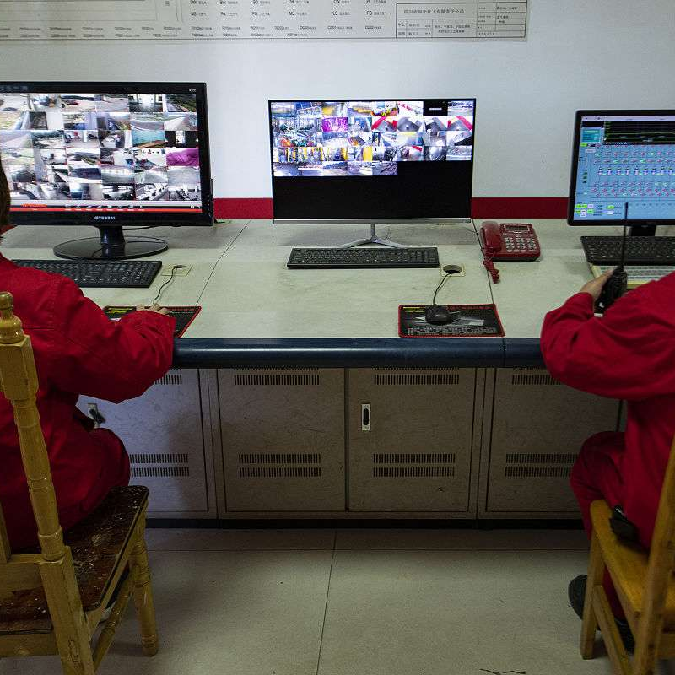
Visual management application cases
Andon system in-depth application
An automobile manufacturer has visualized the response levels of line shutdown alarms, using seven-color LED lamp posts to display abnormality levels, and supporting electronic screens to push standard disposal procedures. The MTTR (mean time to repair) has been reduced from 23 minutes to 4.5 minutes.
Value stream visual dashboard
Medical device companies use magnetic dynamic flow charts to display the flow of work-in-progress in real time, and combine it with the Andon system to trigger material calls, reducing the production cycle from 14 days to 6 days and increasing the on-time delivery rate to 98.7%.
Warehouse intelligent identification system
Using RFID + color landmark positioning to achieve "three-dimensional visual navigation", the picking efficiency is increased by 55%, the inventory accuracy rate reaches 99.99%, and the annual logistics cost is saved by 2.8 million yuan.

Slide 29


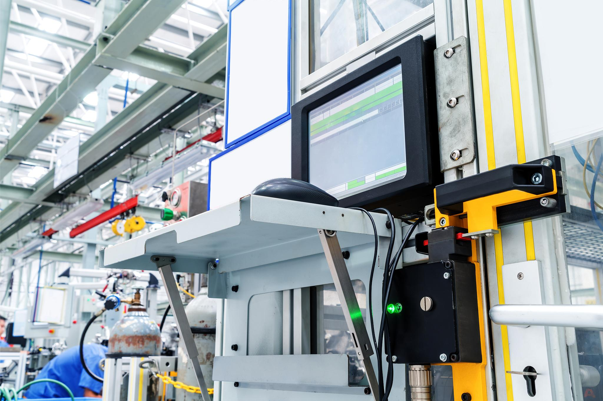
Visual management application cases
Quality risk matrix dashboard
The food factory uses "red, yellow and green" three-color lights to display the status of key control points, combined with sound and light alarms, the customer complaint rate dropped by 82%, and it won the McDonald's Global Supplier Quality Gold Award.
Panoramic monitoring of equipment status
Energy consumption visualization
Deploying an IoT signboard in the injection molding workshop and using a heat map to display the mold temperature distribution increased the accuracy of predictive maintenance by 90% and reduced unplanned downtime by 70%.
A steel company has established a real-time energy consumption monitoring wall to display unit energy consumption curves by process, saving 19 million yuan in electricity costs annually and reducing carbon emissions by 120,000 tons.

Slide 30
Common challenges and solutions
zoning responsibility system
Visual Kanban
Identify regional responsible persons
red card combat mechanism
buck-passing
Create a sample area
Standard repetition
Fixed point photography comparison
Develop a 5S schedule
Execution delays
Visual countdown

Slide 31
Thank You
qtank.org
QTank
qtank.org

