Slide 1
In-Depth Guide to the QC Seven Tools
Check Sheet
The "simplest" tool is often the easiest to misuse
QTank
Knowledge Code 5.2.4 · QC Seven Tools (Classic Seven QC Tools)
qtank.org

Slide 2
Contents
Chapter 1 Nature of Check Sheets
Chapter 2 Check Sheet Design Principles
Chapter 3 Check Sheet Practical Cases
Chapter 4 Common Check Sheet Pitfalls
Chapter 5 Check Sheet Combined with Other Tools
Chapter 6 Digital Check Sheets
Chapter 7 Check Sheet Evaluation Criteria
Summary: Check Sheet "Principle" and "Practice"
Appendix: Complete QC Seven Tools Framework
2/26

Slide 3
Preface
"The simplest tool is often the easiest to misuse."
Check sheet — the "simplest" of the QC seven tools
So simple almost every QC uses it
Because it is so simple, few think seriously:
What check sheet actually solves problems?
What check sheet is just "going through motions"?
Well-designed check sheet → easy, accurate data collection
Poor check sheet → shop-floor compliance theater, worthless data
3/26

Slide 4
Chapter 1
Nature of Check Sheets
4/26

Slide 5
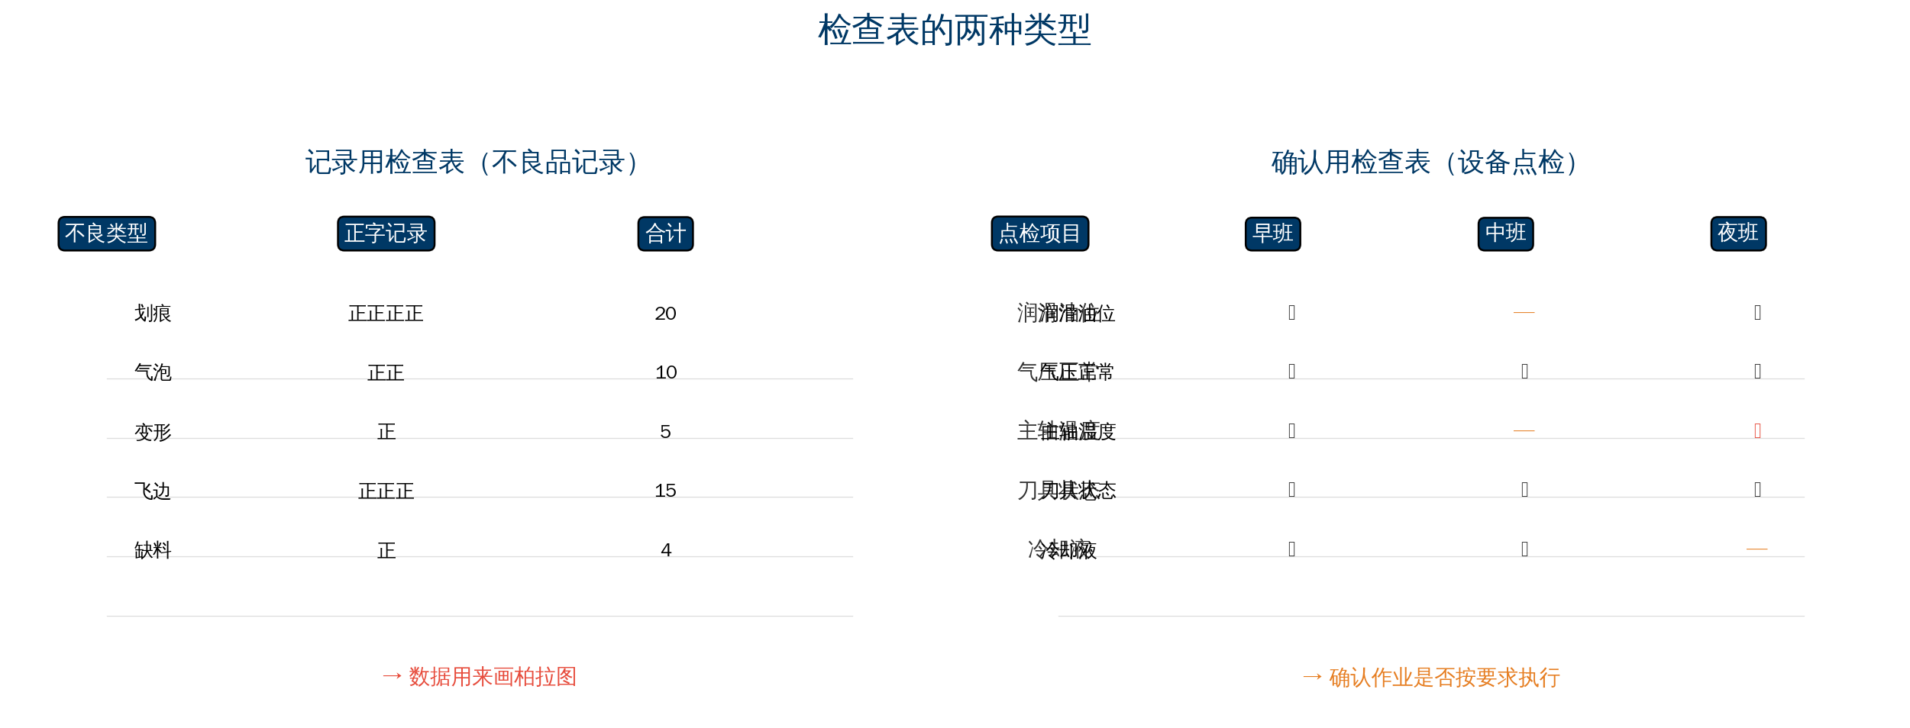
1.1–1.2 What Is a Check Sheet & Two Types
5/26

Slide 6
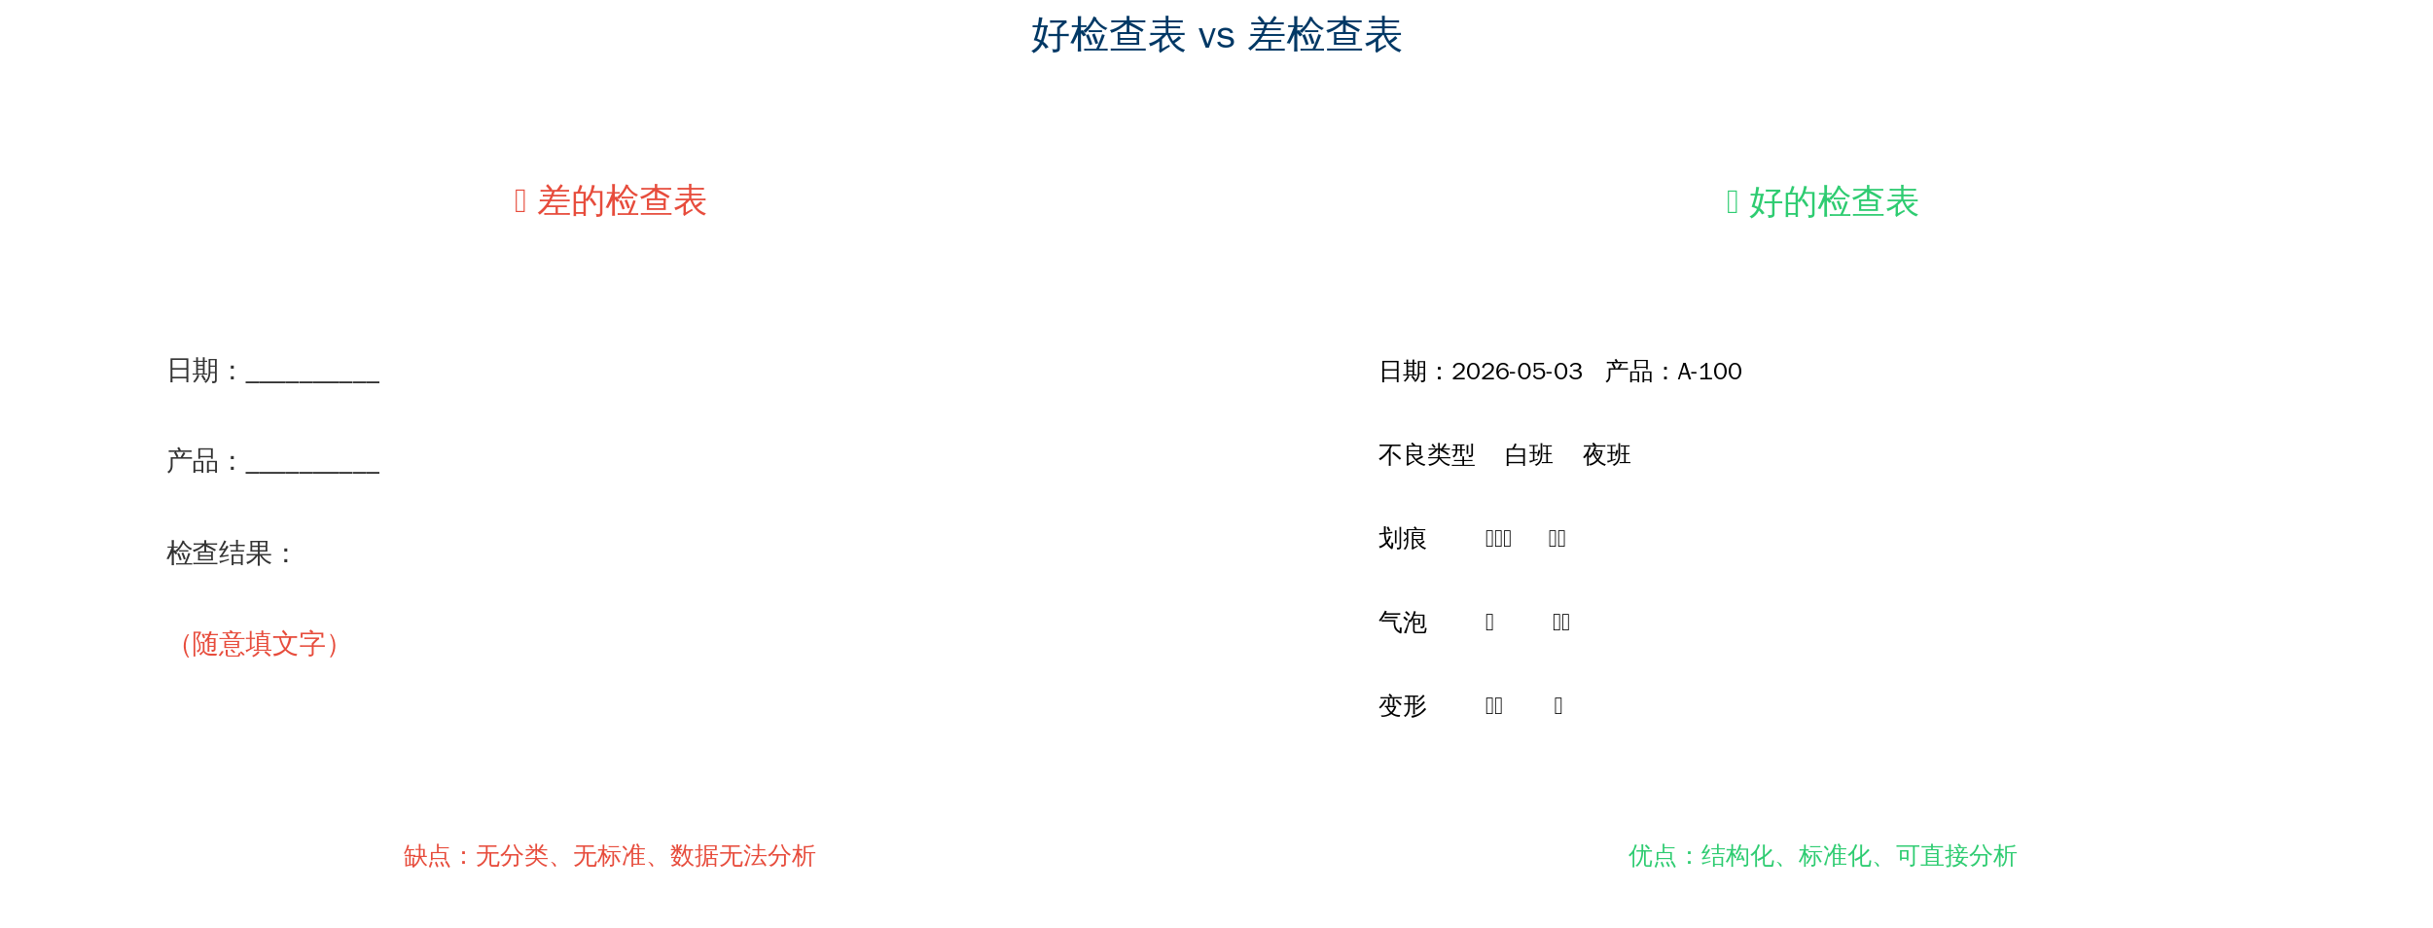
1.4 Check Sheet vs Ordinary Data Log
6/26

Slide 7
1.3 Three Purposes of Check Sheets
Purpose | Description | Application
Standardized data collection | Ensure consistent method across operators | Daily inspection, patrol checks
Prevent omissions | Structured table prevents forgetting | Equipment inspection, safety checks
Improve efficiency | Checkmarks faster than writing | Batch data recording
7/26

Slide 8
Chapter 2
Check Sheet Design Principles
8/26

Slide 9
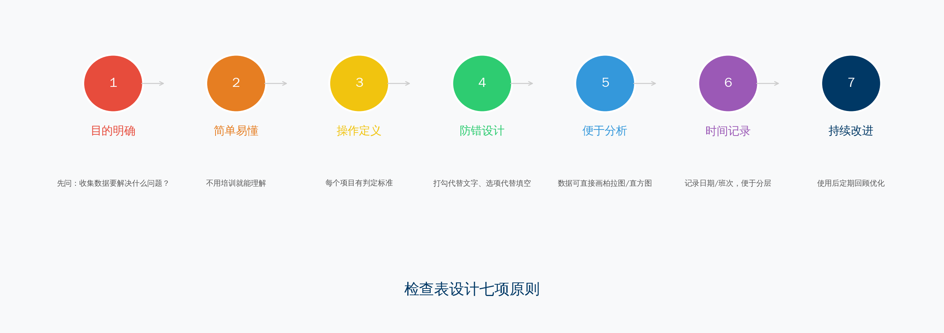
2.1 Seven Design Principles for Check Sheets
9/26

Slide 10
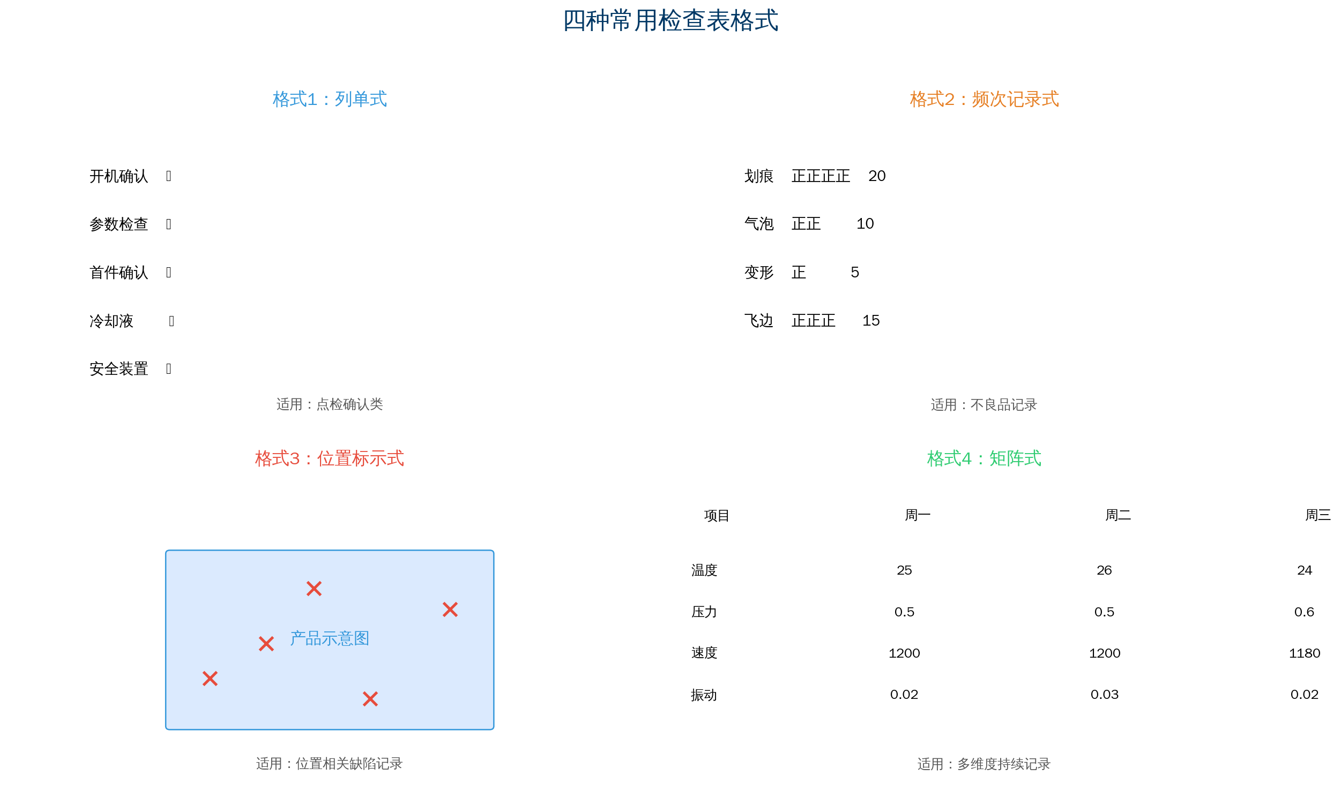
2.2 Design Process & 2.3 Check Sheet Formats
Six-Step Design Process:
Four Common Formats
Step 1 Define purpose
Step 2 Define check items
Step 3 Define recording method
Step 4 Design table format
Step 5 Write completion instructions
Step 6 Pilot and optimize
10/26

Slide 11
Chapter 3
Check Sheet Practical Cases
11/26

Slide 12
Case1-3: Equipment Inspection / 5S Audit / Customer Complaints
Case1: Equipment Inspection
Case2: 5S Check Sheet
Case3: Customer Complaint Log
Daily CNC inspection
5 items × 3 shifts
✓/✗ recording
→ Equipment downtime reduced 40%
Key: each item has acceptance criteria
Score by area × 5S dimension
1–5 scale
→ Qualitative to quantitative
→ Compare areas horizontally
→ Track improvement over time
Complaint category + severity
→ Data ready for Pareto chart
→ Found most complaints on Product A packaging
→ Targeted packaging improvement
13/26

Slide 13
Chapter 4
Common Check Sheet Pitfalls
14/26

Slide 14
Five Common Check Sheet Pitfalls
Pitfall 1: Too many items — form becomes burden
✗ 30–40 items, 15 minutes to fill
✓ Keep 10–15 items; complete in under 3 minutes
Pitfall 2: No operational definition
✗ "Product appearance" → subjective judgment
✓ "No visible scratches or color difference on surface"
Pitfall 3: Fill for sake of filling; no analysis
✗ File away after filling; never analyze
✓ Analyze regularly; use Pareto/stratification
Pitfall 4: "One-time" check sheet, never optimized
✗ Same form used for 3 years
✓ Monthly review; formal review every 6 months
Pitfall 5: Check sheet = Quality dept only
✗ Quality designs; production resists
✓ Users co-design; see data value
15/26

Slide 15
Chapter 5
Check Sheet Combined with Other Tools
16/26

Slide 16
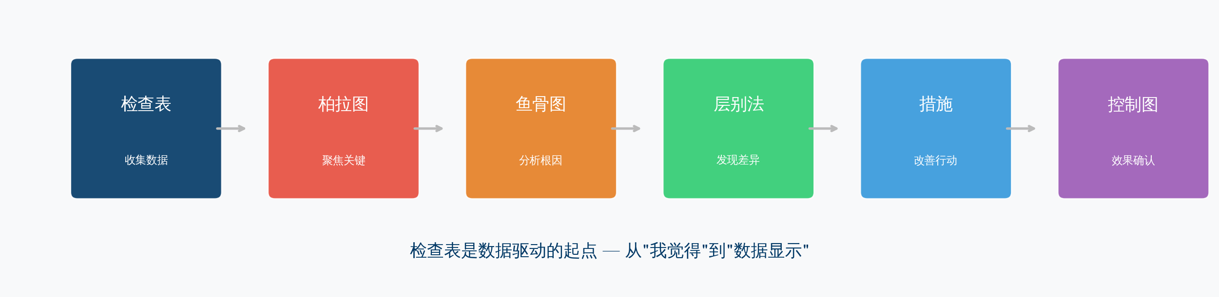
5.1–5.4 Check Sheet as Data-Driven Starting Point
Check Sheet + Pareto: collect raw data → analyze vital few
Check Sheet + Stratification: build stratification into design
Check Sheet + Histogram/Control Chart: continuous collection → distribution → monitoring
Check Sheet + Fishbone: fishbone hypotheses → check sheet data verification
17/26

Slide 17
Chapter 6
Digital Check Sheets
18/26

Slide 18
6.1–6.2 Digital Check Sheets
Limitations of paper check sheets:
→ Data entry: paper to electronic — extra work
→ Searching paper archives — inefficient
→ Statistics require manual computer entry
→ Paper forms easily lost
Advantages of digital check sheets:
→ Real-time entry: phone/tablet direct input
→ Auto summary: charts generated automatically
→ Instant feedback: auto alert on abnormality
→ Data security: cloud storage
Principle upgrades in the digital era:
Clear purpose → database schema design
Simple → mobile UI design
Operational definition → options + image reference
Mistake-proofing → required fields + logic validation
Analysis-ready → auto-generated charts
Time recording → automatic timestamp
Continuous improvement → A/B test optimization
19/26

Slide 19
Chapter 7 — Check Sheet Evaluation Criteria
Evaluation Dimension | Good Standard | Poor Practice
Clear purpose | Know what analysis the data supports | Filling for its own sake
Reasonable item count | 10–15 items; complete in 3 minutes | 30+ items — too heavy
Clear definitions | Each item has operational definition | Judgment by feel only
Simple format | At a glance; no thinking required | Confusing layout needs training
Analysis-ready | Data ready for charts and statistics | Messy format — cannot analyze
Continuous update | Regular review and optimization | Used once then abandoned
20/26

Slide 20
Summary
Check Sheet "Principle" and "Practice"
21/26

Slide 21
Summary: Check Sheet "Principle" and "Practice"
Practice (How to Design)
Principle (Why Design)
▸ Define purpose first
▸ Keep items within 15
▸ Operational definition per item
▸ Simple format; optimize regularly
▸ Not "fill and forget"
▸ It is "collect reliable data
to support decisions"
▸ It is "convert shop-floor experience into
analyzable data"
Greatest value of check sheets — data to speak with
Without data you say "I think"; with data you say "the data shows"
22/26

Slide 22
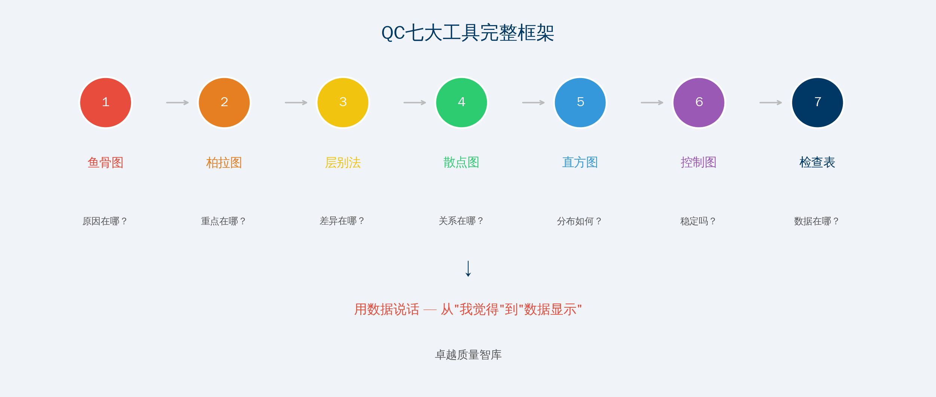
Appendix: Complete QC Seven Tools Framework — Let Data Speak
23/26

Slide 23
SeriesPart 1
In-Depth Guide to the QC Seven Tools
Issue 1 Check Sheet → Issue 2 Stratification → Issue 3 Pareto Chart
Issue 4 Fishbone Diagram → Issue 5 Scatter Diagram → Issue 6 Histogram
Issue 7 Control Chart
Don't be a QE who "can use tools" — be one who "chooses the right tool"
QTank · Continuous improvement with you
24/26

Slide 24
Thank You
qtank.org
QTank
qtank.org

