Slide 1
In-Depth Guide to the QC Seven Tools
Stratification
| Internal Use
QTank
Knowledge Code 5.2.4 · QC Seven Tools (Classic Seven QC Tools)
qtank.org

Slide 2
Contents
Chapter 1 The Essence of Stratification
Chapter 2 Common Stratification Dimensions
Chapter 3 Stratification Workflow (Standard 5-Step Process)
Chapter 4 Stratification Case Studies
Chapter 5 Common Pitfalls in Stratification
Chapter 6 Combining Stratification with Other Tools
Chapter 7 Evaluation Criteria for Stratification
Summary: The "Principle" and "Technique" of Stratification
2/28

Slide 3
Preface
"Data does not lie,
but those who look only at aggregated data may deceive themselves."
Stratification — the most underrated weapon among the QC Seven Tools
Not complex: simply viewing data separated by different dimensions
But its most critical insight is:
Without stratification, your conclusions may be completely wrong
This is "Simpson's Paradox"
An overall trend that reverses in every stratum
3/28

Slide 4
Chapter 1
The Essence of Stratification
4/28

Slide 5
1.1 What Is Stratification
Stratification — also called data stratification or layering
One of the most fundamental yet most overlooked of the QC Seven Tools
The core idea is very simple:
Classify collected data by source, characteristics, conditions, and other dimensions
into strata (layers), then analyze each separately
Mathematical essence:
Decompose the population into non-overlapping subsets (strata),
analyze within each subset separately,
then compare stratum results with overall results for validation
5/28

Slide 6
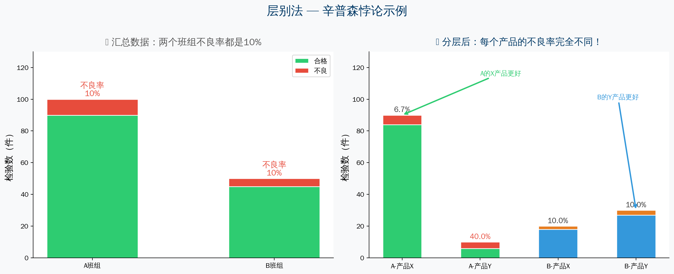
1.2 Why Stratify — Simpson's Paradox
6/28

Slide 7
1.3 Three Key Roles of Stratification
Role | Description | Application
Uncover hidden truths | Reveal real problems masked in aggregated data | Defect analysis, customer complaint analysis
Pinpoint problem sources | Identify exactly where the problem occurs | Production line analysis, team comparison
Avoid misjudgment | Prevent being misled by Simpson's Paradox | Any statistical data analysis
7/28

Slide 8
Chapter 2
Common Stratification Dimensions
8/28

Slide 9
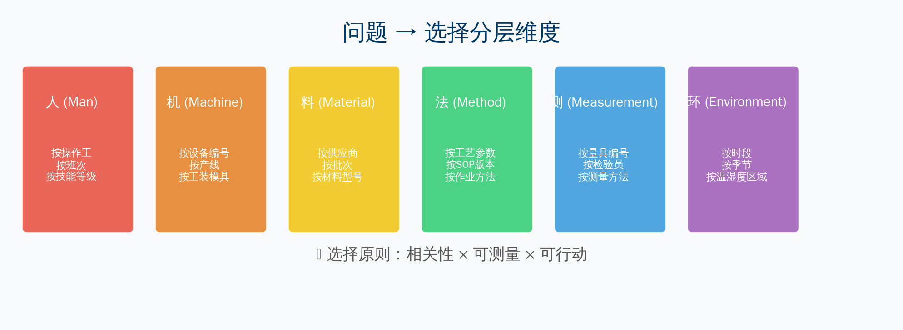
2.1 Classic Stratification Dimensions — 4M1E
Selection principle: Relevance × Measurability × Actionability
Start with the broadest dimension, then drill down progressively
9/28

Slide 10
2.2–2.3 Time Dimension & Product/Customer Dimension
Stratification by Time Dimension
Stratification by Product/Customer Dimension
▸ By shift: day shift vs. night shift
▸ By time period: hourly / daily / weekly
▸ By season: differences across seasons
▸ By cycle: beginning vs. end of month
▸ By product model
▸ By production batch
▸ By product line
▸ By customer type
▸ By regional market
▸ By sales channel
10/28

Slide 11
Chapter 3
Stratification Workflow (Standard 5-Step Process)
11/28

Slide 12
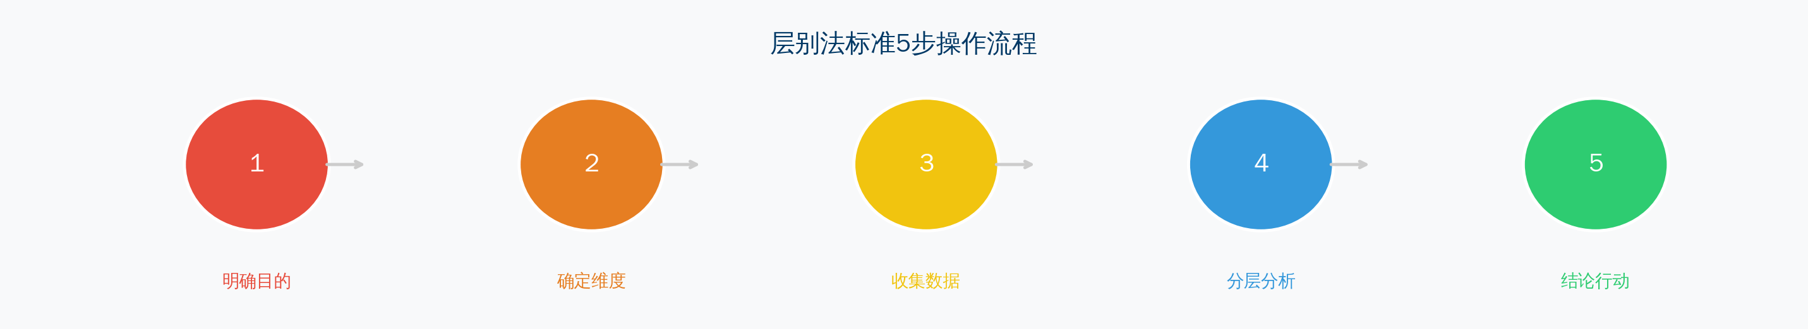
Standard 5-Step Workflow
Step 1 Define analysis objective — What problem am I solving?
Step 2 Select stratification dimensions — 1–3 key dimensions
Step 3 Collect and organize data — ensure completeness, accuracy, and sufficiency
Step 4 Stratified comparative analysis — tables, charts, statistical tests
Step 5 Draw conclusions and act — improvement actions + effect verification
12/28

Slide 13
Step 3 — Data Collection Guidelines
Four fundamental principles of data collection:
✅ Completeness
No missing key fields
Every record has complete dimension labels
✅ Accuracy
No erroneous records
Data sources are reliable
✅ Adequate sample size
At least 30 samples per stratum
If a stratum has too few samples → merge with adjacent stratum or "Other"
✅ Traceability
Retain raw data
Enable backtracking and verification
13/28

Slide 14
Chapter 4
Stratification Case Studies
14/28

Slide 15
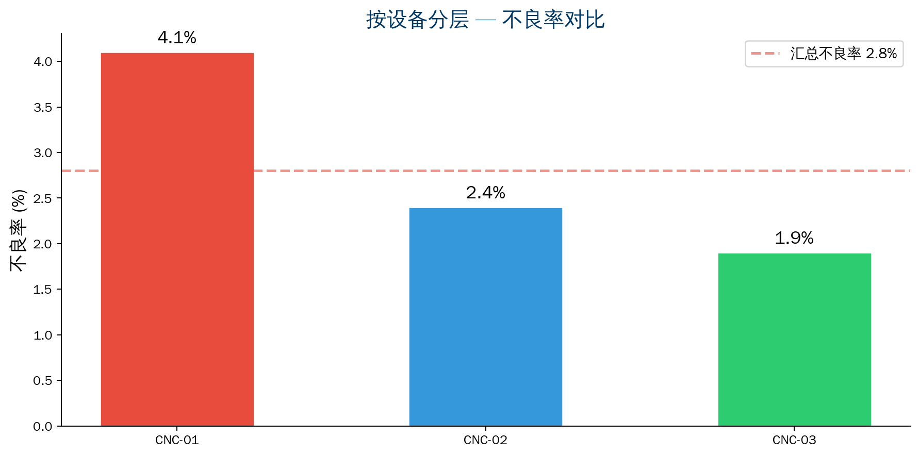
Case 1: Manufacturing — Stratify by Equipment
Background: Defect rate in machining shop is 2.8%
After stratification:
CNC-01: 4.1% (above average)
CNC-02：2.4%
CNC-03：1.9%
Deep-dive analysis:
→ Spindle bearing wear
→ Maintenance overdue by 6+ months
Actions:
✓ Replace spindle bearings
✓ Maintenance cycle 12→6 months
✓ Defect rate reduced to 1.8%
15/28

Slide 16
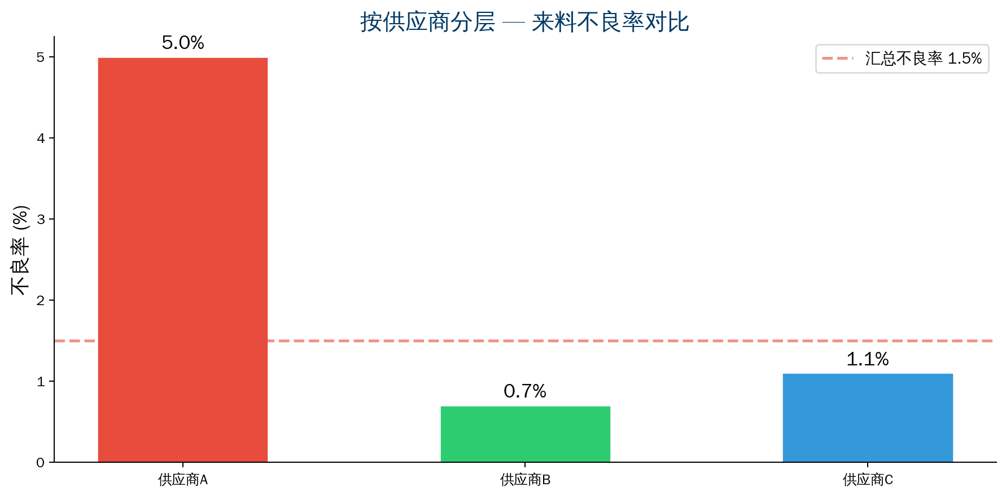
Case 2: Manufacturing — Stratify by Supplier
Background: Incoming material defect rate is 1.5%
After stratification:
Supplier A: 5.0% (above average)
Supplier B: 0.7%
Supplier C: 1.1%
Deep-dive on Supplier A:
→ Dimensional out-of-spec is the main defect
→ Mold has exceeded service life
Actions:
✓ Require mold replacement
✓ Strengthen outgoing inspection
✓ Defect rate reduced to 1.2%
16/28

Slide 17
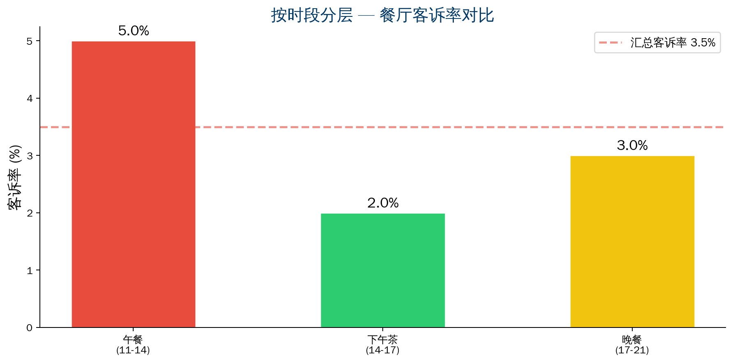
Case 3: Service Industry — Stratify by Time Period
Background: Restaurant complaint rate is 3.5%
After stratification:
Lunch: 5.0% (above average)
Afternoon tea: 2.0%
Dinner: 3.0%
Deep-dive on lunch period:
→ Signature beef noodle complaint rate 8.1%
→ Beef supplier changed
→ Taste profile changed
Actions:
✓ Restore original supplier
✓ Complaint rate reduced to 3.0%
17/28

Slide 18
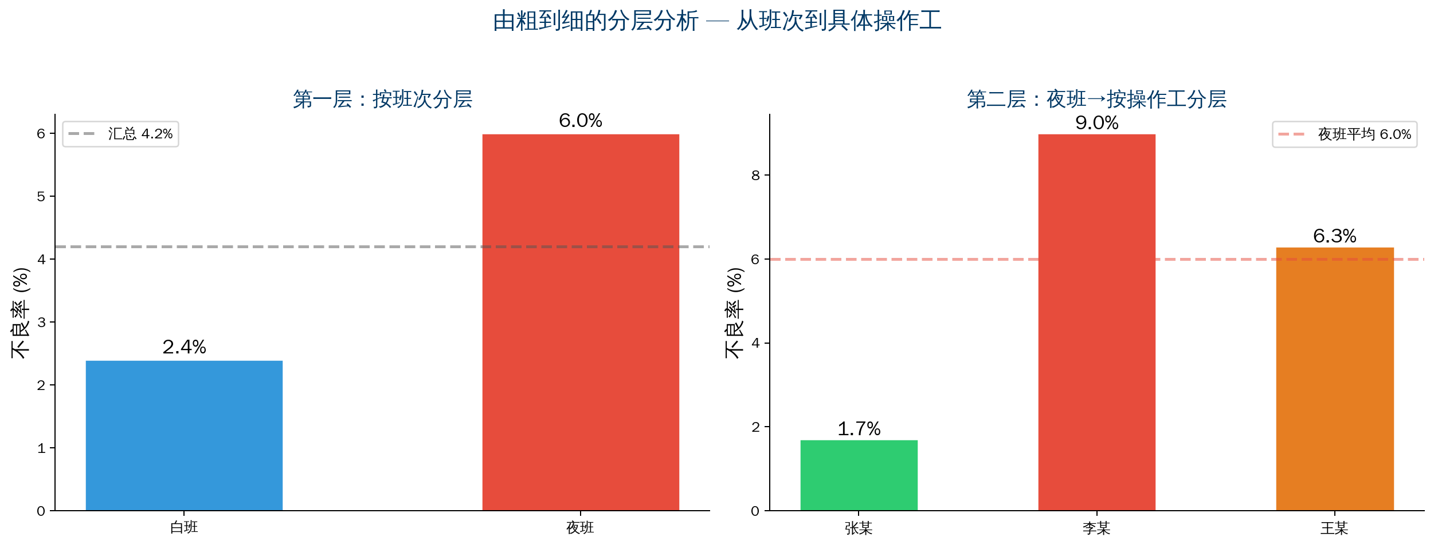
Case 4: Stratify by Shift + Operator (coarse to fine)
18/28

Slide 19
Chapter 5
Common Pitfalls in Stratification
19/28

Slide 20
Four Common Pitfalls in Stratification
Pitfall 1: Wrong stratification dimension selected
× Choose dimensions by gut feel, e.g. "stratify by color"
✓ Select based on process knowledge + data analysis
Pitfall 2: Over-stratification with insufficient samples
× Split into 20+ strata with only a few samples each
✓ At least 30 samples per stratum
Pitfall 3: Drawing conclusions after only one level
× Draw conclusions as soon as a difference is found
✓ Go from coarse to fine, drill down layer by layer
Pitfall 4: Ignoring "interaction effects"
× Assume each dimension is independent
✓ Dimensions may interact — cross-analysis is needed
20/28

Slide 21
Chapter 6
Combining Stratification with Other Tools
21/28

Slide 22
Stratification — Golden Partners with Other Tools
Stratification + Pareto Chart
First use stratification to find the dimension where the problem lies
Then use Pareto chart to focus on the vital few within that dimension
Stratification + Fishbone Diagram
Fishbone provides "hypotheses" → Stratification provides "verification"
Stratification + Histogram
Draw separate histograms for each stratification dimension
Compare mean, standard deviation, and distribution shape across strata
Stratification + Control Chart
Overall control chart detects anomaly → stratify by dimension
Identify which stratum's process has changed
22/28

Slide 23
Chapter 7 — Evaluation Criteria for Stratification
Evaluation Dimension | Good Practice | Poor Practice
Clear purpose | Stratification purpose is clear and aligned with analysis objective | Stratifying for its own sake
Reasonable dimensions | Select key dimensions relevant to the problem | Randomly pick dimensions
Adequate samples | Each stratum has enough data to support analysis | Over-stratification with insufficient samples
Cross-analysis | Two-dimensional cross-analysis when needed | Draw conclusions after only one level
Actionable | Stratification conclusions map to improvement actions | Conclusions cannot be implemented
Verifiable | Stratification results can be repeatedly verified | Random/chance differences
23/28

Slide 24
Summary
The "Principle" and "Technique" of Stratification
24/28

Slide 25
Summary: The "Principle" and "Technique" of Stratification
Technique (How to Stratify)
Principle (Why Stratify)
▸ Define purpose before stratifying
▸ Select dimensions using 4M1E
▸ Drill down from coarse to fine
▸ Verify with cross-analysis
▸ Not just splitting data apart to look at it
▸ To "prevent aggregated data from misleading you"
▸ To "precisely locate the true source of the problem"
at its root"
The greatest value of stratification — revealing what you couldn't see before
A quality engineer who never uses stratification is like searching in the dark wearing sunglasses
QTank
25/28

Slide 26
Thank You
qtank.org
QTank
qtank.org

