Slide 1
In-Depth Guide to the QC Seven Tools
Pareto Chart
Solve 80% of problems with 20% of the effort
QTank
Knowledge Code 5.2.4 · QC Seven Tools (Classic Seven QC Tools)
qtank.org

Slide 2
Contents
Chapter 1 The Essence of Pareto Chart
Chapter 2 Structure and Construction of Pareto Chart
Chapter 3 Practical Applications of Pareto Chart
Chapter 4 Common Pitfalls in Pareto Chart
Chapter 5 Combining Pareto Chart with Other Tools
Chapter 6 Advanced Pareto Chart Techniques
Chapter 7 Evaluation Criteria for Pareto Chart
Summary: The "Principle" and "Technique" of Pareto Chart
2/28

Slide 3
Preface — The Pareto Principle
Italian economist Vilfredo Pareto (1906) discovered:
80% of land held by 20% of the population
Quality guru Joseph Juran applied it to quality management:
▶ 80% of problems caused by 20% of root causes
Pareto chart → the tool that visualizes this principle
If fishbone diagram tells you "where causes might be,"
then Pareto chart tells you "where to start"
3/28

Slide 4
Chapter 1
The Essence of Pareto Chart
4/28

Slide 5
1.1 What Is a Pareto Chart
Pareto Chart
Ranks quality problem frequency from high to low
Bar chart also showing cumulative percentage
Core logic:
Separate data into "vital few" and "trivial many"
Deploy limited resources where impact is greatest
Origin: Pareto Principle
▶ Juran introduced the 80/20 rule to quality management
▶ Became the most "decision-oriented" of the QC Seven Tools
5/28

Slide 6
1.2 Three Key Roles of Pareto Chart
Role | Description | Application
Focus on priorities | Identify the "vital few" among many problems | Quality improvement priority ranking
Demonstrate improvement results | Before/after comparison to verify improvement effectiveness | 8D-D5, CAPA effectiveness verification
Support decision-making | Provide data-driven basis for resource allocation | Annual quality planning, project initiation
6/28

Slide 7
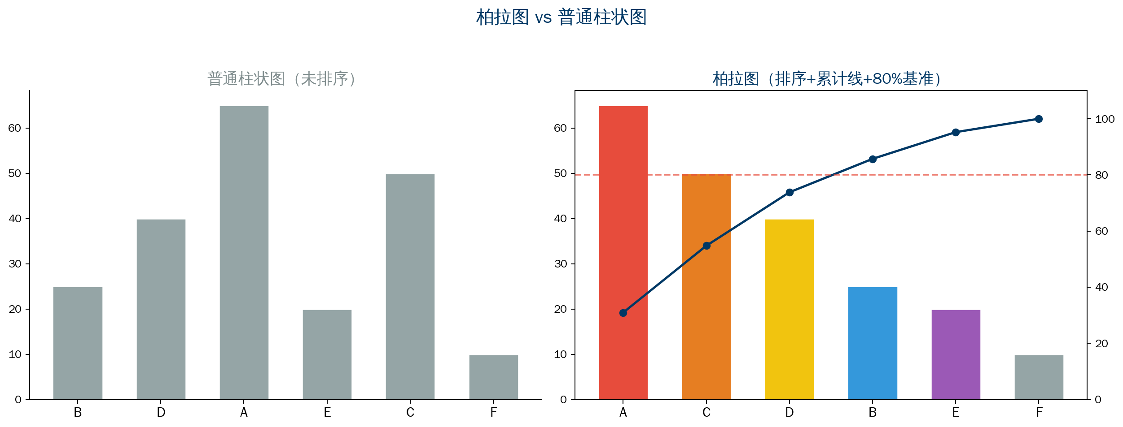
1.3 Pareto Chart vs. Regular Bar Chart
7/28

Slide 8
Chapter 2
Structure and Construction of Pareto Chart
8/28

Slide 9
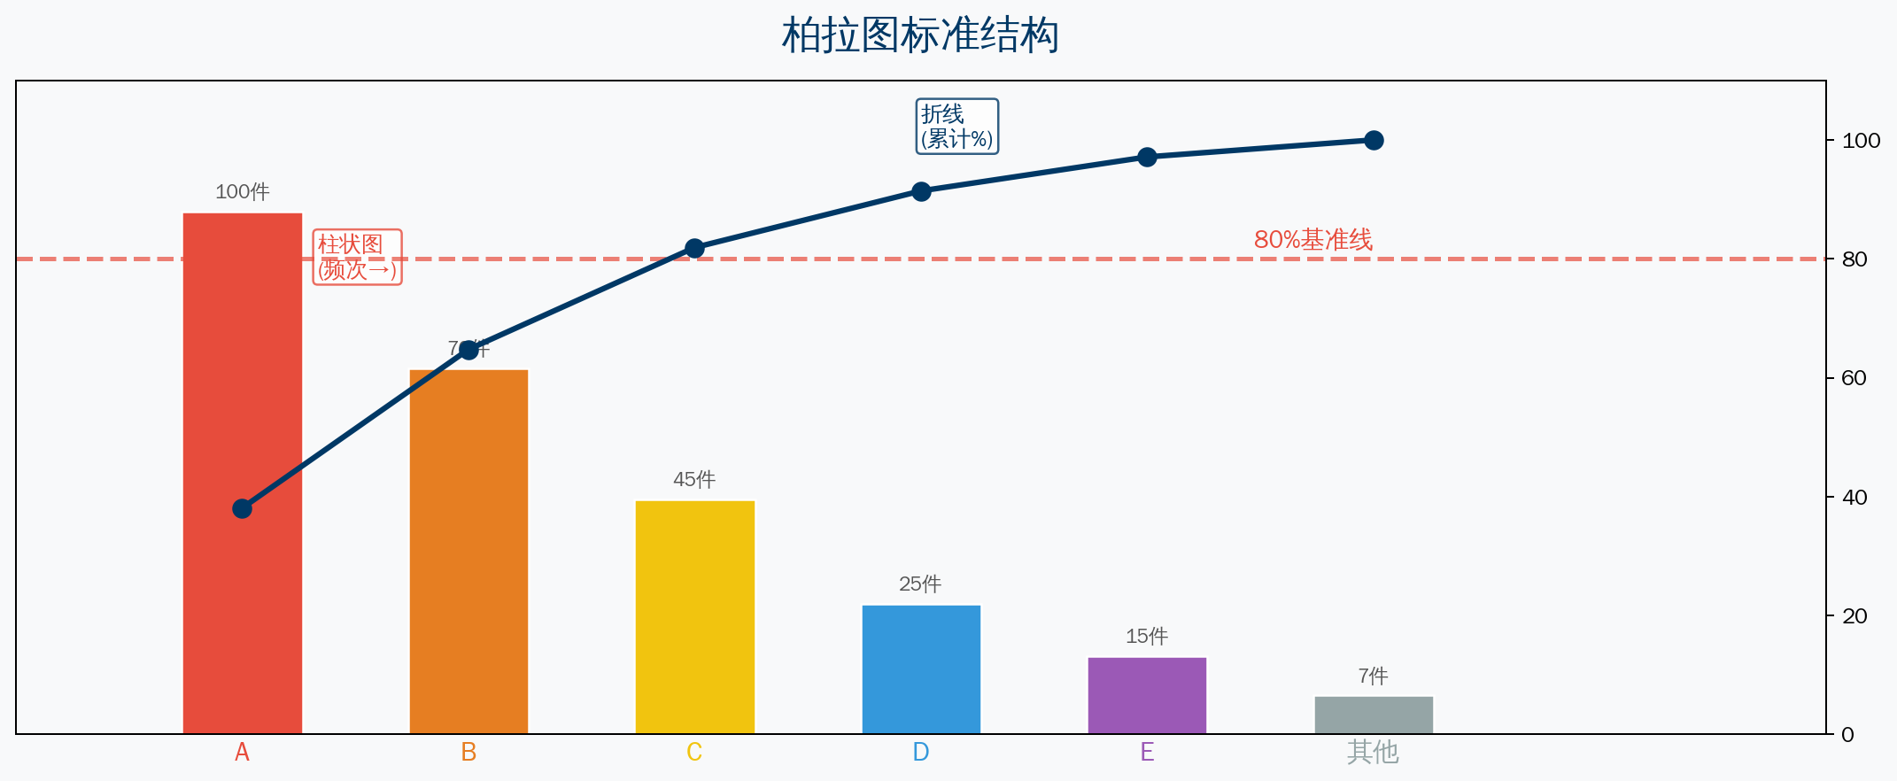
2.1 Standard Pareto Chart Structure
Bar chart: frequency high to low
Line: cumulative percentage
80% reference line: separate vital from trivial
9/28

Slide 10
2.2 Six Steps to Draw a Pareto Chart
Step 1 Collect data — define analysis period, gather defect data by category
Step 2 Sort — rank by frequency high to low, calculate percentages
Step 3 Draw bar chart — X-axis = cause categories, left Y-axis = frequency
Step 4 Draw cumulative line — right Y-axis = cumulative percentage (0%–100%)
Step 5 Draw 80% reference line — separate vital few from trivial many
Step 6 Analyze — items left of reference line = priority improvement projects
10/28

Slide 11
2.3 Pareto Chart Calculation Example
Item percentage = (Item frequency / Total frequency) × 100%
Cumulative percentage = (Sum of preceding item frequencies / Total frequency) × 100%
Example: Total defects = 500 units
Category Frequency Percentage Cumulative %
A 200 40.0% 40.0%
B 150 30.0% 70.0%
C 80 16.0% 86.0% ← 80% line
D 40 8.0% 94.0%
E 30 6.0% 100.0%
→ Vital few: A+B+C = 430 units, 86% of total
→ Prioritize these three categories to resolve 86% of problems
11/28

Slide 12
Chapter 3
Practical Applications of Pareto Chart
12/28

Slide 13
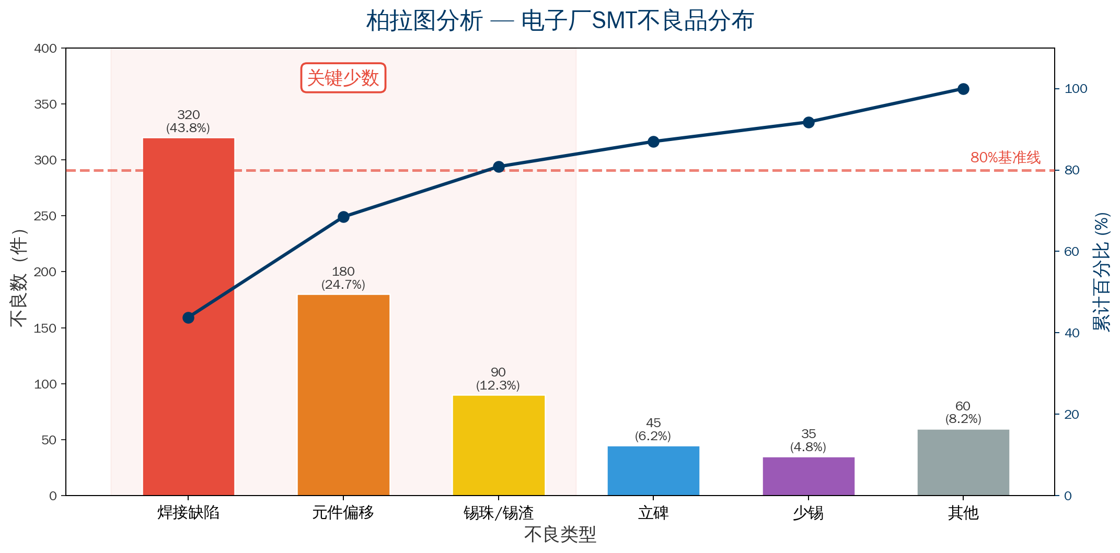
3.1 Classic Case: Electronics Plant Defect Analysis
13/28

Slide 14
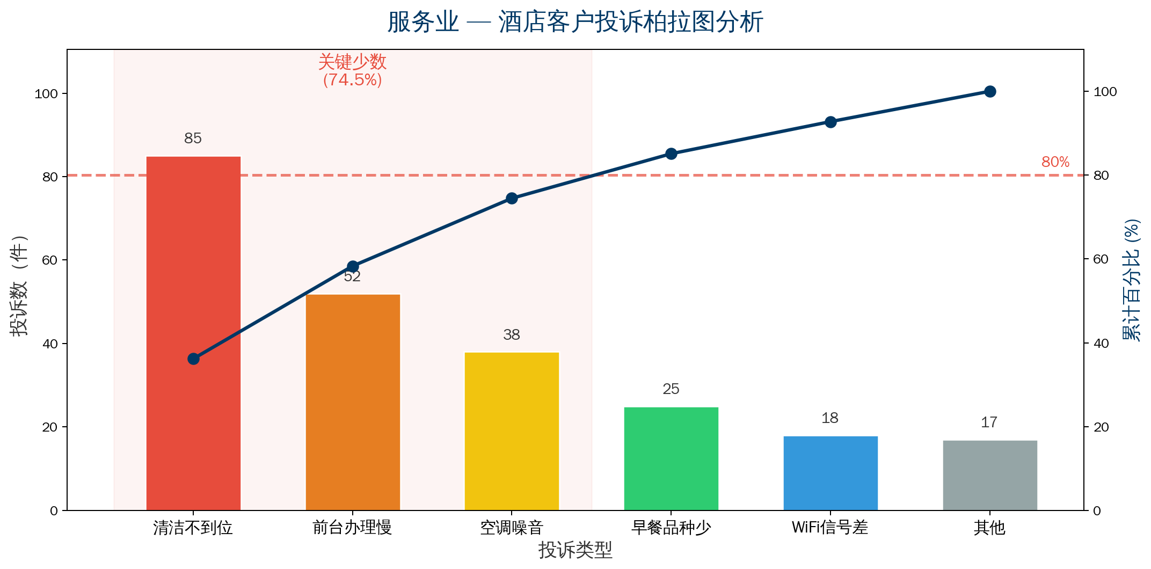
3.2 Service Industry — Hotel Customer Complaint Analysis
Conclusion: Housekeeping + Front desk + HVAC = 175 cases, 74.5%
→ Addressing top three complaints significantly boosts satisfaction
14/28

Slide 15
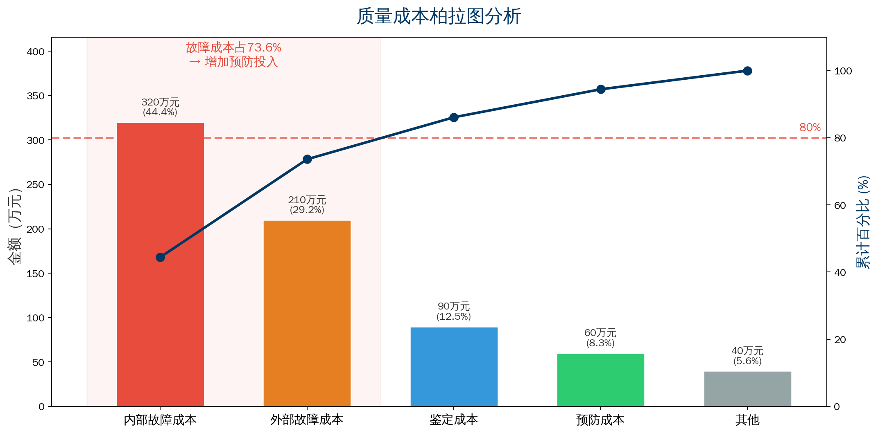
3.3 Cost of Quality Pareto Analysis
Conclusion: Failure costs (internal + external) = ¥5.3M, 73.6%
→ Increase prevention investment to reduce failures at source
15/28

Slide 16
Chapter 4
Common Pitfalls in Pareto Chart
16/28

Slide 17
Pitfalls 1–3
Pitfall 1: Too many categories, losing focus
× Plot 20+ defect causes on one chart
✓ Keep 5–8 main categories, merge rest as "Other"
Pitfall 2: Pareto chart is not "one-and-done"
× Draw once before improvement, then never revisit
✓ Re-collect data and draw new Pareto chart after improvement for comparison
Pitfall 3: Focus only on top items, ignore systemic causes
× Improve only the #1 ranked item
✓ Prioritize vital few, plan follow-up for trivial many
✓ Also analyze "why these problems keep recurring"
17/28

Slide 18
Pitfalls 4–5
Pitfall 4: Insufficient data stratification
× Mix all defect data together for analysis
✓ Draw separate Pareto charts by line, shift, product model
✓ "Vital few" may differ completely across strata
Pitfall 5: Ignoring "cost weighting"
× Draw Pareto chart by defect count only
✓ Select metric based on analysis purpose:
By defect count → focus on frequency
By loss amount → focus on cost
By customer impact → focus on satisfaction
18/28

Slide 19
Chapter 5
Combining Pareto Chart with Other Tools
19/28

Slide 20
5.1 Pareto Chart + Fishbone Diagram
Best partners: Pareto tells "what to fix," Fishbone tells "why"
Step 1: Pareto chart identifies the "vital few"
→ Identify the top 3 most important problems
Step 2: Draw fishbone diagram for each vital problem
→ Systematically analyze all potential causes
Step 3: Verify root causes with data
→ Use Pareto chart to validate root cause hypothesis priority
💡 Combined value:
Pareto answers "what to do" → Fishbone answers "why"
Together, the two charts form a complete improvement plan
20/28

Slide 21
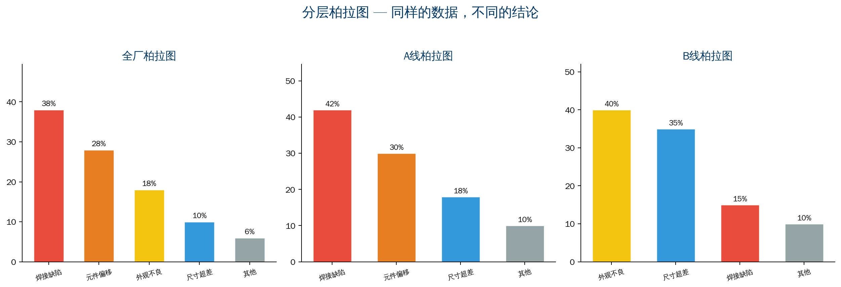
5.2 Pareto Chart + Stratification
21/28

Slide 22
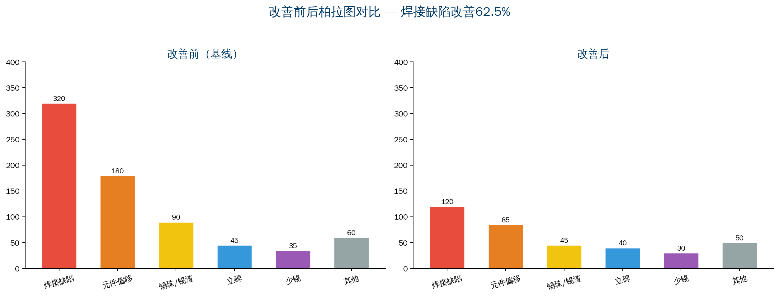
5.4 Pareto Chart + Before/After Comparison
22/28

Slide 23
Chapter 6
Advanced Pareto Chart Techniques
23/28

Slide 24
6.1 Weighted Pareto Chart
When problem severity varies, sorting by count alone is insufficient
Weighted method example:
Problem Category Count Weight Weighted Score
Safety issue 10 10 100
Dimensional defect 80 2 160
Appearance defect 200 1 200
→ By weighted score: Appearance (200) > Dimensional (160) > Safety (100)
→ But safety issues carry the highest risk level
💡 Weighted Pareto chart more accurately reflects true problem impact
Weights determined by severity, customer impact, cost, and other dimensions
24/28

Slide 25
6.2 Multi-Dimensional Pareto & Digitalization
Multi-dimensional Pareto analysis:
▸ By product model × defect type → main problems per product
▸ By production line × defect type → problems per line
▸ By team × defect type → which team needs support
▸ By time period × defect type → when problems concentrate
Pareto chart in the digital era:
▸ Real-time update: MES auto-captures data
▸ Dynamic filtering: switch dimensions on the fly
▸ Auto alert: warn when vital few changes
▸ Auto push: periodic reports to responsible parties
25/28

Slide 26
Chapter 7 — Evaluation Criteria for Pareto Chart
Evaluation Dimension | Good Practice | Poor Practice
Data accuracy | Reliable source, reasonable period | Incomplete data, arbitrary period
Reasonable categories | 5–8 main categories + Other | Too many or too few categories
Correct sorting | Strictly sorted high to low | Unsorted or wrong order
Clear cumulative line | Smooth line, clear percentages | Missing cumulative line or confused scale
80% reference line | Clear reference line, key items marked | No reference line
Actionable output | Clear improvement targets and owners | Display data only, no follow-up plan
26/28

Slide 27
Summary
The "Principle" and "Technique" of Pareto Chart
27/28

Slide 28
Summary: The "Principle" and "Technique" of Pareto Chart
Technique (How to Draw)
Principle (Why Use It)
▸ Collect data accurately
▸ Sort by frequency high to low
▸ Draw bar chart + cumulative line
▸ Mark 80% reference line
▸ Identify the "vital few"
▸ Not about drawing a "pretty chart"
▸ Not just to complete an 8D step
▸ To "deploy limited resources
where they create the most value"
The greatest value of Pareto chart is not "statistics" but "decision-making"
— Knowing what to fix first matters more than fixing everything
QTank
28/28

Slide 29
Thank You
qtank.org
QTank
qtank.org

