Slide 1
In-Depth Guide to the QC Seven Tools
Fishbone Diagram
Structured · Systematic · Visual Root Cause Analysis Framework
QTank
Knowledge Code 5.2.4 · QC Seven Tools (Classic Seven QC Tools)
qtank.org

Slide 2
Contents
Chapter 1 The Essence of Fishbone Diagram
Chapter 2 Fishbone Diagram Structure and Elements
Chapter 3 5M1E — The "Skeleton" of Fishbone Diagram
Chapter 4 Fishbone Diagram Workflow (Standard 7-Step Process)
Chapter 5 Common Pitfalls and How to Avoid Them
Chapter 6 Combining Fishbone with Other Tools
Chapter 7 Fishbone Case Studies by Industry
Chapter 8 Fishbone Variants and Advanced Techniques
Chapter 9 Evaluation Criteria for Fishbone Diagram
Summary: The "Principle" and "Technique" of Fishbone Diagram
2/30

Slide 3
Before the Series
QC Seven Tools — the most fundamental and powerful "seven weapons" in quality management
▸ Check Sheet ▸ Stratification ▸ Pareto Chart ▸ Cause-and-Effect Diagram (Fishbone)
▸ Scatter Diagram ▸ Histogram ▸ Control Chart
Many QCs can use them, but don't necessarily "understand" them
Many QEs know what they are, but can't "use them to full effect"
Series goal: Take apart each weapon —
✓ What it does
✓ When to use it
✓ How to use it correctly
✓ Pitfalls in practice
✓ How to go from "can use" to "master"
3/30

Slide 4
Chapter 1
The Essence of Fishbone Diagram
4/30

Slide 5
1.1 What Is a Fishbone Diagram
Fishbone Diagram
Also called Cause-and-Effect Diagram
Proposed by quality master Kaoru Ishikawa in 1943
Hence also called Ishikawa Diagram
Standard definition:
A visual tool that systematically analyzes causal chains to layer out
potential causes of a problem by category
Core logic:
Every outcome (problem/effect) has multiple causes,
with hierarchical and categorical relationships among them
5/30

Slide 6
1.2 Essence of Fishbone — Not "drawing," but a "thinking framework"
Structured: not random listing, but 5M1E categorization
Systematic: covers all possible cause dimensions, avoids gaps
Visual: one diagram shows all potential causes and relationships
Many beginners treat fishbone as "drawing a fish on the meeting room wall"
— precisely missing its value
The essence of fishbone is a
structured, systematic, visual
root cause analysis thinking framework
6/30

Slide 7
1.3 Three Key Roles of Fishbone Diagram
Role | Description | Application
Identify root causes | Systematically map all possible causes, find true root cause | 8D-D4, CAPA analysis, quality incident investigation
Prevent problems | Proactively identify "what could go wrong" | FMEA brainstorming, new line ramp-up
Promote collaboration | Cross-functional teams collaborate around "one fish" | Quality meetings, improvement project kickoffs
7/30

Slide 8
Chapter 2
Fishbone Diagram Structure and Elements
8/30

Slide 9
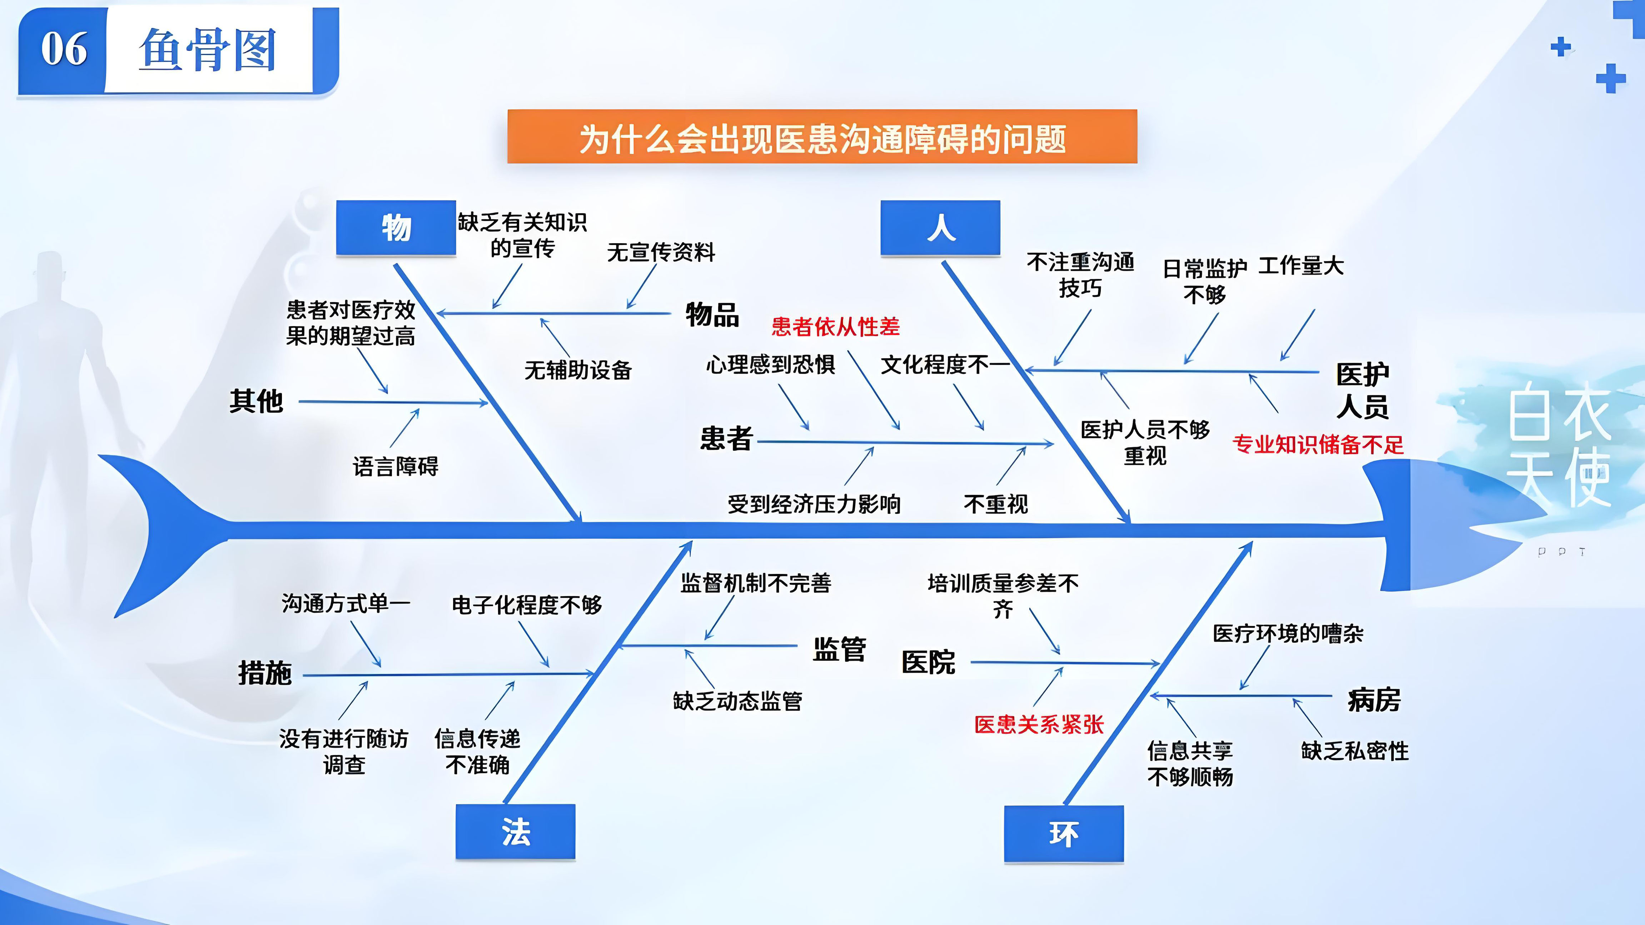
2.1 Standard Fishbone Diagram Structure
9/30

Slide 10
2.2 Fishbone Diagram Core Elements Reference
Element | Name | Description | Position
Fish Head | Problem/Effect | Core problem to analyze — the more specific, the better | Far right
Fish Spine (Main Bone) | Main trunk line | Arrow line from left pointing to fish head | Center
Major Bone | Cause Category | Classified by 5M1E or other framework | Angled up/down from main bone
Medium Bone | Primary Cause | Primary causes under each major category | Extending from major bone
Minor Bone | Sub-cause | Specific causes under primary causes | Extending from medium bone
Fine Bone | More granular causes | Deepest level of analysis | Outermost tip
10/30

Slide 11
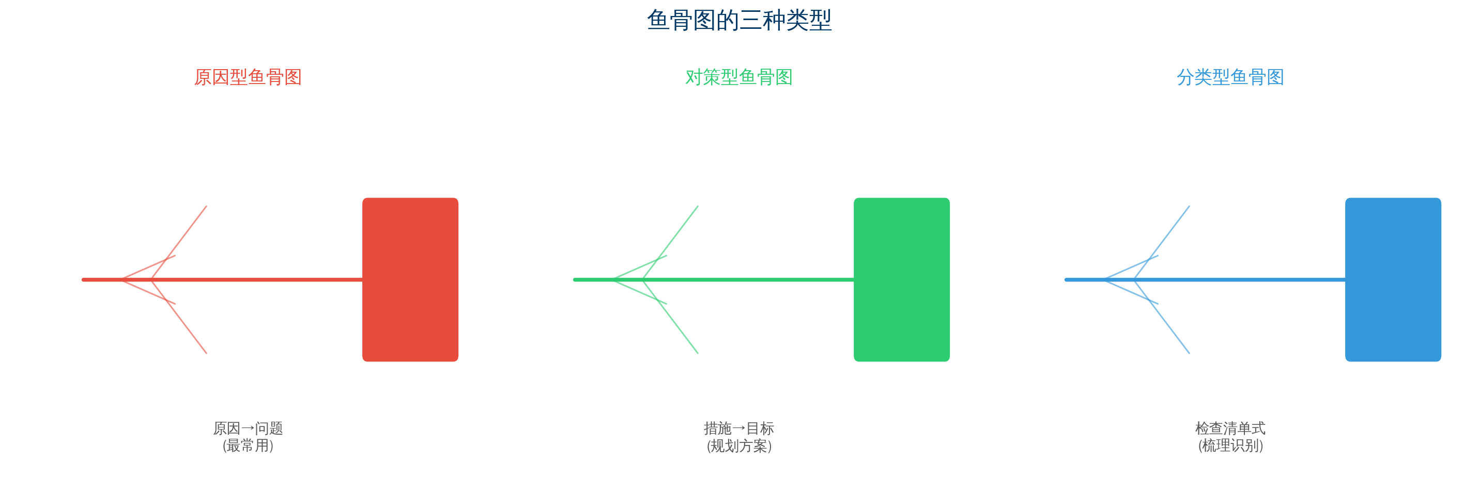
2.3 Three Types of Fishbone Diagram
11/30

Slide 12
Chapter 3
5M1E — The "Skeleton" of Fishbone Diagram
12/30

Slide 13
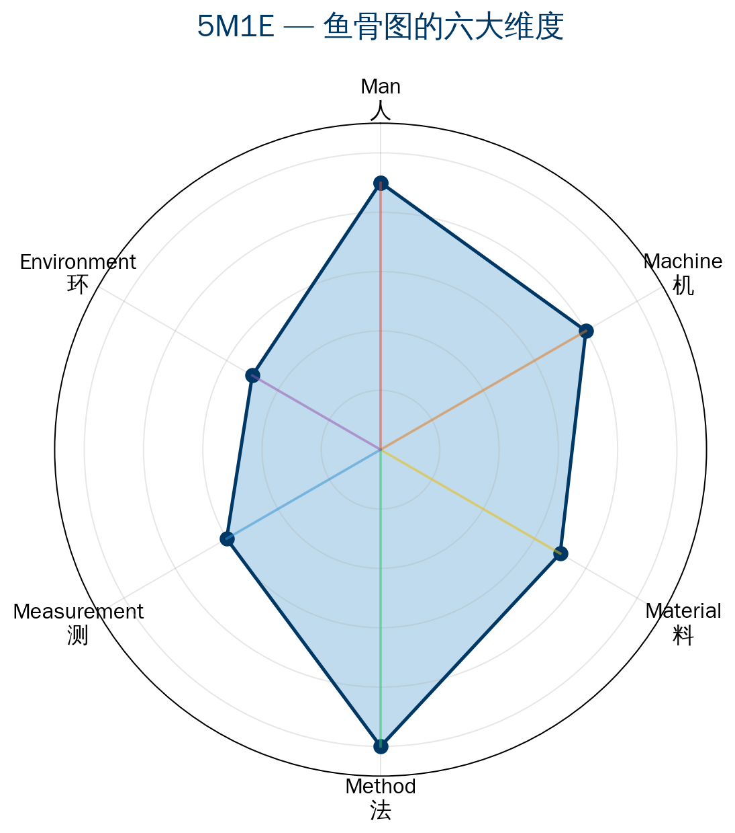
3.1 Full Meaning of 5M1E
5M1E = Man + Machine + Material
+ Method + Measurement + Environment
The "standard classification framework" for manufacturing fishbone analysis
Each dimension must be drilled to at least 3 levels to find true root cause
Not done after "drawing one major bone"
13/30

Slide 14
M1 — Man (Personnel)
Insufficient skills → inadequate training, many new hires
Non-standard operation → unfamiliar with SOP, shortcuts taken
Lack of focus → fatigue, monotonous work
Weak quality awareness → unclear on quality standards
Poor communication → handover information gaps
Staff turnover → skilled workers leaving, temporary replacements
⚠ Deep insight:
"People" problems are often blamed on "bad attitude"
Excellent quality professionals keep asking:
Why bad attitude? Inadequate training? Insufficient motivation?
Or is the process design itself error-prone?
14/30

Slide 15
M2 — Machine | M3 — Material
Machine (Equipment)
Material
Insufficient equipment precision → aging, wear
Parameter abnormality → drift, deviation
Tooling/mold issues → wear, poor positioning
Poor maintenance → missed PM
Low automation → no mistake-proofing devices
Incoming defects → supplier quality issues
Material change → undisclosed specification change
Improper storage → moisture, oxidation
Label confusion → mixed batches
Poor packaging → transport damage
15/30

Slide 16
M4 — Method | M5 — Measurement
Method
Measurement
Unreasonable process parameters → narrow parameter window
Incomplete SOP → key parameters omitted
Unclear inspection criteria → subjective judgment
Process design flaws → no mistake-proofing
Method change → unapproved change
Insufficient gauge precision → inadequate resolution
Improper measurement method → inconsistent position/technique
Reference standard failure → gauge block wear
Insufficient inspection frequency → sample too small
Poor MSA → excessive GR&R
⚠ Deep insight: Measurement system issues are often overlooked — excellent QEs always ask first: Is this data reliable? Is there a measurement system problem?
16/30

Slide 17
M6 — Environment | Industry Extensions
Environment
5M1E extensions by industry
Temperature/humidity → climate control failure
Cleanliness → dust, oil, static
Lighting → insufficient illuminance, color temperature deviation
Noise/vibration → floor vibration impact
Layout → inefficient routing
Service: 4M+1C (+ Customer)
Software: +2M (Management + Metrics)
Healthcare: +1P (Patient)
Food: +1C (Cold Chain)
17/30

Slide 18
Chapter 4
Fishbone Diagram Workflow (Standard 7-Step Process)
18/30

Slide 19
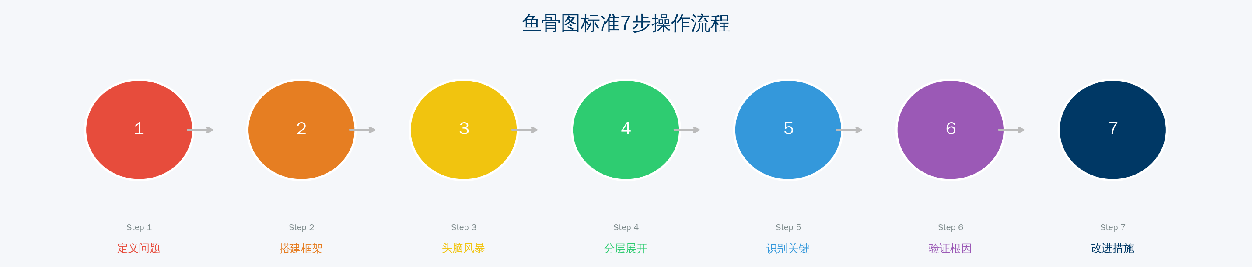
Standard 7-Step Workflow
Step 1 Define problem (fish head) — the more specific, the better
Step 2 Build framework (main bone + major bones) — 5M1E categories
Step 3 Brainstorm (team co-creation) — cross-functional participation
Step 4 Layer out (minor → fine bones) — drill at least 3 levels
Step 5 Identify key factors — select top 3–5 most important
Step 6 Verify root causes — fishbone is hypothesis, data verification is conclusion
Step 7 Define improvement actions — short, medium, and long term
19/30

Slide 20
Step 1 — Define Problem (Fish Head)
Key: The more specific the problem definition, the more effective the analysis
✗ Bad example: "Poor product quality"
→ Too vague to focus analysis
✓ Good example: "Welding strength of Product B on Line A
dropped 30% over the past two weeks"
→ Specific to: which product, which process,
which metric, what time period, what deviation
Checklist:
□ Is the problem measurable?
□ Is there a time/space boundary?
□ Are known factors excluded?
□ Is there a single focus?
20/30

Slide 21
Step 3 — Brainstorm (Team Co-creation)
The greatest value of fishbone diagram is multi-perspective collision
Recommended participants:
▸ QC (most familiar with shop floor details)
▸ QE (most familiar with quality data and systemic issues)
▸ Production operators/team leaders (most familiar with actual operations)
▸ Process engineers (most familiar with process parameters)
▸ Maintenance staff (most familiar with equipment condition)
Brainstorming rules:
No criticism, no judgment
Encourage quantity — volume leads to breakthrough
Encourage "piggybacking" — build on others' ideas
Describe each cause in neutral language
21/30

Slide 22
Step 4 — Layer Out (Drill at Least 3 Levels)
Example (rising defect rate → welding defect):
Level 1 (major → medium bone):
Method: Unreasonable welding parameters
Level 2 (medium → minor bone):
Unreasonable welding parameters → welding current setpoint deviation
Level 3 (minor → fine bone):
Current deviation → parameters not adjusted per standard after shift change
Current deviation → equipment parameter memory function failed
Level 4 (finer):
Memory function failure → not covered in preventive maintenance
💡 In excellent quality fishbone diagrams,
true root causes are found at levels 3–4
22/30

Slide 23
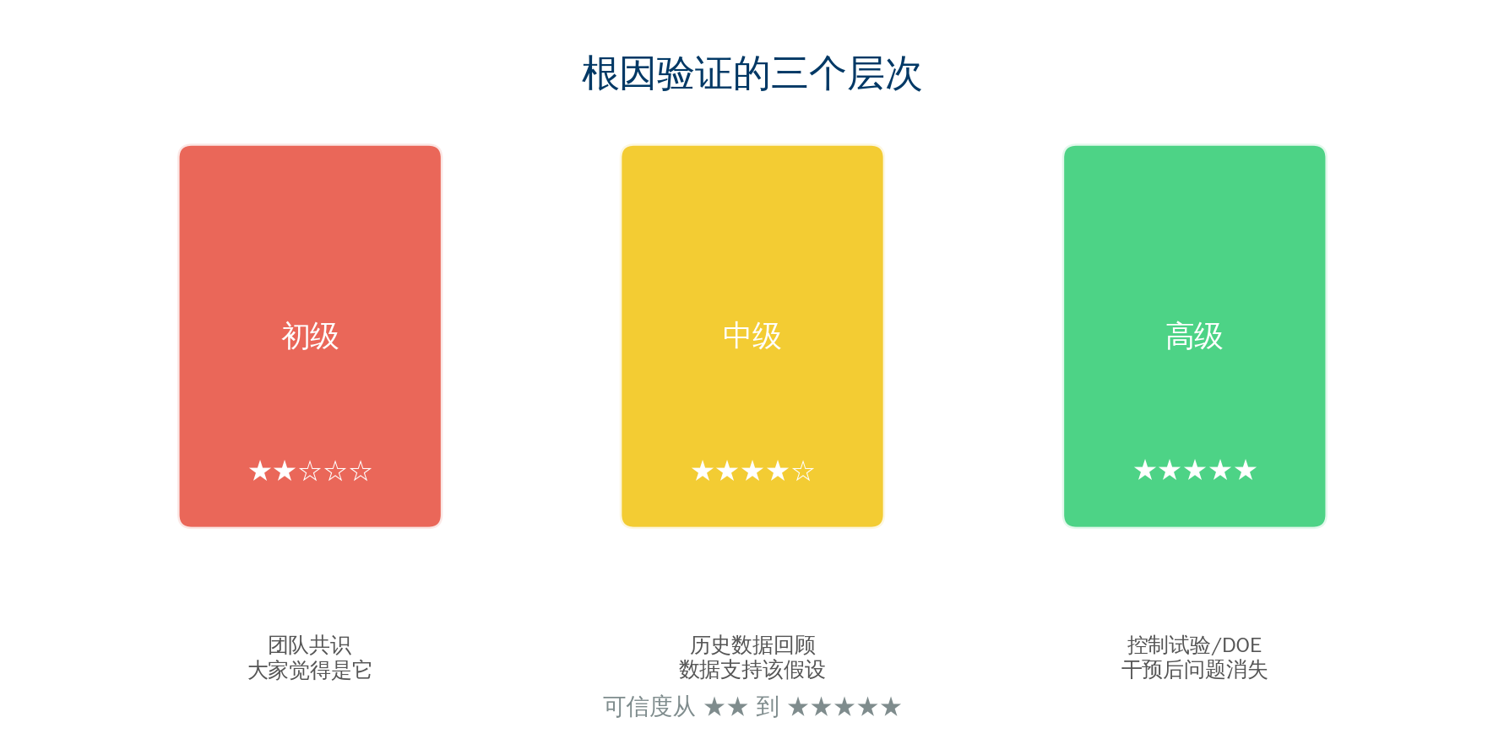
Step 5–7 — Identify · Verify · Improve
Step 5 — Identify Key Contributing Factors
Voting | Data verification | Pareto screening | Controlled experiment
Step 6 — Verify Root Causes (Most Critical Step!)
Fishbone → Generate hypotheses (Hypothesis Generation)
Data verification → Verify hypotheses (Hypothesis Verification)
A fishbone without data verification is just a "pretty picture"
Step 7 — Define Improvement Actions
Short term: Immediate fix, verify after line stop and repair
Medium term: Incorporate into standard process and checklists
Long term: Prevent recurrence at system level
23/30

Slide 24
Chapter 5
Common Pitfalls and How to Avoid Them
24/30

Slide 25
Seven Common Pitfalls in Fishbone Diagram
25/30

Slide 26
Pitfall Details (Part 1)
Pitfall 1: Listing causes without categorization
× Draw all brainstormed causes directly on the fishbone
✓ Classify with 5M1E first, then fill — "classification is analysis itself"
Pitfall 2: Major bones only, no breakdown
× Write "Man" on major bone and stop
✓ Drill each major bone to at least levels 2–3
Pitfall 3: Fishbone stops at "surface causes"
× "Rising defect rate → Man: inexperienced operator → no further drill-down"
✓ Drill to "what can we do to change it"
Pitfall 4: One person draws the entire diagram
× QE draws alone in office, missing shop floor reality
✓ Cross-functional team draws together, complementary perspectives
26/30

Slide 27
Pitfall Details (Part 2)
Pitfall 5: Treating fishbone as "case closed report"
× Draw a nice diagram in 8D report, then nobody revisits it
✓ Key question: "Have analysis conclusions been converted to improvement actions?"
Pitfall 6: Confusing "causes" with "symptoms"
× Cause of "high defect rate" is "dimensional out-of-spec"
✓ Dimensional out-of-spec is a symptom, not a cause
✓ True cause: tool wear → unreasonable life setting → missing management system
Pitfall 7: One fishbone analyzing multiple problems
× Mix three problems: "rising scrap, more complaints, falling efficiency"
✓ One problem per fishbone — draw separate fishbones for multiple problems
27/30

Slide 28
Chapter 6
Combining Fishbone with Other Tools
28/30

Slide 29
Fishbone + Other Tools — Golden Partners
29/30

Slide 30
Summary: The "Principle" and "Technique" of Fishbone Diagram
Technique (How to Draw)
Principle (Why Draw It)
▸ Define problem precisely
▸ Classify using 5M1E
▸ Drill to 3+ levels
▸ Team co-creation
▸ Not about drawing a pretty picture
▸ Not just completing an 8D step
▸ Not to "prove I did the analysis"
▸ To "find root causes we can act on"
The greatest value of fishbone — it forces you from "it's a people problem" to "it's a system problem"
QTank
30/30

Slide 31
Thank You
qtank.org
QTank
qtank.org

