Slide 1
In-Depth Guide to the QC Seven Tools
Scatter Diagram
"I think they're related" and "data proves they're related" are not the same
QTank
Knowledge Code 5.2.4 · QC Seven Tools (Classic Seven QC Tools)
qtank.org

Slide 2
Contents
Chapter 1 Nature of Scatter Diagrams
Chapter 2 Scatter Diagram Plotting and Analysis
Chapter 3 Scatter Diagram Practical Cases
Chapter 4 Common Scatter Diagram Pitfalls
Chapter 5 Scatter Diagram Combined with Other Tools
Chapter 6 Advanced Scatter Diagram Uses
Chapter 7 Scatter Diagram Evaluation Criteria
Summary: Scatter Diagram "Principle" and "Practice"
2/28

Slide 3
Preface
In prior issues we learned:
Fishbone: hypothesized causes (qualitative)
Pareto: focus on vital few (ranking)
Stratification: find differences (classification)
Scatter answers: do two variables relate at all?
How strong? What direction?
"I think they're related" and "data proves they're related" are not the same
3/28

Slide 4
Chapter 1
Nature of Scatter Diagrams
4/28

Slide 5
1.1 What Is a Scatter Diagram
Scatter Diagram
Plot two variables as points on a coordinate system
To observe and analyze correlation between two variables
Core logic:
X-axis = one variable (e.g., temperature)
Y-axis = another variable (e.g., defect rate)
Each point = one data pair (temperature, defect rate)
Judge from point pattern: do the variables relate?
5/28

Slide 6
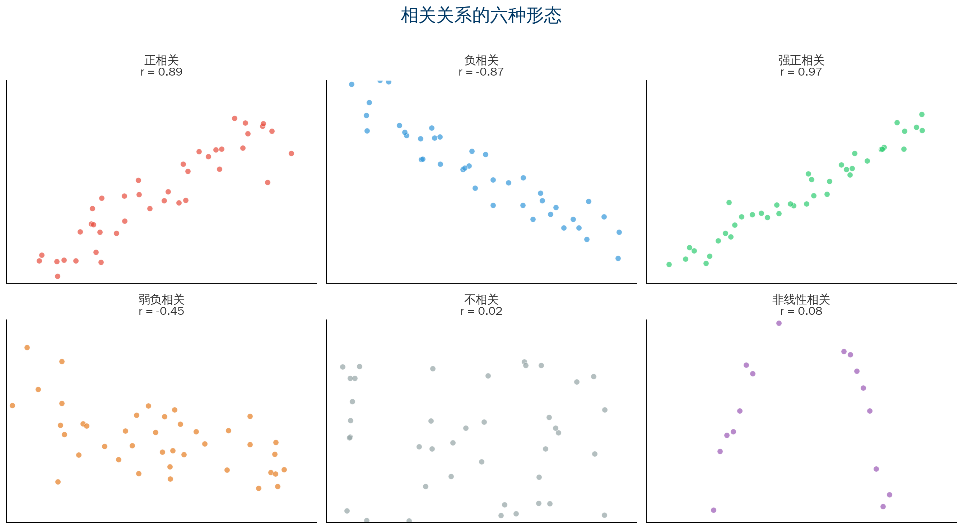
1.2 Six Correlation Patterns
6/28

Slide 7
1.3 Three Purposes + 1.4 Scatter vs Correlation Analysis
Purpose | Description | Application
Verify hypotheses | Test correlation between two variables | Data verification of fishbone hypotheses
Determine direction | Positive or negative correlation | Process parameter optimization
Identify outliers | Find points deviating from overall trend | Process anomaly detection
Scatter (qualitative) vs Correlation coefficient (quantitative)
View point pattern Calculate r mathematically
Judge direction/shape Linear strength only
Detect nonlinear/outliers Outliers affect r
Best practice: plot scatter first, then calculate r!
7/28

Slide 8
Chapter 2
Scatter Diagram Plotting and Analysis
8/28

Slide 9
2.1 Standard 5-Step Plotting Process
Step 1 Define subjects — X (cause) and Y (effect)
Step 2 Collect pairs — at least 30–50 pairs
Step 3 Set axes — X = cause, Y = effect
Step 4 Plot — one point per pair
Step 5 Analyze — observe distribution pattern
9/28

Slide 10
2.2 Data Collection Requirements
① Pairing rule — each point must match the same conditions
✓ Same lot: temperature + defect rate
✗ Today's temperature + yesterday's defect rate
② Sample size — minimum 30 pairs; recommend 50+
③ Data range — cover full possible range of variables
④ Data accuracy — measurement system must be reliable
10/28

Slide 11
2.3 Correlation Coefficient (r) Quick Reference
r=1.0 Perfect positive correlation
r=0.8–1.0 Strong positive correlation
r=0.5–0.8 Moderate positive correlation
r=0.3–0.5 Weak positive correlation
r=-0.3–0.3 No correlation
r=-0.5–-0.3 Weak negative correlation
r=-0.8–-0.5 Moderate negative correlation
r=-1.0–-0.8 Strong negative correlation
r=-1.0 Perfect negative correlation
⚠ Notes:
1. r measures linear correlation only
Cannot measure nonlinear correlation
2. r is heavily influenced by outliers
3. Correlation ≠ causation
Two variables related does not mean
one causes the other
11/28

Slide 12
Chapter 3
Scatter Diagram Practical Cases
12/28

Slide 13
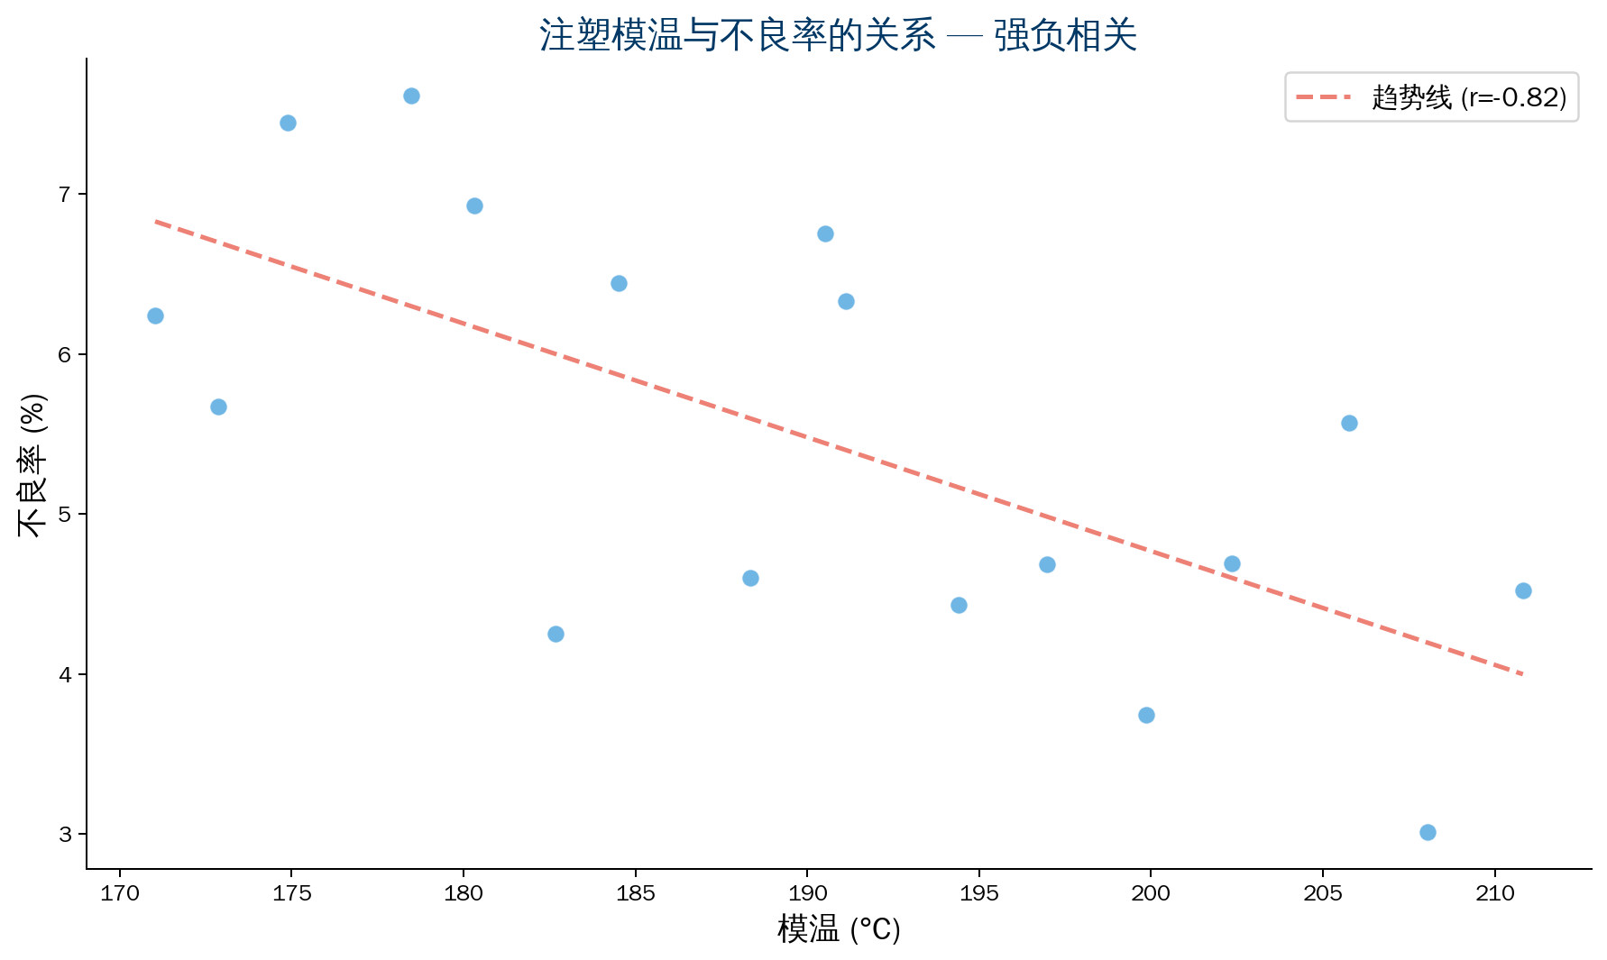
Case 1: Manufacturing — Mold Temperature vs Defect Rate
Background: Injection molding shop
Mold temperature vs shrinkage defects
Conclusion: Strong negative correlation
r = -0.82
Higher mold temp → lower defect rate
Action:
Mold temp 180→200°C
Defect rate 4.5%→2.1%
13/28

Slide 14
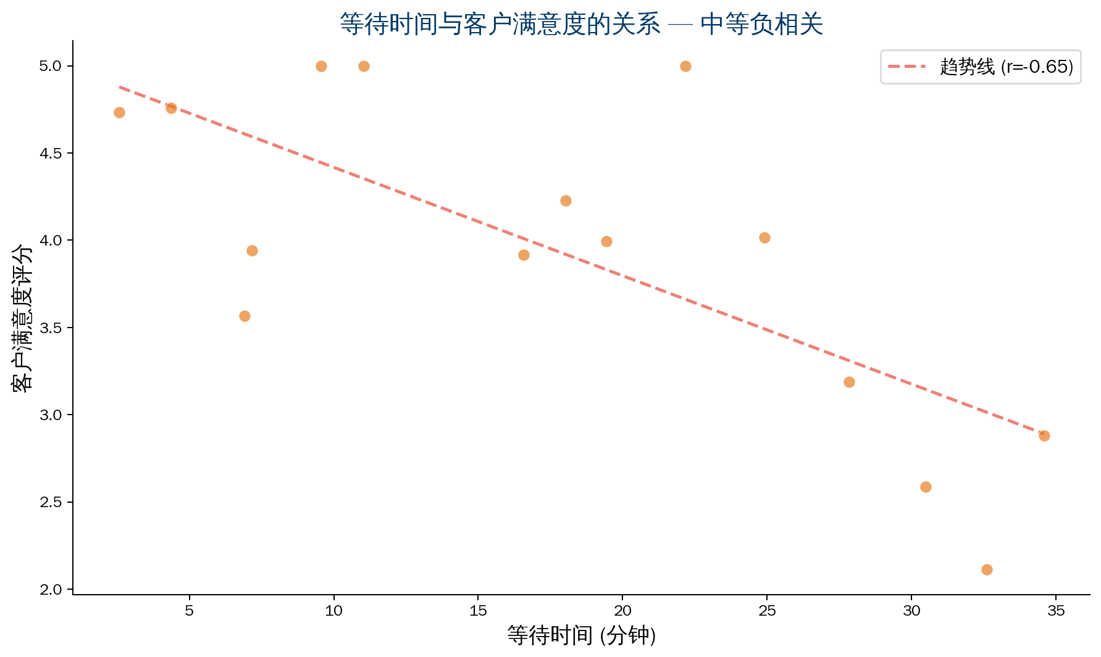
Case 2: Service — Wait Time vs Satisfaction
Background: Bank branch
Wait time affects satisfaction
Conclusion: Moderate negative correlation
r = -0.65
Longer wait → lower satisfaction
But not the only factor
Action:
15-minute timeout alert
Add peak-hour windows
Satisfaction 3.2→4.1
14/28

Slide 15
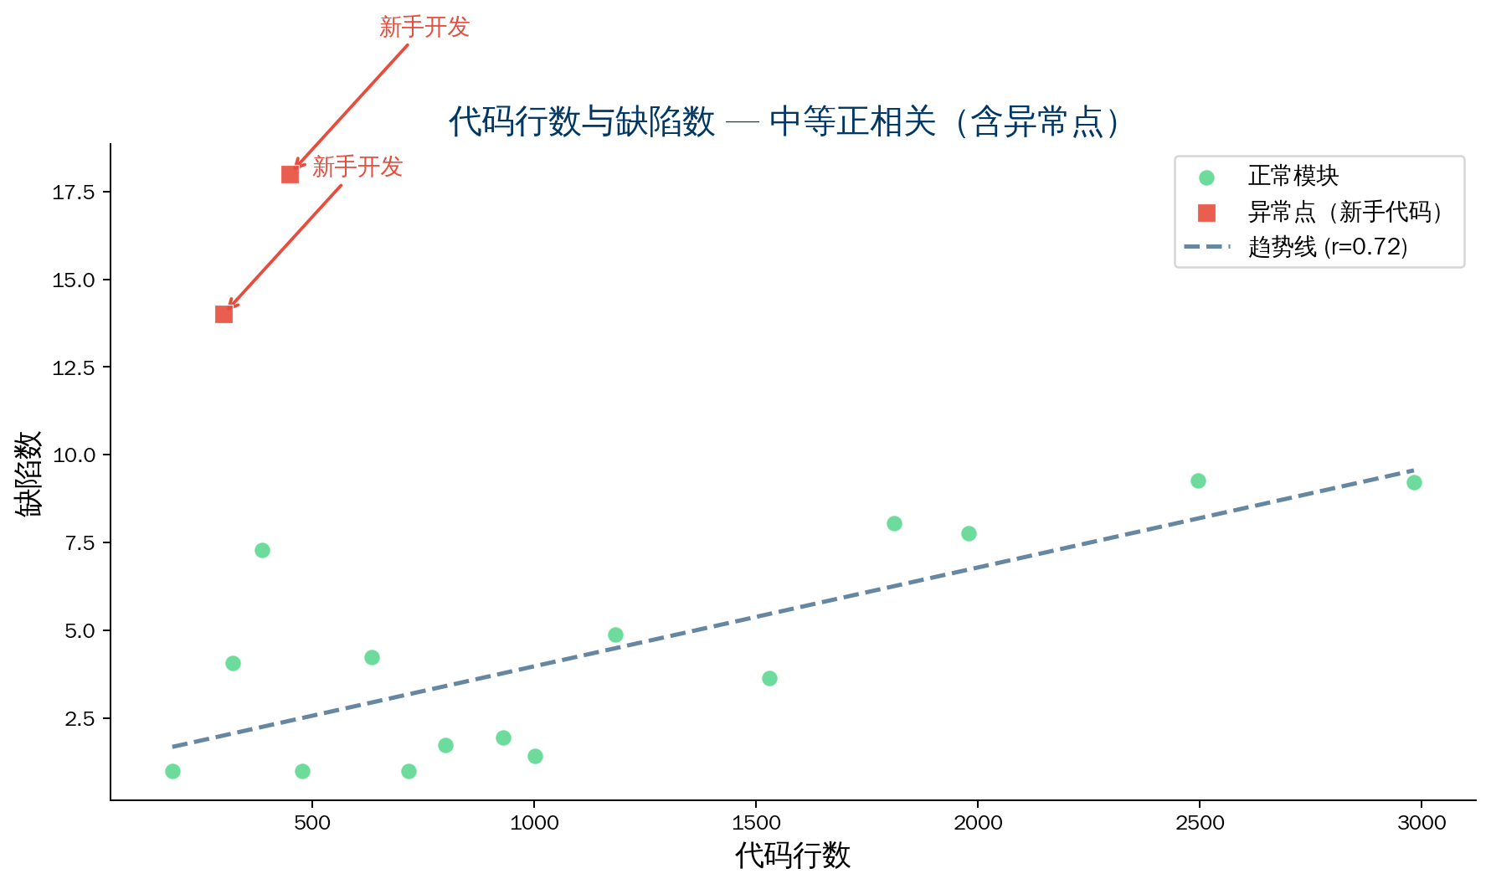
Case 3: Software — Lines of Code vs Defect Count
Background: Code size vs defects
Conclusion: Moderate positive correlation
r = 0.72
More code → more defects
Outliers found:
Small module but many defects
→ Novice developer code
Action:
Large module code review
Extra review for novice code
Defect rate reduced 35%
15/28

Slide 16
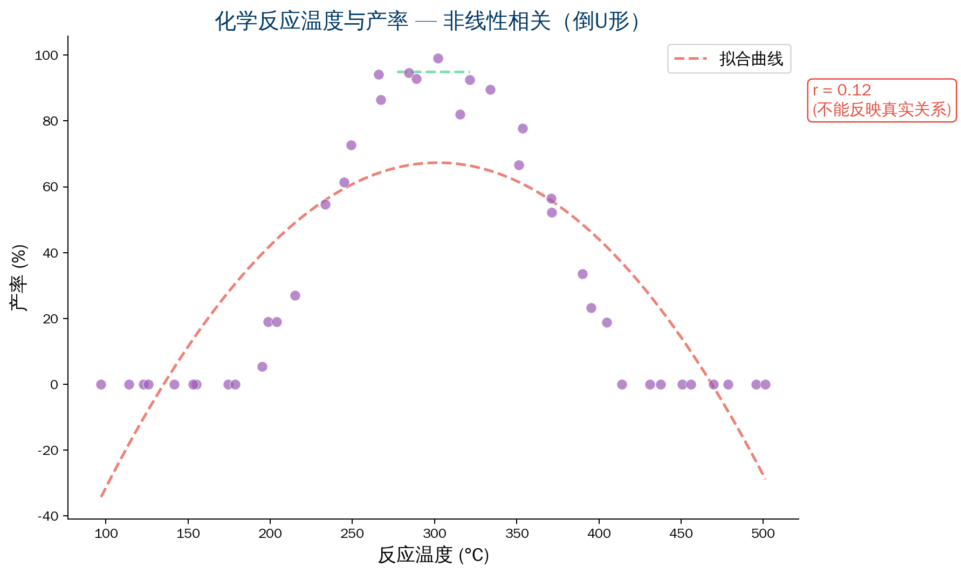
Case 4: Nonlinear — Reaction Temperature vs Yield
Background: Chemical product
Reaction temperature vs yield
r = 0.12 (no correlation?)
❌ Actually an inverted-U curve
⚠ Key lesson:
Relying on r alone misleads!
Plot first, then interpret numbers
Optimal temperature range exists
Too low or too high both hurt
16/28

Slide 17
Chapter 4
Common Scatter Diagram Pitfalls
17/28

Slide 18
Five Common Scatter Diagram Pitfalls
Pitfall 1: Treat correlation as causation
"Ice cream sales correlate with drownings" → ice cream causes drowning?
✓ Correlation≠causation; both result from hot weather
Pitfall 2: Look at r only, not the plot
✗ r=0.02 → no correlation → done
✓ Plot first — may reveal nonlinear correlation or outliers
Pitfall 3: Insufficient sample size
✗ 5–10 data pairs
✓ Minimum 30 pairs; recommend 50+
Pitfall 4: Data range too narrow
✗ Collect only in normal range
✓ Include critical values; cover full range
Pitfall 5: Ignore outliers
✗ Delete outliers on sight
✓ Investigate — may reveal important information
18/28

Slide 19
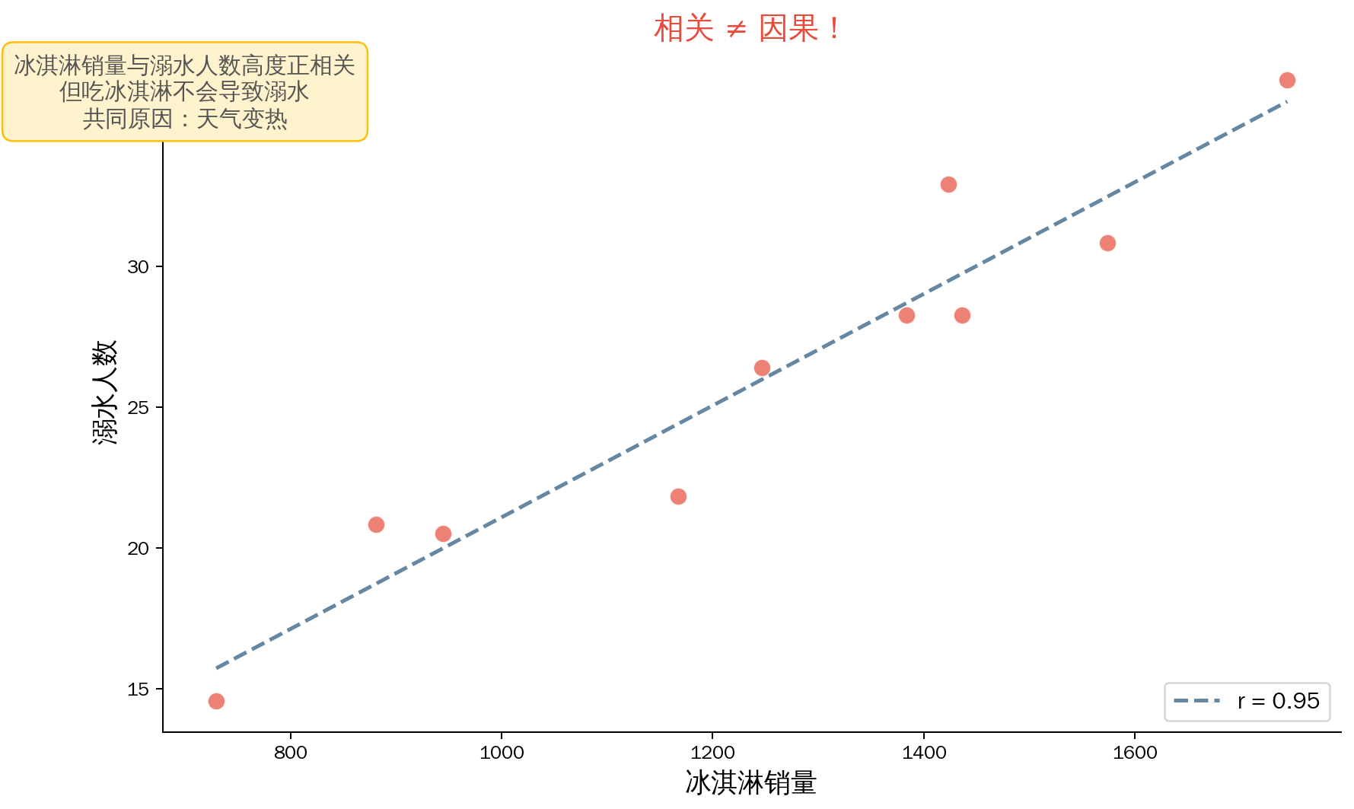
Pitfall 1 Detail: Correlation ≠ Causation
19/28

Slide 20
Chapter 5
Scatter Diagram Combined with Other Tools
20/28

Slide 21
Scatter + Fishbone / Stratification / Control Chart / Regression
Scatter + Fishbone
Fishbone lists hypotheses → scatter verifies which hold
Scatter + Stratification
Stratify and plot separately; compare relationships
Scatter + Control Chart
Analyze variable relationships after process in control
Scatter + Regression Analysis
Scatter for qualitative view → regression for modeling
Upgrade path:
Scatter → correlation → regression equation → prediction and control
21/28

Slide 22
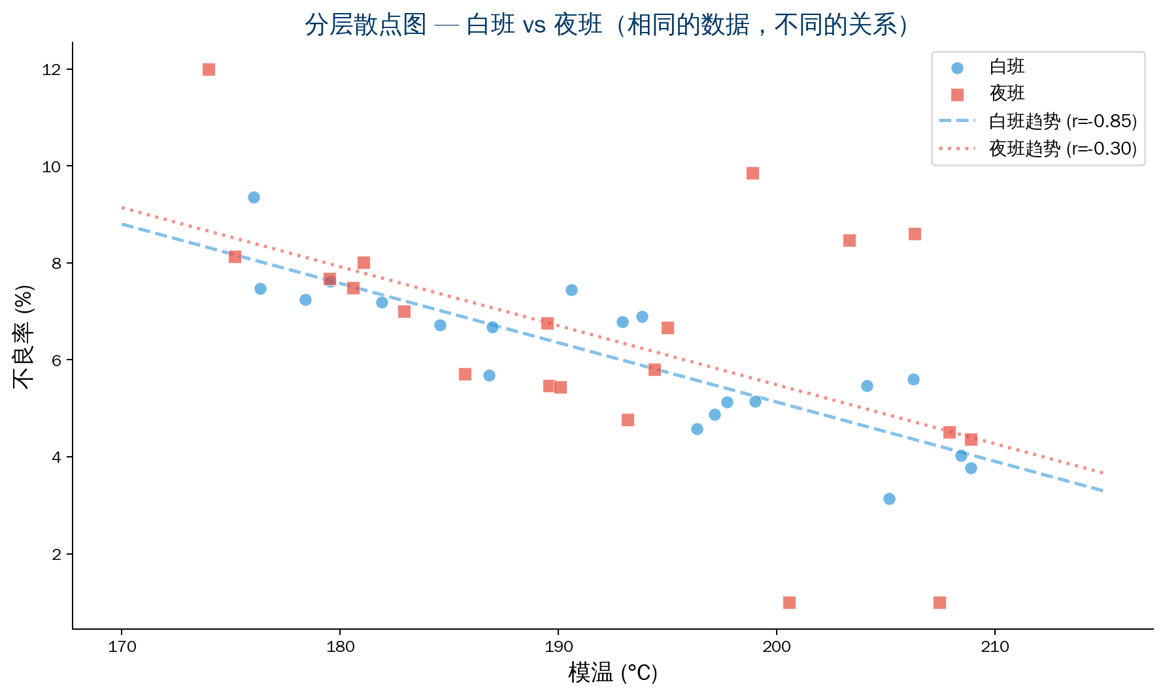
5.2 Scatter + Stratification in Practice
22/28

Slide 23
Chapter 6
Advanced Scatter Diagram Uses
23/28

Slide 24
Advanced Scatter Diagram Uses
Grouped scatter plot
Use colors/symbols for different groups
See overall trend + between-group differences
Time-series scatter plot
Label points with time sequence
Observe if relationship changes over time
Multivariate matrix scatter plot
Show pairwise relationships among multiple variables
Quickly find key variables and interactions
💡 Advanced = TQC thinking:
Layer multiple dimensions on one chart
24/28

Slide 25
Chapter 7 — Scatter Diagram Evaluation Criteria
Evaluation Dimension | Good Standard | Poor Practice
Adequate sample | 50+ data pairs | Under 30 pairs
Range coverage | Cover full variable range | Middle range only
Data accuracy | Reliable measurement system | Uncertain data source
Clear chart | Clear axis labels | Confusing scale; clustered points
Correct analysis | Combine plot and r value | r value only, no plot
Reasonable conclusion | Correlation≠causation; verified | Treat correlation as causation
25/28

Slide 26
Summary
Scatter Diagram "Principle" and "Practice"
26/28

Slide 27
Summary: Scatter Diagram "Principle" and "Practice"
Practice (How to Plot)
Principle (Why Plot)
▸ Collect 50 paired data sets
▸ X = cause, Y = effect
▸ Plot points and observe distribution
▸ Interpret with r value
▸ Not "a chart with a trend"
▸ It is "replace intuition with data"
▸ It is "before taking action,
confirm the direction is right"
Greatest value — avoid wasting resources in the wrong direction
The costliest mistake is not doing wrong things — but improving an unrelated cause at great expense
QTank
27/28

Slide 28
Thank You
qtank.org
QTank
qtank.org

