Slide 1
In-Depth Guide to the QC Seven Tools
Histogram
Averages alone can mislead you twice
QTank
Knowledge Code 5.2.4 · QC Seven Tools (Classic Seven QC Tools)
qtank.org

Slide 2
Contents
Chapter 1 Nature of Histograms
Chapter 2 Histogram Plotting and Interpretation
Chapter 3 Histogram Practical Cases
Chapter 4 Common Histogram Pitfalls
Chapter 5 Histogram Combined with Other Tools
Chapter 6 Advanced Histogram Uses
Chapter 7 Histogram Evaluation Criteria
Summary: Histogram "Principle" and "Practice"
2/28

Slide 3
Preface
"Averages alone can mislead you twice."
Two shifts both average 3% defect rate:
Shift A: stable 2.5%–3.5%
Shift B: swings 0.5% to 8%
Which would you accept?
Averages hide distribution
Histogram is the mirror that reveals distribution
3/28

Slide 4
Chapter 1
Nature of Histograms
4/28

Slide 5
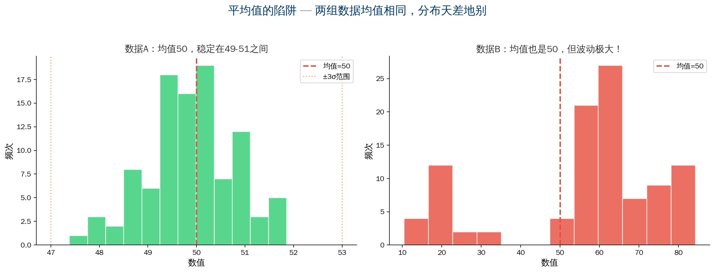
1.1–1.2 What Is a Histogram & The Average Trap
5/28

Slide 6
1.3 Three Purposes + 1.4 Histogram vs Bar Chart
Purpose | Description | Application
Understand process state | Judge if process is stable/normal | Process capability analysis
Detect abnormal patterns | Bimodal/skewed/island shapes | Process anomaly diagnosis
Assess process capability | Compare to spec limits; calculate Cp/Cpk | SPC, capability studies
Histogram vs Bar Chart:
Histogram → continuous data, no gaps, numeric order
Bar chart → categorical data, gaps, any order
6/28

Slide 7
Chapter 2
Histogram Plotting and Interpretation
7/28

Slide 8
2.1 Seven-Step Plotting Process
Step 1 Collect data — minimum 50; recommend 100+
Step 2 Determine range — max − min = R
Step 3 Determine bins — k=√n or k=1+3.3lg(n)
50→7 bins, 100→10 bins, 200→12 bins
Step 4 Bin width — range/bins (rounded)
Step 5 Bin boundaries — upper/lower limits, no overlap
Step 6 Count frequency — data per interval
Step 7 Plot — X=value, Y=frequency, mark spec limits
8/28

Slide 9
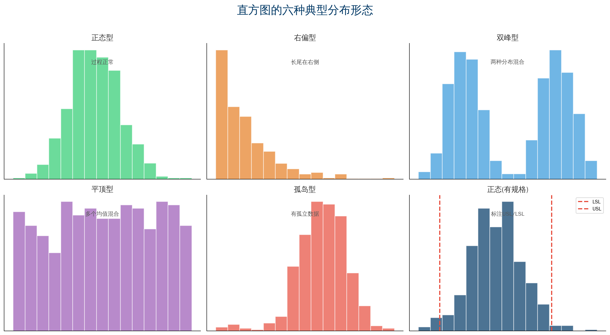
2.2 Six Typical Histogram Shapes
9/28

Slide 10
Chapter 3
Histogram Practical Cases
10/28

Slide 11
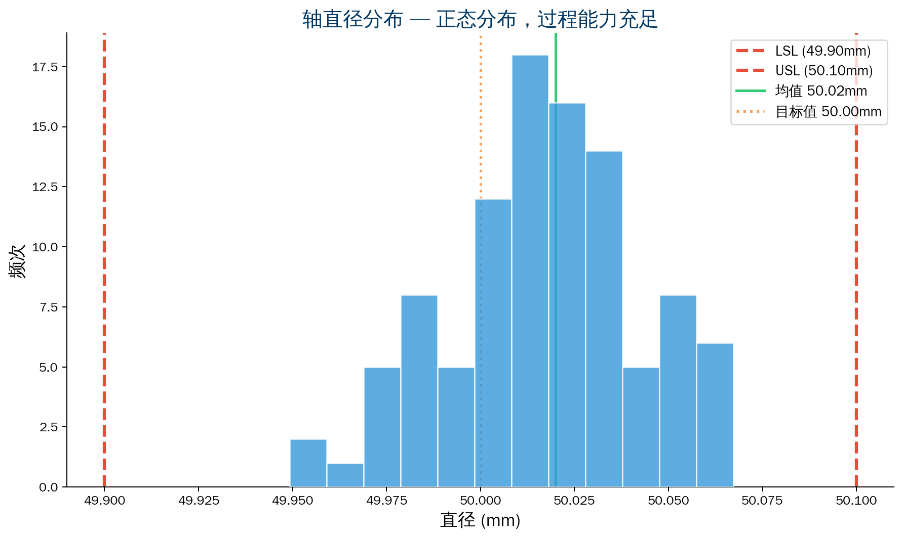
Case 1: Manufacturing — Shaft Diameter Distribution
Background: Turned shaft diameter
Spec φ50±0.1 mm
100 data points
Analysis: Normal distribution
Center 50.02 mm
All within spec limits
CPK≈1.2
Recommendation:
Target 50.00 mm
Allow margin for tool wear
11/28

Slide 12
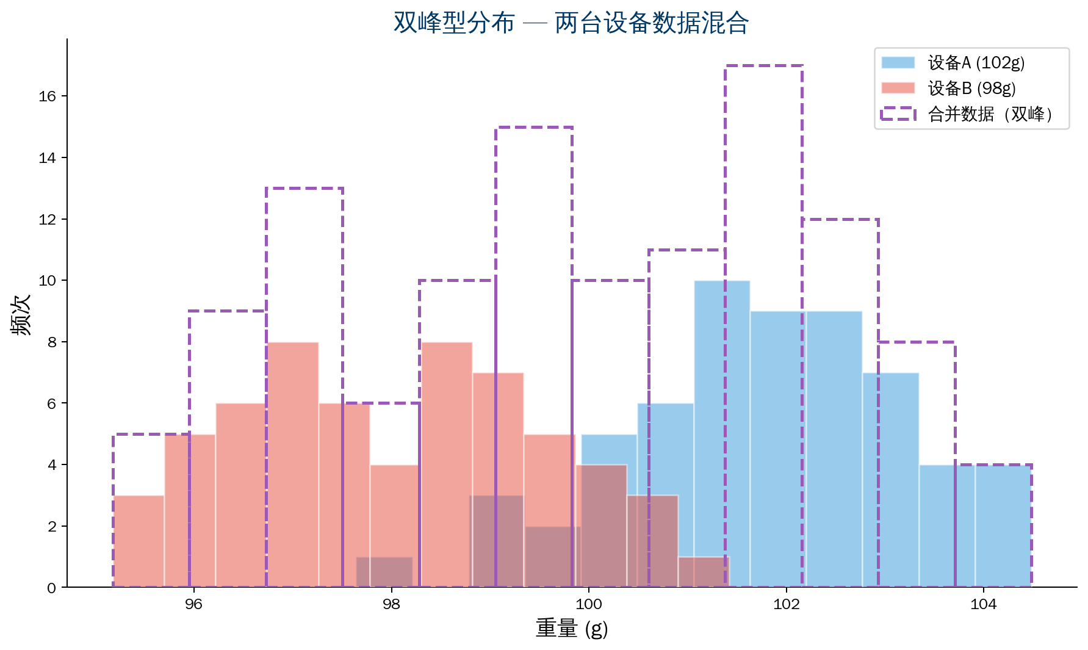
Case 2: Bimodal — Mixed Equipment
Background: Injection molded part weight
Histogram shows bimodal shape
Stratification analysis:
Machine A: average 102 g
Machine B: average 98 g
Root cause: different temperature settings
Action:
Standardize process parameters
Restore normal distribution
Case 4: Isolated Island
→ Measurement error found
→ Uncalibrated gauge
→ Retrain
Case 3: Skewed
→ Service wait time
→ Long-tail distribution
→ Set 15-minute alert
12/28

Slide 13
Case 3: Skewed + Case 4: Isolated Island
Case 3: Service — Skewed Wait Time Distribution
Case 4: Isolated Island — Measurement Error
Background: Bank teller wait time
→ Mostly 3–8 minutes
→ Few exceed 20 minutes
→ Classic "long-tail distribution"
Action:
→ Set 15-minute timeout alert
→ Add windows at peak hours
Background: Resistance measurement
Main body 100–105 Ω, normal
Three outliers at 95 Ω
Investigation: from new inspector
Used uncalibrated gauge
Action:
→ Recalibrate gauge
→ Retrain
→ Remeasure that lot
13/28

Slide 14
Chapter 4
Common Histogram Pitfalls
14/28

Slide 15
Five Common Histogram Pitfalls
Pitfall 1: Insufficient sample — 20 points hide true distribution
✓ Minimum 50; recommend 100+
Pitfall 2: Wrong number of bins
✗ 3–4 bins lose info; 20+ bins messy
✓ k=√n → 50 points→7 bins, 100→10 bins
Pitfall 3: No comparison to spec limits
✗ Ignore conformance
✓ Mark USL/LSL; judge process capability
Pitfall 4: Abnormal shapes not investigated
✗ Bimodal/island — look and forget
✓ Abnormal shape is a clue → stratify → root cause
Pitfall 5: Shape only, ignore sample size
✗ 30 points look "normal" — false comfort
✓ Large sample reliable; confirm with control chart first
15/28

Slide 16
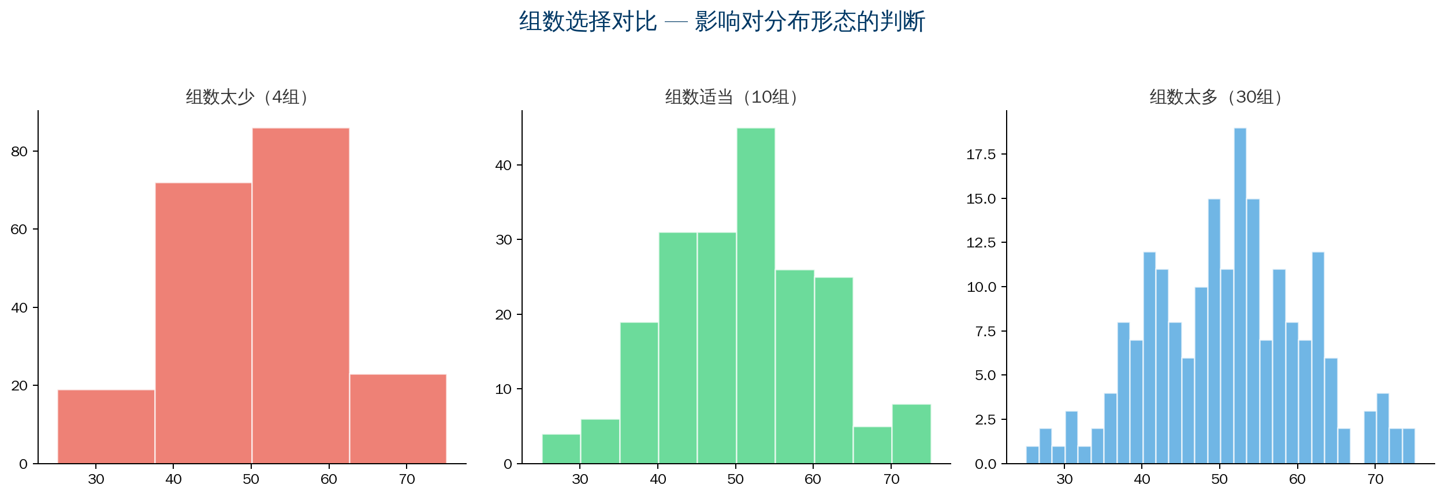
Pitfall 2 Detail: Impact of Wrong Bin Count
Too few bins → lost info Right count → clear shape Too many → cluttered
Rule of thumb: k = √n or k = 1 + 3.3lg(n)
16/28

Slide 17
Chapter 5
Histogram Combined with Other Tools
17/28

Slide 18
Histogram + Control Chart / Stratification / Normality Test / Capability
Histogram + Control Chart
Control chart → in control over time?
Histogram → static distribution shape
Histogram + Stratification
Overall histogram abnormal (e.g., bimodal) → stratify
Histogram finds "problem"; stratification finds "where"
Histogram + Normality Test
Histogram qualitative → normality test quantitative
Cpk calculation assumes normal distribution
Histogram + Spec Limits = Process Capability Index
Cpk = min(CPL, CPU) | Cpk≥1.33 adequate
18/28

Slide 19
5.4 Process Capability Indices (Cp/Cpk)
Prerequisites:
① Process in control (control chart confirmed)
② Data normally distributed (histogram confirmed)
CP = (USL - LSL) / 6σ
CPK = min(CPL, CPU)
Where CPL = (μ - LSL) / 3σ
CPU = (USL - μ) / 3σ
Criteria:
Cpk ≥ 1.33 → adequate capability
1.0 ≤ Cpk < 1.33 → acceptable; monitor
Cpk < 1.0 → inadequate; improve
19/28

Slide 20
Chapter 6
Advanced Histogram Uses
20/28

Slide 21
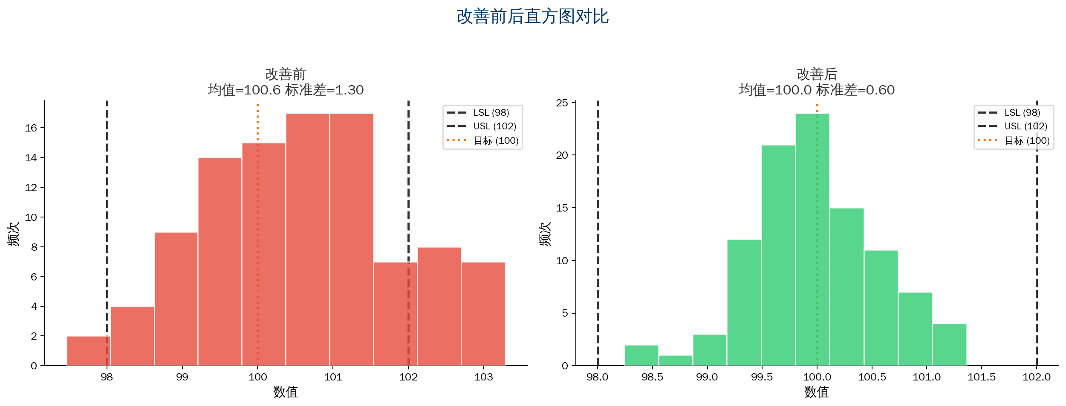
Advanced Histogram Uses
Advanced: histogram + spec limits | before/after | grouped histograms
One chart: shape + location + spread + capability
21/28

Slide 22
Chapter 7 — Histogram Evaluation Criteria
Evaluation Dimension | Good Standard | Poor Practice
Adequate sample | 100+ data points | Under 50
Reasonable bin count | Determine bins by formula | Too many or too few
Clear scale | Clear axis labels | Confusing scale; no units
Spec marked | Mark USL/LSL/target | No spec limits
Correct analysis | Combine shape, location, spread | Shape only, ignore location
Action output | Abnormal shapes investigated | Plot and forget
22/28

Slide 23
Summary
Histogram "Principle" and "Practice"
23/28

Slide 24
Summary: Histogram "Principle" and "Practice"
Practice (How to Plot)
Principle (Why Plot)
▸ Collect 100+ data points
▸ Determine bins and bin width
▸ Draw bars + mark spec limits
▸ Observe distribution shape
▸ Not "a pretty distribution chart"
▸ It is "see what hides behind
the average"
▸ It is "find problems in data,
find improvement direction in distribution"
Greatest value — expose the lie of averages
A manager focused only on averages may run a wildly unstable process — and think all is well
QTank
24/28

Slide 25
Thank You
qtank.org
QTank
qtank.org

