Slide 1
In-Depth Guide to the QC Seven Tools
Control Chart
From "After-the-Fact Analysis" to "Prevention"
QTank
Knowledge Code 5.2.4 · QC Seven Tools (Classic Seven QC Tools)
qtank.org

Slide 2
Contents
Chapter 1 Nature of Control Charts
Chapter 2 Control Chart Types and Selection
Chapter 3 Control Chart Practical Cases
Chapter 4 Common Control Chart Pitfalls
Chapter 5 Control Chart Combined with Other Tools
Chapter 6 Advanced Control Chart Uses
Chapter 7 Control Chart Evaluation Criteria
Summary: Control Chart "Principle" and "Practice"
2/28

Slide 3
Preface
"Every process varies — the key is whether you can tell:
normal variation or a problem?"
Prior five issues: problem analysis tools (after-the-fact)
This issue — control chart: real-time process monitoring (prevention)
Core value: from "after-the-fact analysis" to "prevention"
Don't wait for failure to analyze
Tell you when the process is about to fail
3/28

Slide 4
Chapter 1
Nature of Control Charts
4/28

Slide 5
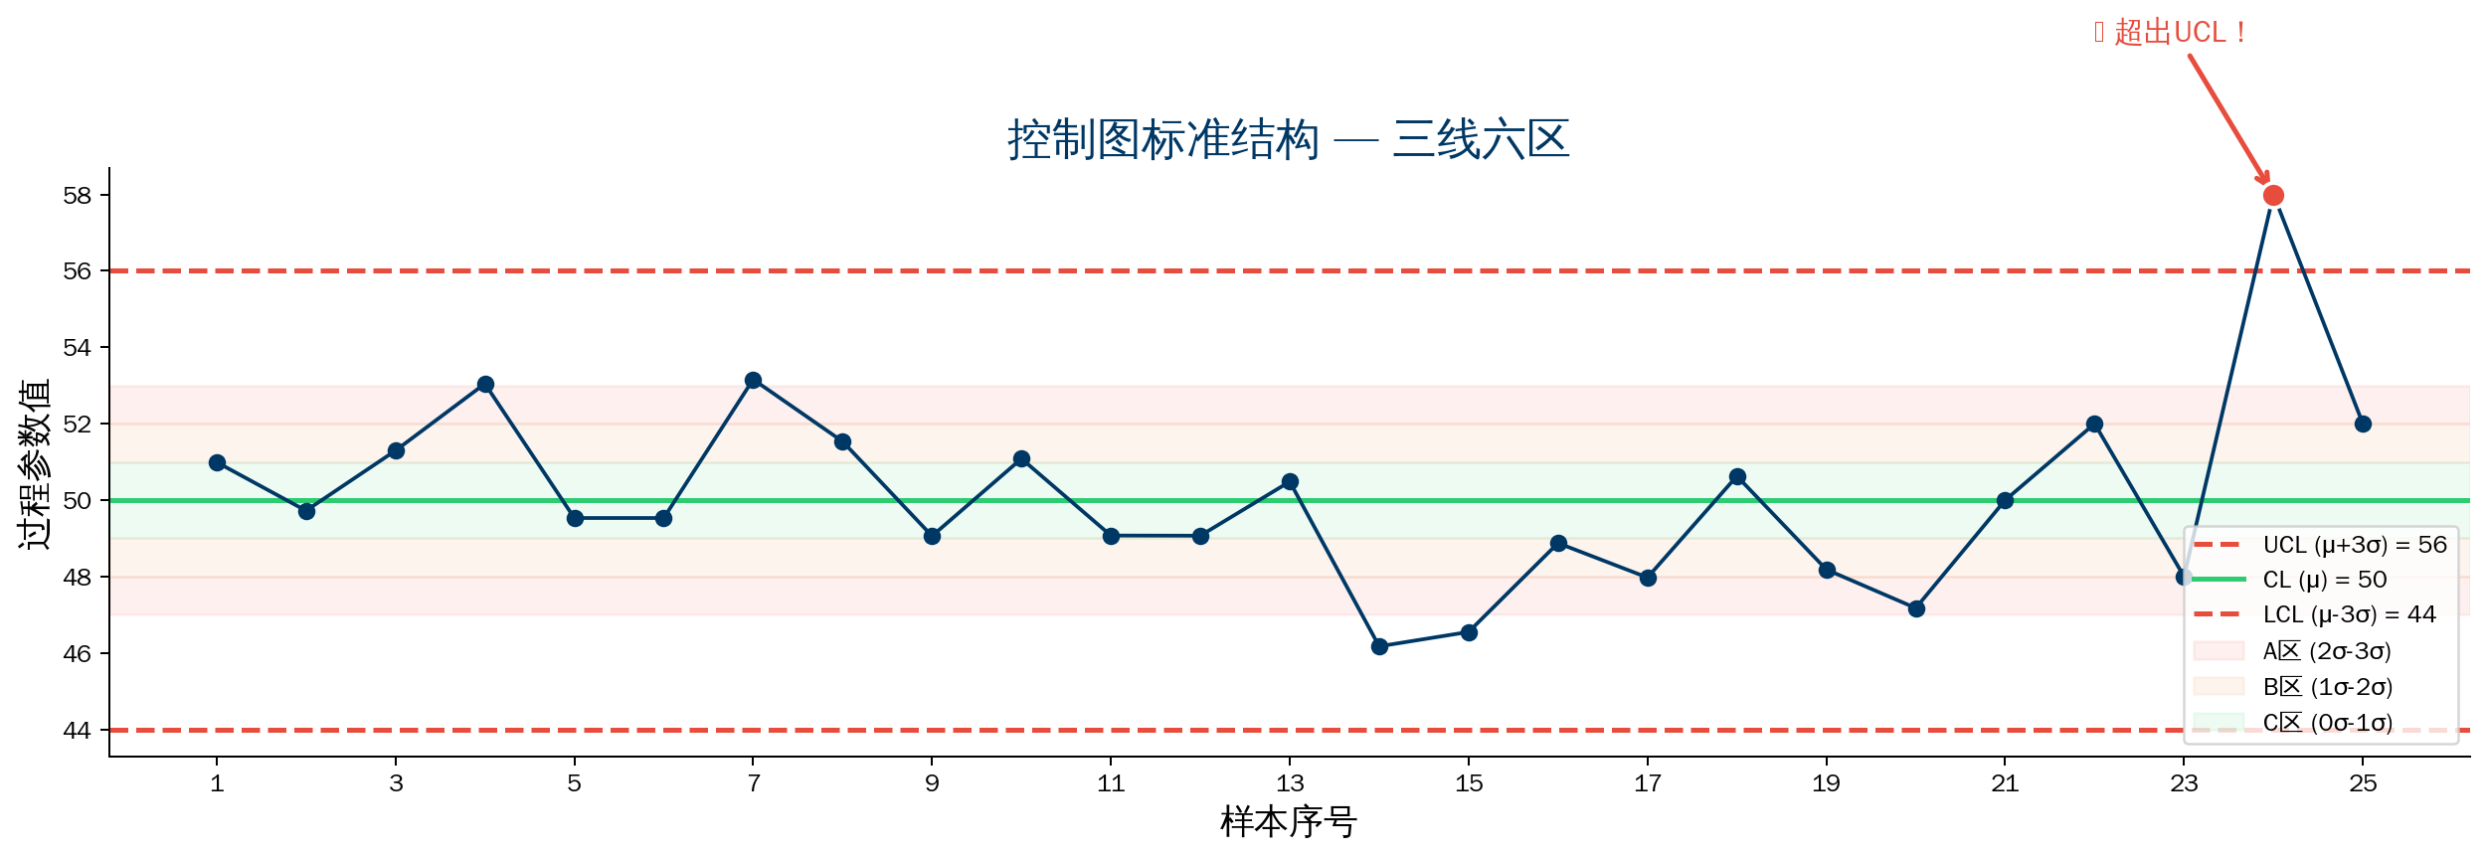
1.1–1.2 Control Chart Structure and Three Elements
5/28

Slide 6
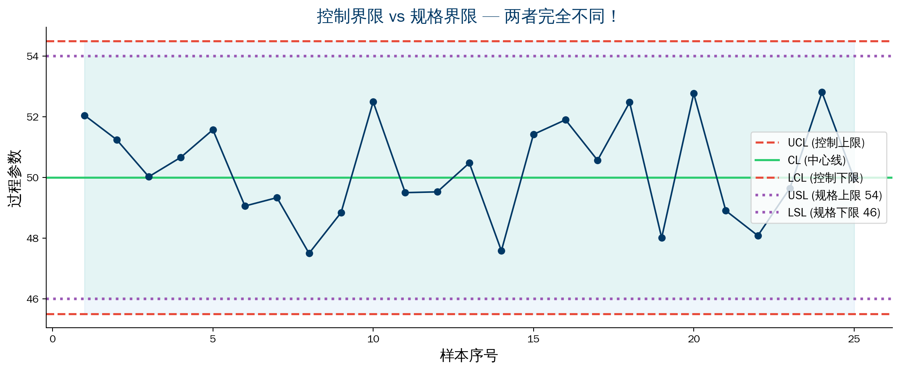
1.3 Control Chart vs Spec Limits
6/28

Slide 7
1.4 Three Purposes of Control Charts
Purpose | Description | Application
Process monitoring | Real-time judgment of process control | Continuous production, daily monitoring
Anomaly alert | Detect early signals of special causes | Process anomaly warning
Process improvement | Evaluate improvement effectiveness | Before/after comparison
Key insight:
Process in control ≠ product conforming
Product conforming ≠ process in control
Control chart watches the process; spec limits watch product conformance
7/28

Slide 8
Chapter 2
Control Chart Types and Selection
8/28

Slide 9
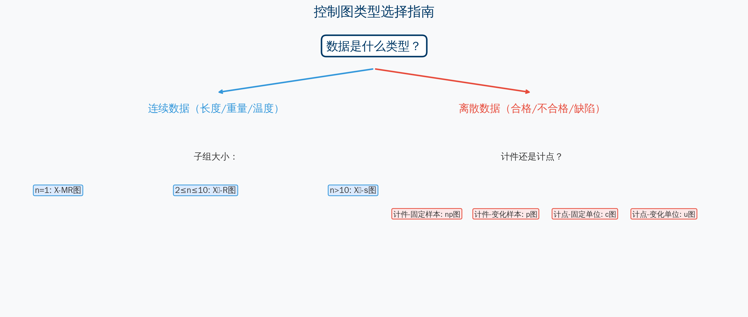
2.1–2.2 Control Chart Types and Selection
9/28

Slide 10
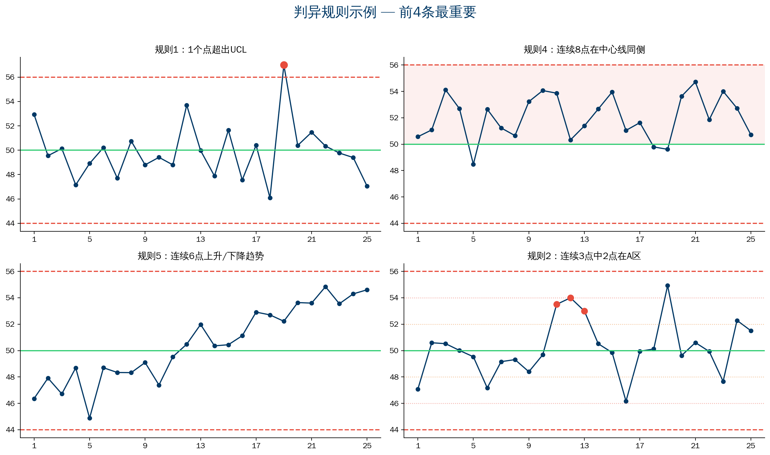
2.3–2.4 Stability Rules & Eight Out-of-Control Rules
10/28

Slide 11
Eight Out-of-Control Rules Explained
Rule 1: One point beyond UCL/LCL
→ Clear abnormality; investigate immediately
Rule 2: 2 of 3 consecutive points in Zone A
→ Mean starting to shift
Rule 3: 4 of 5 consecutive points beyond Zone B
→ Clear shift trend
Rule 4: 8 consecutive points on same side of center line
→ Mean has changed
Rule 5: 6 consecutive points rising/falling
→ Trend factor (e.g., tool wear)
Rule 6: 14 consecutive points alternating up/down
→ Two different processes alternating
Rule 7: 15 consecutive points in Zone C (±1σ)
→ Data may have been altered
Rule 8: 8 consecutive points outside Zone C
→ Possible stratification mix
11/28

Slide 12
Chapter 3
Control Chart Practical Cases
12/28

Slide 13
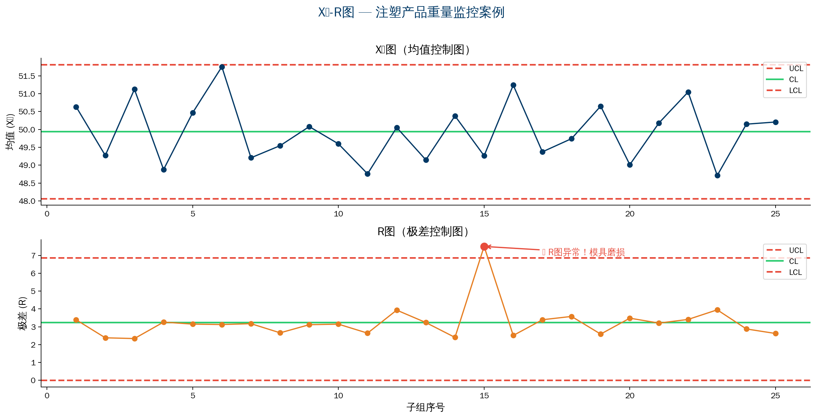
Case 1:X̄-RChart — Injection Molding Part Weight Monitoring
13/28

Slide 14
Cases 2–4: Other Control Chart Applications
Case 2: Individual-Moving Range Chart
Case 3: p Chart (Defect Rate)
Case 4: c Chart (Defect Count)
Precision machining; 1–2 parts per day
X-MR chart monitoring
MR chart rising consecutively
→ Tool gradually wearing
Replace early to avoid out-of-spec
SMT shop welding defect rate
Sample size varies daily
p chart UCL changes accordingly
Day 8 exceeded UCL
→ New operator on line
Recovered after enhanced training
Electroplating surface defect count
5 consecutive points above center line
→ Plating bath concentration change
Recovered after adjusting formula
Early signal of mean shift detected
14/28

Slide 15
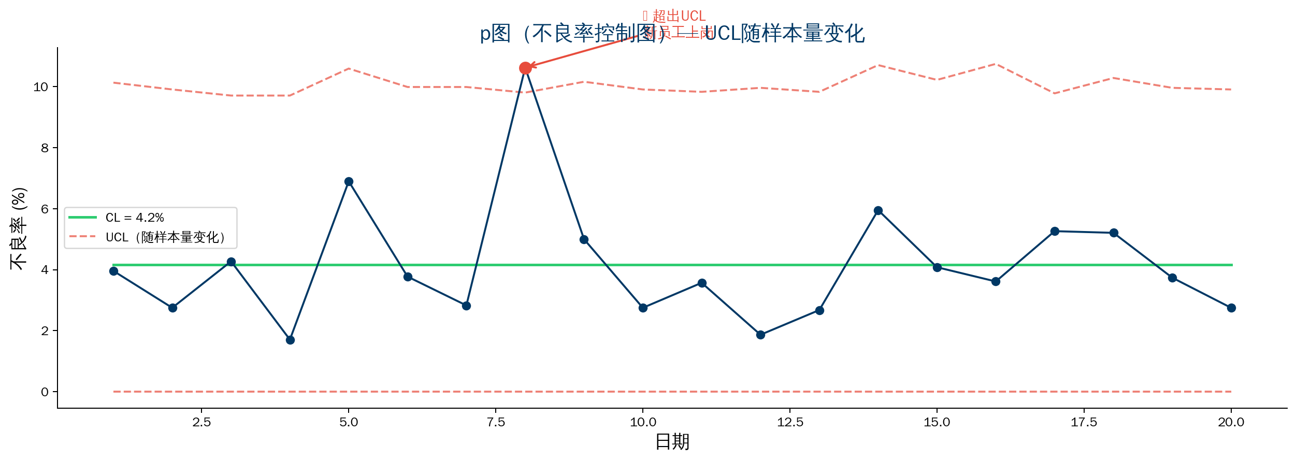
Case 3 Detail: p Chart — UCL Varies with Sample Size
15/28

Slide 16
Chapter 4
Common Control Chart Pitfalls
16/28

Slide 17
Five Common Control Chart Pitfalls
Pitfall 1: Treat control limits as spec limits
✗ "In control limits → product OK"
✓ Control limits = stability; conformance = spec limits
Pitfall 2: Out-of-limit points only; ignore patterns
✗ No out-of-limit = "process OK"
✓ Rising/same-side/cyclic patterns → all abnormal signals
Pitfall 3: Control chart before understanding process
✗ Start with control chart immediately
✓ Use histogram first; then build control chart
Pitfall 4: Control limits never updated
✗ First calculation fixed forever
✓ Recalculate periodically; limits narrow after improvement
Pitfall 5: Misuse of control charts
✗ Chart anything; chart with insufficient data
✓ At least 20–25 subgroups; time-ordered
17/28

Slide 18
Chapter 5
Control Chart Combined with Other Tools
18/28

Slide 19
Control Chart + Histogram / Stratification / Pareto / Scatter
Control Chart + Histogram
Histogram → control chart → Cpk → ongoing monitoring
Control Chart + Stratification
Control chart finds abnormal point → stratify → targeted fix
Control Chart + Pareto
Pareto finds vital few → control chart → real-time monitoring
Control Chart + Scatter
Control chart trend → scatter analyzes suspect variables → restore stability
💡 Combined thinking:
Control chart is the "alarm"; other tools are "diagnostics"
19/28

Slide 20
Chapter 6
Advanced Control Chart Uses
20/28

Slide 21
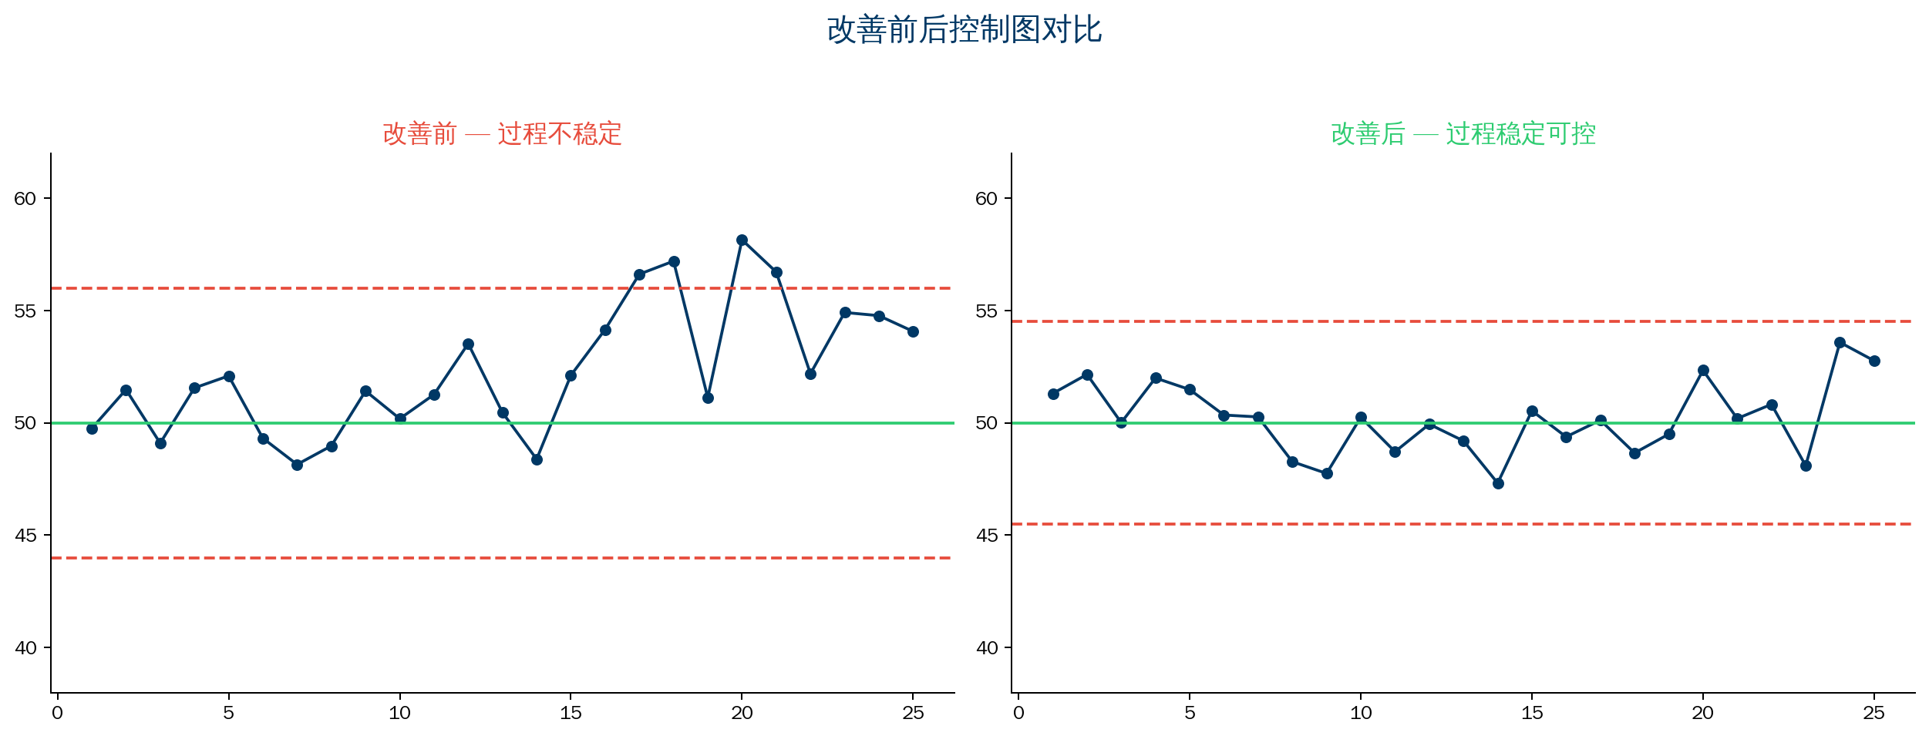
6.1 Before/After Control Chart Comparison
Before: unstable, abnormal points After: stable, narrower limits
21/28

Slide 22
6.2–6.3 Short-Run & Digital Control Charts
Short-run control charts (small lot, high mix)
→ Standardized data (Z), target charts, pre-control charts
Digital control charts (Industry 4.0)
→ MES/SCADA auto-collect process data
→ Real-time display on control chart
→ System auto-checks eight out-of-control rules
→ Auto-notify on abnormality
→ Link fishbone and scatter for root cause
💡 Digital = auto collect + auto detect + auto alert + auto analyze
22/28

Slide 23
Chapter 7 — Control Chart Evaluation Criteria
Evaluation Dimension | Good Standard | Poor Practice
Sufficient data | 20–25 subgroups for control limits | Fewer than 10 subgroups
Type selection | Choose by data type and subgroup size | Wrong chart type
Correct interpretation | Combine with out-of-control rules | Out-of-limit points only
Timeliness | Real-time or regular update | Chart only after the fact
Action taken | Investigation and improvement records on abnormality | Abnormality not investigated
Update frequency | Control limits recalculated periodically | Limits never change
23/28

Slide 24
Summary
Control Chart "Principle" and "Practice"
24/28

Slide 25
Summary: Control Chart "Principle" and "Practice"
Practice (How to Use)
Principle (Why Use)
▸ Choose correct chart type
▸ Calculate control limits correctly
▸ Plot in time order
▸ Apply out-of-control rules
▸ Not "a chart with control lines"
▸ It is "turn after-the-fact analysis into
prevention"
▸ It is "before the process fails,
detect the signal"
Greatest value is not "monitoring" but "prediction"
From "firefighting" to "fire prevention" — before the first defect, the process signals trouble
QTank
25/28

Slide 26
Thank You
qtank.org
QTank
qtank.org

