Slide 1
SPC statistical process control practical training (including Minitab operation)
From basic statistics to control chart application, process capability analysis (CPK/PPK), exception handling, with MINITAB practical videos and practice data
QTank
Knowledge No. 6.3.1 · Control Chart Selection and Discrimination
qtank.org

Slide 2


Table of contents
  SPC basics and statistical principles
  Control Chart Principles and Applications
  Process capability analysis in practice
  Process exception analysis and handling
  Minitab practical drill
  Comprehensive case practice
CONTENTS

Slide 3

Part.
01
SPC basics and statistical principles

Slide 4
SPC definition and core role
process capability quantification
Quantify process capabilities by calculating indicators such as CPK and PPK to provide data support for quality improvement and help companies achieve Six Sigma management levels.
Quality Prevention Tools
decision support system
The core role of SPC is to shift from passive detection to active prevention, discover potential problems in advance through control charts and other tools, and reduce the production of defective products and quality costs.
SPC data provides management with an objective basis for decision-making, avoiding judgment based on experience and realizing a data-driven quality management model.
03
02
04
statistical process control definition
Basics of continuous improvement
SPC is a method of real-time monitoring of the production process through statistical analysis technology, aiming to identify abnormal variations and take corrective measures to ensure that the process is stable and controlled.
SPC is a key tool in the Check phase of the PDCA cycle, providing a visual feedback mechanism for continuous improvement.
01
05

Slide 5
Analysis of process variation types and causes
common cause variation
special cause variation
trend variation
periodic variation
Random fluctuations
inherent process variation
not attributable to a specific cause
Abnormal fluctuations with “identifiable causes” requiring immediate intervention
Progressive Offset
Tool Wear
Material Aging
Seasonal Fluctuations
Shift Differences
Environmental Cycles
Improvement strategies: process optimization
Improvement strategies: root cause analysis
Improvement strategies: preventive maintenance
Improvement Strategies: Pattern Recognition
1
Adjust equipment parameters
Optimize process parameters
1
5Why analysis method
Fishbone diagram analysis
1
Regular equipment maintenance
Establish replacement standards
1
Time Series Analysis
Spectral Analysis
2
Use error-proofing techniques to reduce human intervention
2
Implement control charts
Establish alarm mechanism
2
SPC Monitoring
Predictive Maintenance
2
Adjust control limits
stratified analysis
Identify improvement opportunities through variation analysis to improve process stability and capability index

Slide 6
Normal distribution and basic statistics
01
02
03
Normal distribution characteristics
central limit theorem
Statistics calculation
The bell-shaped symmetrical curve is completely determined by the mean μ and the standard deviation σ, covering the practical application scenarios of 68-95-99.7% of the rules of thumb.
Regardless of the original distribution shape, the sample mean distribution approaches a normal distribution as the sample size increases, which is the theoretical basis of control charts.
Describe in detail the calculation formulas for statistics such as mean, range, moving range, standard deviation and their implementation paths in Minitab.
04
05
06
Distribution pattern diagnosis
Non-normal data processing
Prerequisites for process capability analysis
Verify the normality of the data through normal probability plots, Anderson-Darling tests and other methods to guide the selection of subsequent analysis methods.
For skewed/kurtotic data, we introduce normalization processing methods such as Box-Cox transformation and Johnson transformation and the key points of Minitab operation.
Emphasis is placed on the impact of the three prerequisites of normality testing, stability verification, and data independence on the accuracy of process capability analysis.

Slide 7
Part.
02
Control Chart Principles and Applications

Slide 8
Control chart types and selection criteria
Measurement type control chart
Count control chart
Data distribution analysis
It is suitable for continuous variable data, such as size, weight, temperature, etc., and is preferred when the data obeys a normal distribution and the sample size is small.
It is suitable for discrete variable data, such as number of defects, defective product rate, etc. It can be divided into P chart, U chart and C chart according to the data type.
A normality test needs to be performed before selecting a control chart. Non-normal data needs to be converted or a non-parametric control chart should be selected.
Sample size considerations
Matching process characteristics
multivariable control chart
For large samples, it is recommended to use the Xbar-S chart instead of the Xbar-R chart, while for small samples, the I-MR chart is preferred.
The I-MR chart is suitable for short-term process fluctuation analysis, and the Xbar-R chart is suitable for long-term process stability monitoring.
When there are multiple relevant quality characteristics, multiple control methods such as T² control charts need to be used.

Slide 9
Metering type control chart (Xbar-R, I-MR)
  Advantages of Xbar-R graph: Suitable for small sample sizes, capable of simultaneously monitoring process center and discreteness, simple calculation, and low implementation cost.
  Xbar-S chart applicability: Suitable for large sample sizes, using standard deviation instead of range for more accurate variability monitoring.
  I-MR chart features: Suitable for single measurement value or high-cost detection, monitoring adjacent sample fluctuations through moving range.
  The difference between P chart and C chart: Chart P monitors the rate of defective products, chart C monitors the number of defects per unit product, and is suitable for different discrete data scenarios.
  Control chart selection principles: Select the appropriate control chart type based on data type, sample size, testing costs, and sources of process fluctuations.
  Practical application cases: The Xbar-R chart is used for battery core winding tightness testing, and the I-MR chart is used for steel composition analysis in spectroscopic laboratories.
Control chart type | Applicable scenarios | Main features
Xbar-R plot | The sample size of the subgroup is small (2-9), and both the mean and variability need to be monitored | The calculation is simple, the implementation cost is low, and it can reflect the process center and discrete degree.
Xbar-S diagram | Subgroup sample size is large (≥10) and variability needs to be monitored more accurately | Use standard deviation instead of range, suitable for large sample sizes
I-MR chart | Single measurement values ​​that cannot be grouped, such as liquids, gases or homogeneously mixed materials | Monitor adjacent sample fluctuations through moving range, suitable for high-cost or time-consuming inspections
P picture | Monitor the rate of defective products, suitable for discrete data | Visually display changes in the rate of unqualified products, suitable for quality monitoring
C picture | Monitor the number of product defects per unit, suitable for scenarios where the number of defects is fixed | Directly reflects changes in the number of defects and is suitable for production processes with a fixed number of defects.

Slide 10
Count type control chart (P, U, C chart)
P picture application scenarios
Features of U diagram
To monitor the proportion of unqualified products, the sample size is required to be fixed or change no more than ±25%, and the control limits are in a zigzag shape.
Tracking the number of unit defects is suitable for situations where the sample size fluctuates greatly, and the standardized defect rate needs to be calculated.
Applicable conditions for Figure C
Binomial distribution and Poisson distribution
The defect number control chart requires the inspection area to be fixed, such as the welding defects of each circuit board.
The P chart is based on the binomial distribution, and the U/C chart is based on the Poisson distribution, and the distribution assumptions need to be verified.
Overdispersion
Minitab implementation path
When the actual variation is greater than the theoretical variation, the Laney P' or U' chart needs to be used to adjust the control limits.
Statistics → Control Chart → Attribute Control Chart, you need to distinguish between "defect" and "defective product" data types.

Slide 11

Eight criteria for judging differences in control charts
01
Principle 1
Point outside control limits: When a data point falls outside the control limits, it indicates special cause variation in the process.
criteria
02
Principle 2
7 consecutive points on the same side: 7 consecutive points on the same side of the center line, indicating a shift in the process mean.
03
Principle 3
contrast
fact
Continuous rise/fall: 6 consecutive points show a monotonic rising or falling trend, indicating that there is drift in the process.

Slide 12
Part.
03
Process capability analysis in practice

Slide 13

Concept analysis of Cp/Cpk and Pp/Ppk
Cp/Cpk definition
1
Cp (process capability index) describes the potential ability of a process to meet product quality specification requirements, and it takes into account the inherent variation of the process; Cpk (process capability index considers deviation) further considers the deviation between the process mean and the specification center value, and is a more comprehensive process capability evaluation index.
Pp/Ppk definition
2
Pp (process performance index) is similar to Cp, but it is calculated based on long-term data and reflects the actual performance of the process over a longer period of time; Ppk (process performance index considering offset) also considers the offset of the process mean and the specification center value, and is an important indicator for evaluating the long-term stability of the process.
The difference between Cp and Pp
3
The main difference between Cp and Pp is that the data basis is different. Cp is based on short-term data, reflecting the potential capability of the process under control; while Pp is based on long-term data, taking into account the actual performance of the process under the influence of various factors, and can better reflect the true situation of the process.

Slide 14

Concept analysis of Cp/Cpk and Pp/Ppk
Cp/Cpk application scenarios
Cp/Cpk is mainly used to evaluate whether a new or improved process meets product quality requirements and helps determine whether the process needs further adjustment or optimization. At the same time, they are also important indicators in process audit and certification, used to prove that the process has the ability to stably produce qualified products.
The difference between Cpk and Ppk
Cpk and Ppk are similar in accounting for offsets, but have different data bases. Cpk is based on short-term data and is used to evaluate the ability of the process in a controlled and stable state; Ppk is based on long-term data and can better reflect the performance of the process in actual operation, including possible offsets and fluctuations.
Pp/Ppk application scenarios
Pp/Ppk is more suitable for evaluating the long-term stability and performance of existing processes and helping to identify possible long-term problems or trends in the process. By regularly calculating the Pp/Ppk value, you can monitor the performance changes of the process, discover and take measures to prevent potential quality problems in a timely manner.

Slide 16
Directions for improvement of insufficient abilities
Optimize control strategy:
Cpk is low
Improve data quality:
Adjust parameters:
Insufficient Cp
Data anomaly
Calibration equipment:
Analyze key parameters through Minitab and adjust the process window to make the process capability index reach the target value.
Regularly calibrate the measurement system to eliminate the impact of MSA errors on process capability analysis.
Filter data:
Update criteria:
Use Minitab to test the normality of the data, and then calculate the capability index after eliminating outliers.
Revise the operation standard book based on the process capability analysis results to ensure that the process parameters are reasonable and controllable.
Improvement measures
Parameter offset problem:
Problems with excessive variation:
Identify significant shifts in key parameters through hypothesis testing and adjust process center values ​​accordingly.
root cause analysis
Use variance analysis to locate the source of variation, and reduce process fluctuations through DOE experimental optimization.

Slide 17
Part.
04
Process exception analysis and handling

Slide 18


Special cause identification method
control chart method
Hypothesis testing method
Use control charts to monitor process data in real time, and identify special causes by observing whether data points exceed control limits or present non-random distribution, such as points out of bounds, several consecutive points on the same side of the center line, trend changes, etc.
Based on statistical principles, hypothesis testing is performed on process data, such as t-test, variance analysis, etc., and by comparing the differences between actual data and theoretical distribution or expected values, it is determined whether there are abnormal fluctuations caused by special reasons.
Cause and Effect Diagram (Fishbone Diagram) Method
By drawing a cause-and-effect diagram, the problem is taken as the result, and the possible causes are analyzed from multiple aspects such as people, machines, materials, methods, and environment, and the special reasons for the abnormal process are found out one by one.

Slide 19
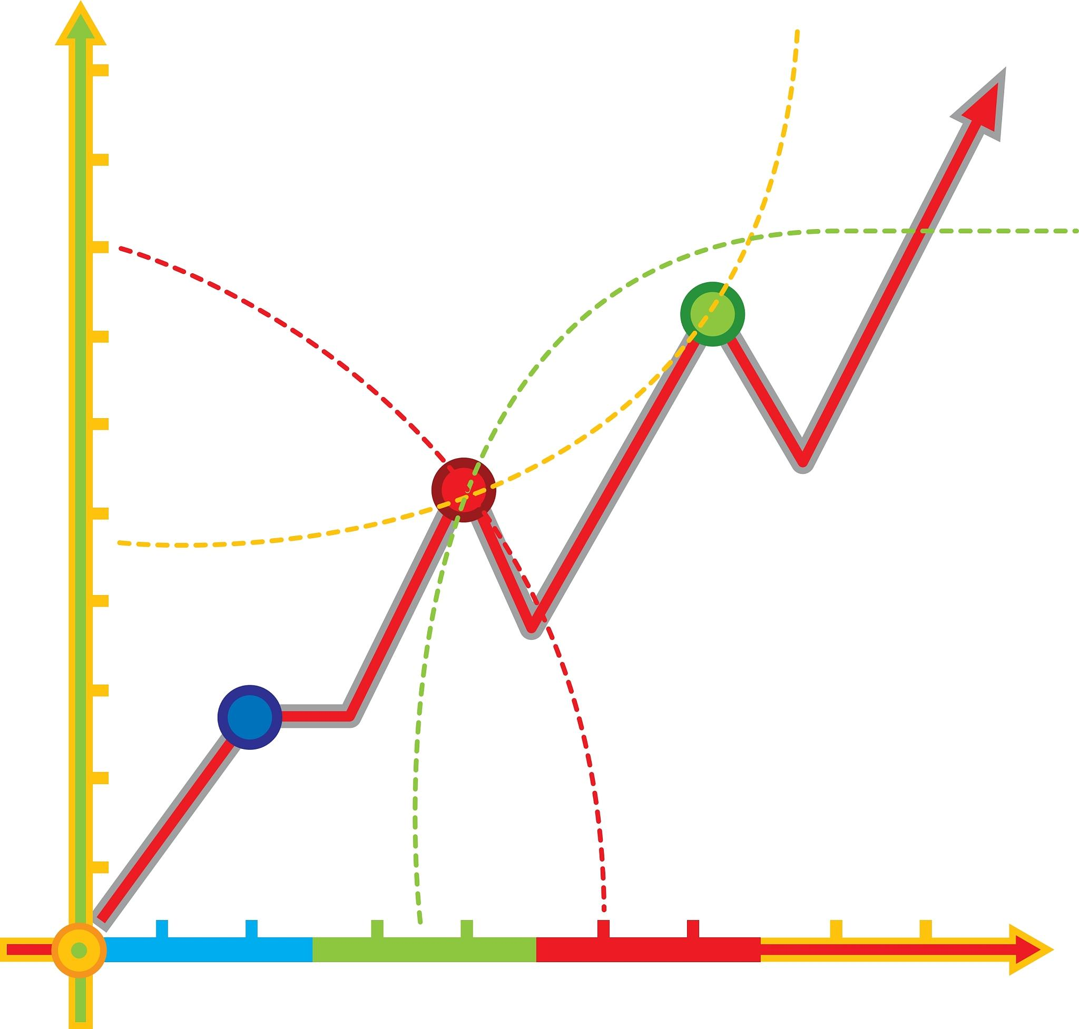
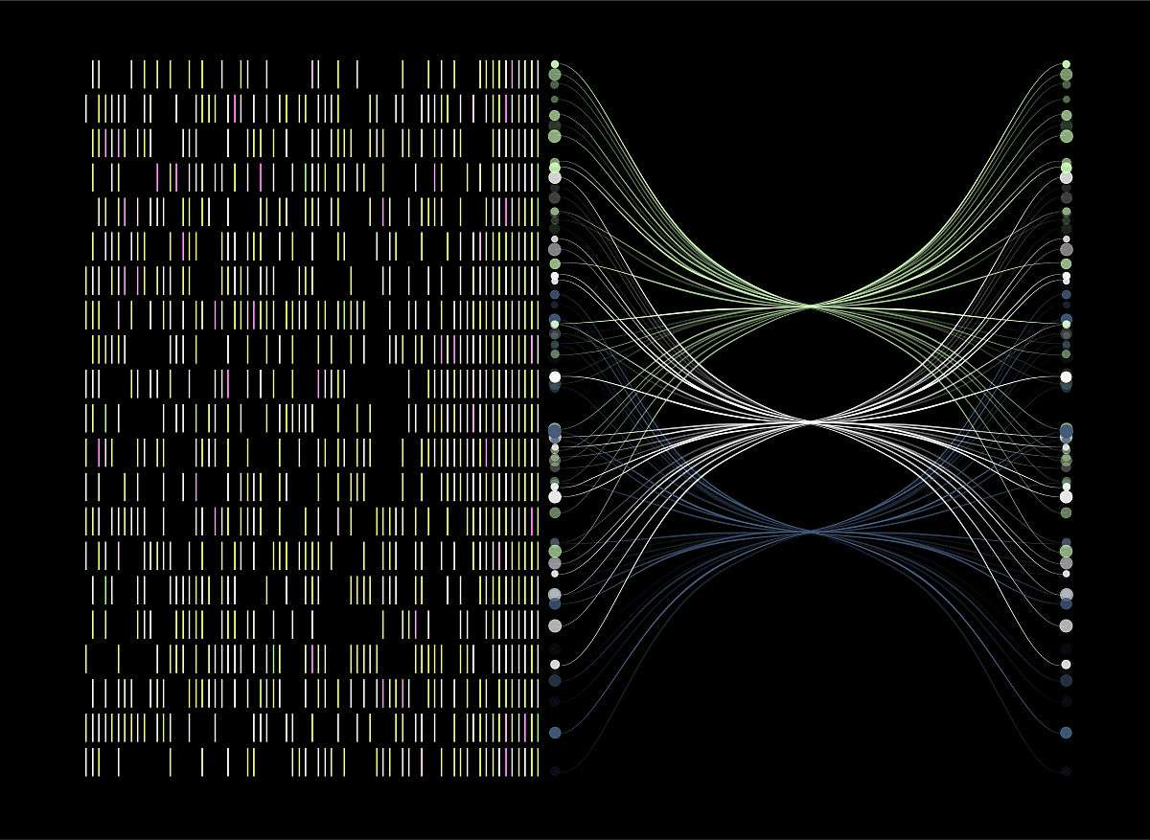

Special cause identification method
Scatter plot method
regression analysis
experimental design method
Use a scatter plot to show the relationship between two variables. By observing the distribution shape and trend of the scatter points, you can determine whether there are correlation changes caused by special reasons, and then identify the cause of the anomaly.
By establishing a regression model, we analyze the relationship between independent variables and dependent variables, and use the difference between model predicted values ​​and actual values ​​to identify whether there are abnormal fluctuations caused by special reasons and further locate the causes.
By designing reasonable experimental plans, making planned changes to process parameters and observing changes in process output, we can identify special causes that have a significant impact on process stability and provide the basis for subsequent improvements.

Slide 20
Exception root cause analysis tool
01
02
03
04
05
5Why analysis method in practice
Fishbone diagram (characteristic factor diagram) drawing
Failure Modes and Effects Analysis (FMEA)
Hypothesis testing toolset
Three-dimensional parameter optimization design
By continuously asking "why" at five levels, we can penetrate the superficial phenomena and get to the root causes. We need to cooperate with on-site verification to prevent logical deviations.
Use Minitab's graphical tools to build a cause-and-effect analysis framework that includes six dimensions: human, machine, material, method, environment, and measurement.
Quantitatively evaluate the severity, frequency and detection of potential failure modes, and calculate the risk priority number RPN to guide the direction of improvement.
Flexibly use statistical methods such as two-sample t-test, analysis of variance (ANOVA), and chi-square test to verify root cause hypotheses.
Establish a mathematical model of key parameters and quality characteristics through response surface method (RSM) to find the optimal parameter combination window.

Slide 21
Corrective actions and preventive mechanisms
Anomaly analysis
prevention mechanism
Identify abnormal data points, analyze root causes, and develop targeted improvement plans.
Improve FMEA analysis to identify potential failure modes and impacts in advance.
01
Establish a quick response mechanism to adjust process parameters in a timely manner to prevent problems from expanding.
Establish an SPC early warning system to monitor key quality characteristics in real time.
01
02
Optimize control plans, improve work instructions, and reduce mutation risks.
personnel
Regularly review control charts to identify trend changes and intervene in advance.
02
data
03
Strengthen personnel training, improve operational standardization, and reduce human errors.
Standardize best practices and form a library of error-proofing technical documents.
03
technology
04
Implement continuous monitoring to verify the effectiveness of measures and ensure process stability.
system
Carry out process capability research and continuously optimize process parameter settings.
04

Slide 22
Part.
05
Minitab practical drill

Slide 23

Data import and preprocessing skills
Data import method selection
According to the data source and format, choose the appropriate data import method, such as importing from Excel, CSV, TXT and other files, or directly connecting to the database to import data to ensure that the data enters the Minitab worksheet accurately.
Data cleaning and outlier processing
Use Minitab's data filtering and sorting functions to identify and process outliers, missing values, and duplicate values ​​in the data, and ensure data quality through replacement, deletion, or interpolation, laying the foundation for subsequent analysis.
Data format conversion and standardization
According to the analysis needs, the necessary format conversion is performed on the data, such as date format, text format, etc. At the same time, the data is standardized to eliminate the dimensional impact, so that different variables are comparable and the accuracy of the analysis is improved.

Slide 24



Data import and preprocessing skills
Data sorting and merging techniques
Master the data splitting function in Minitab to split a column of data into multiple columns according to specific rules to facilitate subsequent analysis. At the same time, use the data merging function to merge multiple data tables according to common fields to achieve data integration and association.
Data screening and sampling methods
According to the purpose of analysis, flexibly use Minitab's data filtering function to extract data subsets that meet specific conditions. In addition, master data sampling methods, such as simple random sampling, stratified sampling, etc., to extract representative samples from a large amount of data for analysis.
Data preprocessing automation script
In order to improve the efficiency of data preprocessing, you can write Minitab scripts to automate data import, cleaning, conversion and other steps to reduce repeated operations. At the same time, standardize data preprocessing through scripts to ensure consistent data quality each time processed.

Slide 25
Control chart automatic generation operation
Mean-Range Control Chart (Xbar-R)
Individual Value-Moving Range Chart (I-MR)
Defective product rate P chart
Select the subgroup capacity in "Statistics-Control Chart-Variable Control Chart of Subgroup", automatically calculate CL/UCL/LCL and mark the exceeding limit points.
For continuous production scenarios, real-time monitoring charts are generated through "single-value variable control charts", and the process offset alarm function is linked.
Set the sample size and number of defects in the "Attribute Control Chart" to automatically calculate proportional control limits and identify special cause variation patterns.
multivariable control chart
Custom rule configuration
Through the "Multivariable Control Chart" module, joint monitoring of relevant parameters is realized, and T² statistics are used to detect multivariate process anomalies.
Set 8 major Western Electric rules in "Options-Inspection" to automatically mark abnormal patterns such as continuous 7-point rise/periodic fluctuation.

Slide 26
Process capability analysis implementation
Normal Process Capability Analysis
Short term/long term capability comparison
Use "Statistics-Quality Tools-Capability Analysis-Normal" to calculate Cp/Cpk/Pp/Ppk, and output a comparison report between potential capabilities and actual capabilities.
Distinguish between σwithin and σoverall through "between/within group" variance decomposition to evaluate process stability and room for improvement.
Non-normal data transformation
Normalize skewed data through "Johnson transformation" or "Box-Cox transformation", and select the optimal fitting distribution in the "Individual Distribution Identification".
Target value deviation analysis
In the "Capability Six Pack", the offset between the process center and the specification center is displayed, and the Sigma level and DPMO value are calculated.
Binomial Distribution Power Analysis
For the defective product rate data, "binary capability analysis" is used to calculate the Z benchmark value and confidence interval, and visualize the DPU/DPO index.

Slide 27
Results visualization and report output
Dynamic chart interaction
Supports click-drilling on control charts to view subgroup details, and the right-click menu can add reference lines/adjust axis ranges/switch display dimensions.
Real-time Kanban configuration
Save key control charts as "Preferences-Dashboard" to realize automatic refresh of multi-indicator monitoring views and email alerts.
Customized report generation
Use the "Report-Create Report" function to combine control chart/capability analysis/histogram and other elements to automatically generate PDF/HTML format documents.
Data export standardization
Supports exporting analysis results in ASQ/ISO format, including complete metadata annotations and calculation process traceability information.
3D process capability diagram
The spatial distribution of LSL/USL/Target is displayed in the "Graphic-3D Scatter Plot" to visually present the risk of process deviation.

Slide 28
Part.
06
Comprehensive case practice

Slide 29
Manufacturing process control case
Injection molding parameter optimization
Welding strength stability analysis
Monitor key parameters such as melt temperature and injection pressure through SPC to identify the root causes of process variation, analyze the Cp/Cpk value with Minitab, and optimize the process window to reduce product warpage defects.
Collect weld strength data, use control charts to determine whether the process is under control, develop a welding gun maintenance plan for special causes of variation, and improve welding consistency.
Assembly line dimensional tolerance monitoring
Improved coating thickness uniformity
Reduced defective rate of stamping parts
Implement Xbar-R chart real-time monitoring of key assembly dimensions, conduct normality testing and process capability analysis through Minitab, and reduce the rework rate by more than 15%.
Based on the histogram and Pareto chart, the nozzle wear problem of the spraying equipment was identified, and the thickness CPK was increased from 0.8 to 1.33 after adjusting the air pressure parameters.
Through hierarchical analysis of defect types, the locked mold gap is the key factor. After optimization using DOE experiments, the defective rate was reduced from 5% to 0.7%.

Slide 30
Continuous improvement project implementation
Improvement measures: Skill strengthening
Improvement measures: system optimization
Special SPC training: organize practical training such as control chart interpretation and process stability analysis to improve the team's sensitivity and response speed to variation signals
Minitab collaboration: Establish a shared analysis template library to achieve real-time synchronization of control chart data and multi-position collaborative analysis through the central database
Teamwork
Conduct process capability analysis training for the current production process, master CP/CPK calculation and interpretation methods, and learn to use control charts to identify sources of process variation.
process capability
Automated analysis: Use Minitab macro commands to automatically generate process capability reports and establish a real-time monitoring system to reduce manual analysis errors
Carry out SPC data collection training, guide team members to formulate measurement plans, determine reasonable sampling frequencies, and master the identification methods of special causes and common causes.
data collection
Minitab application: Use Minitab for data entry and outlier screening, and establish standardized data collection templates to ensure the stability of the measurement system

Slide 31
Practice data analysis after class
Case 1
Case 2
Case 3
Thread aperture stability: 300 sets of aperture measurement data are provided, and students are required to complete stability analysis, process capability calculation and inference of root causes of abnormal points.
Battery voltage consistency: Contains voltage test data of 5 production lines. It is required to use box plots to compare differences in production lines and design improvement plans.
Packaging weight compliance: simulate FDA audit scenarios and generate reports based on 2,000 pieces of weight data, including trend analysis, traceability of out-of-standard batches and corrective measures.
Case 4
Case 5
Case 6
Heat treatment hardness distribution: Different heat hardness values ​​are given to guide students to complete normality conversion, control weight limit calculation and long-term process performance evaluation.
Stamping speed impact analysis: including paired data of speed parameters and dimensional deviations, practicing regression analysis and interaction diagram drawing.
Cleanliness testing data: For particle count data, teachers use Poisson distribution control charts to monitor and formulate cleaning standard optimization suggestions.

Slide 32
thanks for listening
qtank.org
QTank
qtank.org

