Slide 1
Quality management general training
From cognition to practice, build a quality defense line that everyone participates in. Compulsory training for all employees · Quality starts with cognition
QTank
Knowledge No. 13.3.3 · Positive incentives and accountability boundaries
qtank.org

Slide 2
01
quality perception
P03-P07
Understand the connotation, cost and evolution of quality
02
Quality management system
P08-P14
ISO 9001 System framework and process approach
CONTENTS
03
Quality Tools and Methods
P15-P19
QCSeven tools and5Smanage
course
Table of contents
Quality responsibility of all employees
P20-P24
04
Role responsibilities, red lines and problem escalation
05
Continuous improvement and quality culture
P25-P28
5Why、8Dand quality culture construction
06
Summary and Action
P29-P30
six chapters
Build a complete understanding of quality
Review of key points and action suggestions for the entire course
Quality management general training
02 / 30

Slide 3
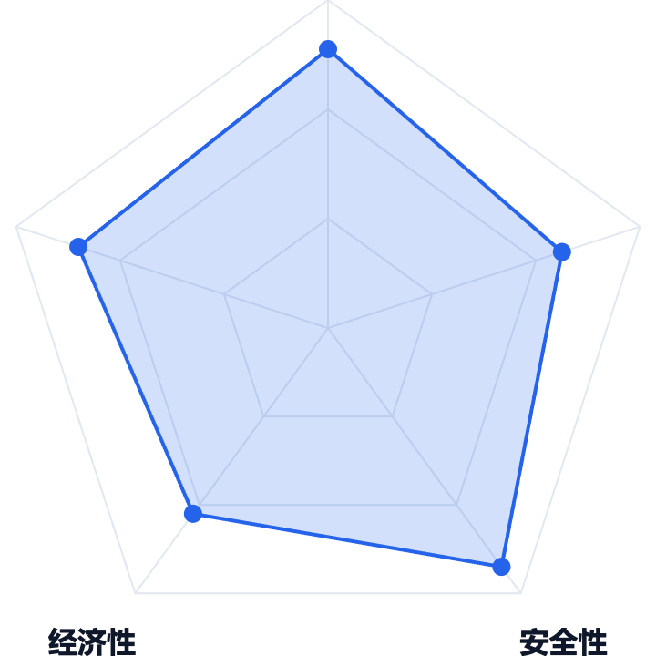



CHAPTER 01 · quality perception
What is quality? —— Definition and multi-dimensional connotation
The five-dimensional connotation of quality
ISO 9001 Standard definition
Quality is a set ofinherent characteristicssatisfydegree of requirement。
quality is not"good"A vague feeling, but a measurable, comparable and improveable yardstick.
It runs through every aspect of products, processes, and services.
Three core perspectives
customer perspective
Meet stated and implicit needs so customers are willing to pay
organizational perspective
Stable process, leading efficiency, and controllable risks
social perspective
Compliance, safety, sustainability, and responsibility to stakeholders
Quality management general training
03 / 30

Slide 4
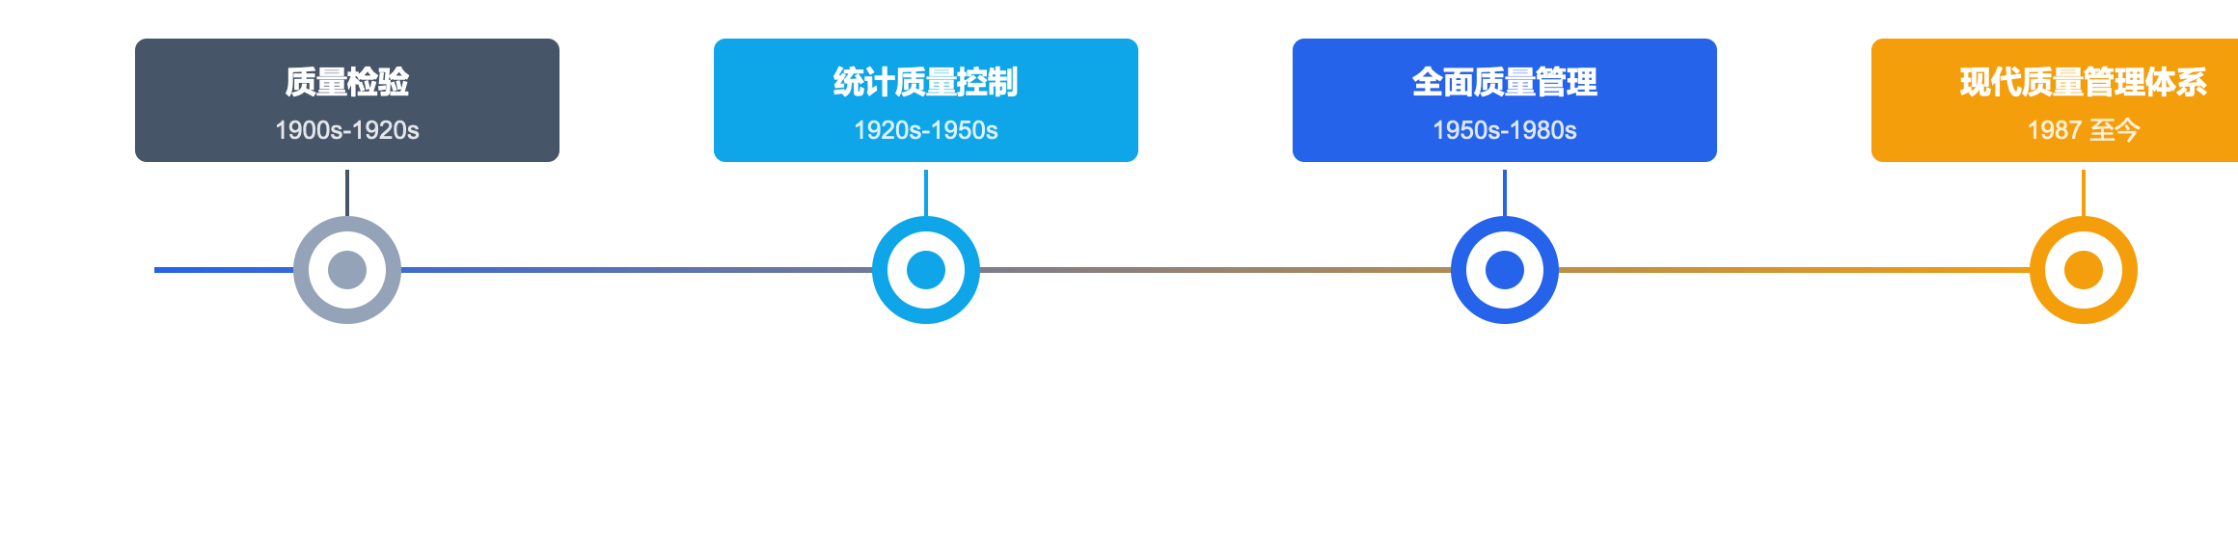




CHAPTER 01 · quality perception
A century of evolution of quality management
1.0
2.0
3.0
4.0
Quality inspection
Statistical quality control
total quality management
Modern quality system
Check afterwards
process prevention
Everyone participates
System management
pass"see, touch, measure"The essence of identifying non-conforming products is"pick out the bad"
use SPC Control charts and error-proofing technology reduce defects from the source
TQM Concept: Quality is designed, not inspected
ISO 9001 / IATF Waiting for system certification,PDCA + risk management
Quality management general training
04 / 30

Slide 5






CHAPTER 01 · quality perception
product quality · process quality · System quality
THREE LAYERS
product quality
PRODUCT QUALITY
quality
three levels
The sum of the characteristics of the product itself that meet stated and implicit needs
Functional performance: Whether it meets the design specifications
Reliability: lifespan, failure rate, maintainability
Appearance experience: senses and user experience
process quality
PROCESS QUALITY
Quality is not just a concept, it runs through every dimension of products, processes and systems
The stability of the sequence of activities that convert inputs into outputs
Stability: Is the process controlled and consistent?
Ability index:Cp/Cpk Is it up to standard?
Efficiency: cycle time and resource utilization
"Product quality is the result, process quality is the means, and system quality is the guarantee."
System quality
SYSTEM QUALITY
Integrity and effectiveness of the organization’s quality management system
Process integrity: Are there rules to follow?
Sustained effectiveness: Is the system really running?
Continuous improvement: whether you have the ability to self-correct
Quality management general training
05 / 30

Slide 6
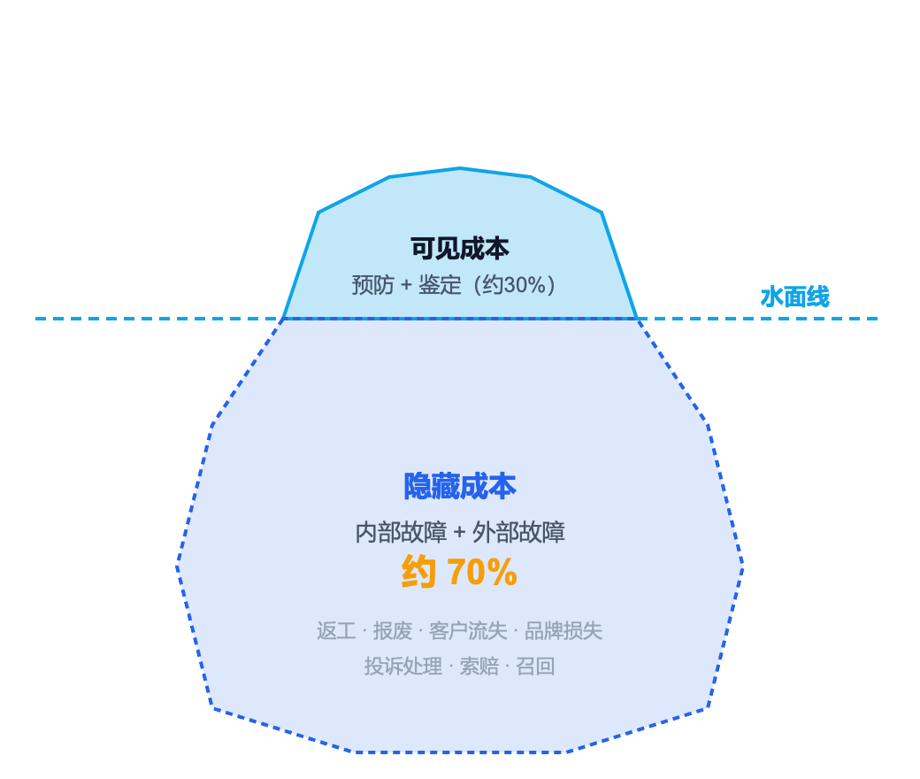




CHAPTER 01 · quality perception
The iceberg of poor quality costs —— Invisible waste is more terrible
Quality cost iceberg model (PAF）
Four major categories of quality costs
prevention cost
Prevention
+
Active investment in training, planning, auditing, etc.
appraisal cost
Appraisal
+
Inspection, testing, measurement and other testing investment
Internal failure
Internal Failure
-
In-factory losses such as rework, scrapping, line shutdown, etc.
external fault
External Failure
-
Returns, claims, recalls and other post-factory losses
key insights
Increase 1 Yuan prevention cost can be reduced 10 Meta failure cost. Invest in prevention and get the biggest return.
Quality management general training
06 / 30

Slide 7

CHAPTER 01 · quality perception
Quality and efficiency —— Not opposition, but unity
DIRFT
vicious circle
virtuous circle
Get it right the first time
1.
ignore quality → Increased rework
1.
Get it right the first time → Zero rework
2.
Increased rework → schedule delays
2.
Zero rework → save time
3.
schedule delays → Working overtime to catch up on work
3.
save time → Delivered calmly
Do It Right The First Time
4.
Working overtime to catch up on work → Worse quality
4.
Delivered calmly → Better quality
Doing things right the first time is the most efficient way to work
Data speaks
1:10
40%
3x
Common misunderstandings
"If you rush to schedule, you can't guarantee quality." —— This is the thinking that regards quality as an additional burden
prevention vs Failure
cost ratio
rework time
Total working hours
Cost of defective products
It's a good product3times
Quality is the best efficiency accelerator —— The more we pursue quality, the more efficient we become
Quality management general training
07 / 30

Slide 8
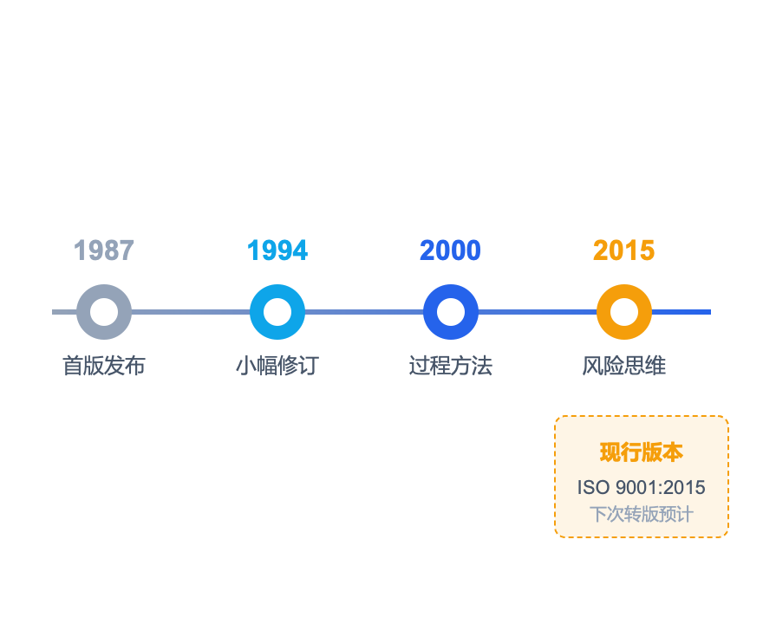
CHAPTER 02 · Quality management system
ISO 9001 —— global quality management"common language"
Standard evolution process
ISO 9001:2015 Standard framework (ten-chapter structure)
1
scope
2
Normative reference documents
3
Terms and definitions
4
organizational environment
5
leadership role
6
plan
7
support
8
run
9
performance evaluation
10
improve
Terms4-6 · core chapters
Terms7-8 · Run Chapter
Terms9-10 · Check for improvements
planning level
execution level
level of improvement
ISO 9001 is the International Organization for Standardization (ISO) has released quality management system standards around the world. 100Ten thousand+ organizations are certified, covering 180+ country.
Quality management general training
08 / 30

Slide 9







CHAPTER 02 · Quality management system
ISO 9001 Seven principles of quality management
01
Focus on customers
ISO 9001:2015
Understand customers' current and future needs, meet and strive to exceed expectations
seven principles
02
leadership role
Leaders set direction and create an environment where everyone is involved in achieving goals
Globally recognized quality management"Basic Law"
03
Everyone participates
Only when everyone has quality capabilities can quality have its source.
"The seven principles are not isolated items, but programmatic thinking that guides organizations to establish, operate, and improve quality management systems."
04
process approach
Systematic management of activities as interrelated processes
05
improve
Continuous improvement is the eternal goal and constant theme of the organization
06
evidence-based decision-making
Analysis based on data and information is more reliable than intuition
07
relationship management
Manage relationships with interested parties (suppliers, etc.) for continued success
Quality management general training
09 / 30

Slide 10
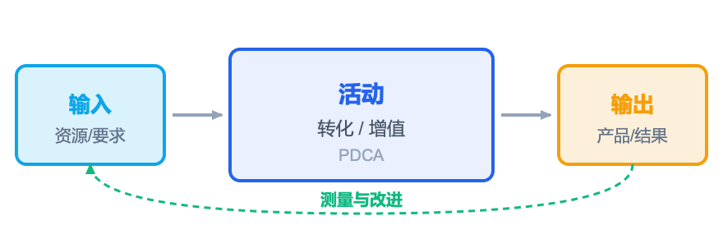
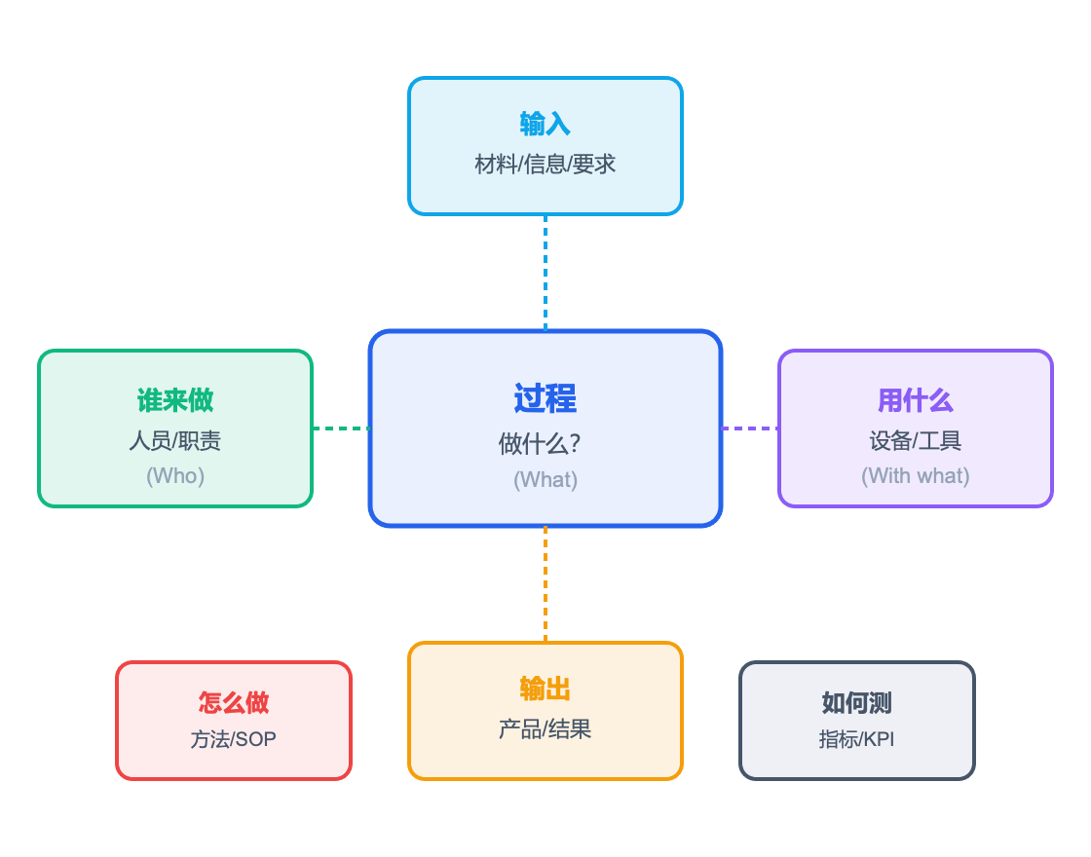
CHAPTER 02 · Quality management system
Process Method and Turtle Diagram —— understand"how to do"
process approach core model
turtle diagram —— process analysis tools
The nature of the process approach
Treat each job as a"process": There are inputs, activities, outputs, and monitoring. By managing every process well, product quality is naturally guaranteed.
1. identification process
2. Clear up the interface
3. Determining method
4. Monitor performance
5. Continuous improvement
Six elements analysis:What · Who · With what · How · Input · Output · KPI
Quality management general training
10 / 30

Slide 11
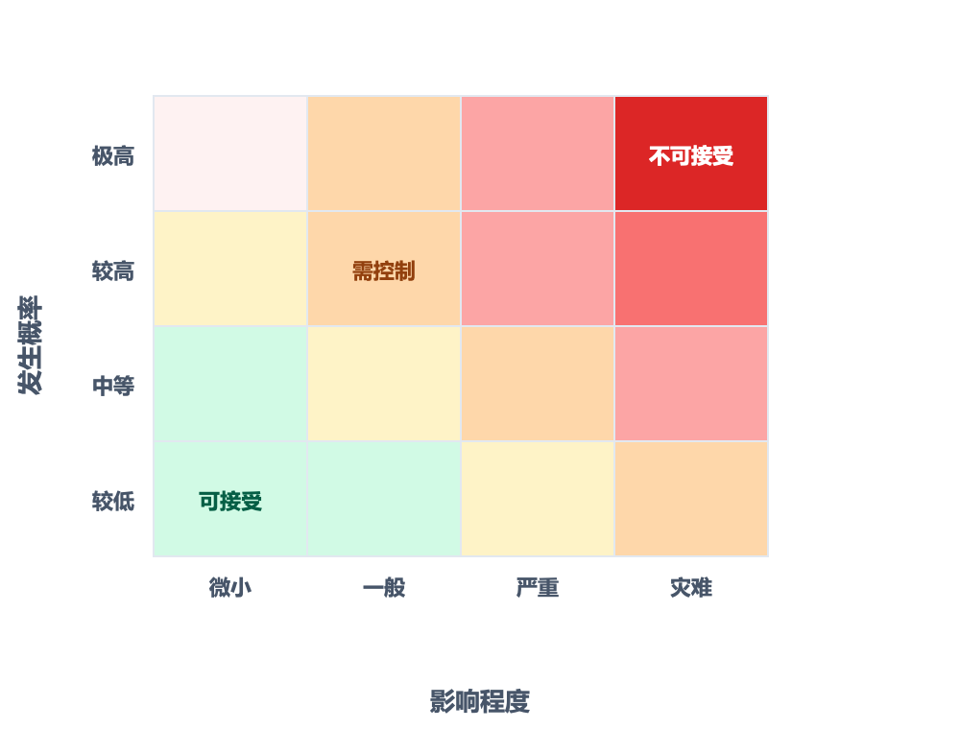



CHAPTER 02 · Quality management system
risk-based thinking —— Prevention is better than correction
Risk assessment matrix (probability × Influence)
Four-step approach to risk assessment
01
Identify risks
What could go wrong? Comprehensive investigation from people, machines, materials, methods, environment and measurement
02
Analysis and evaluation
What is the probability? How serious is the impact? Quantify risk levels using a matrix
03
Develop measures
Avoid, reduce, transfer, accept - choose the optimal strategy
04
Monitoring review
Are the measures effective? Regularly review and dynamically update the risk list
FMEA Introduction
Failure Mode and Effects Analysis (FMEA）： RPN = Severity(S) × Occurrence(O) × Detection(D) RPN The higher it is, the more priority it needs to be processed.
Quality management general training
11 / 30

Slide 12
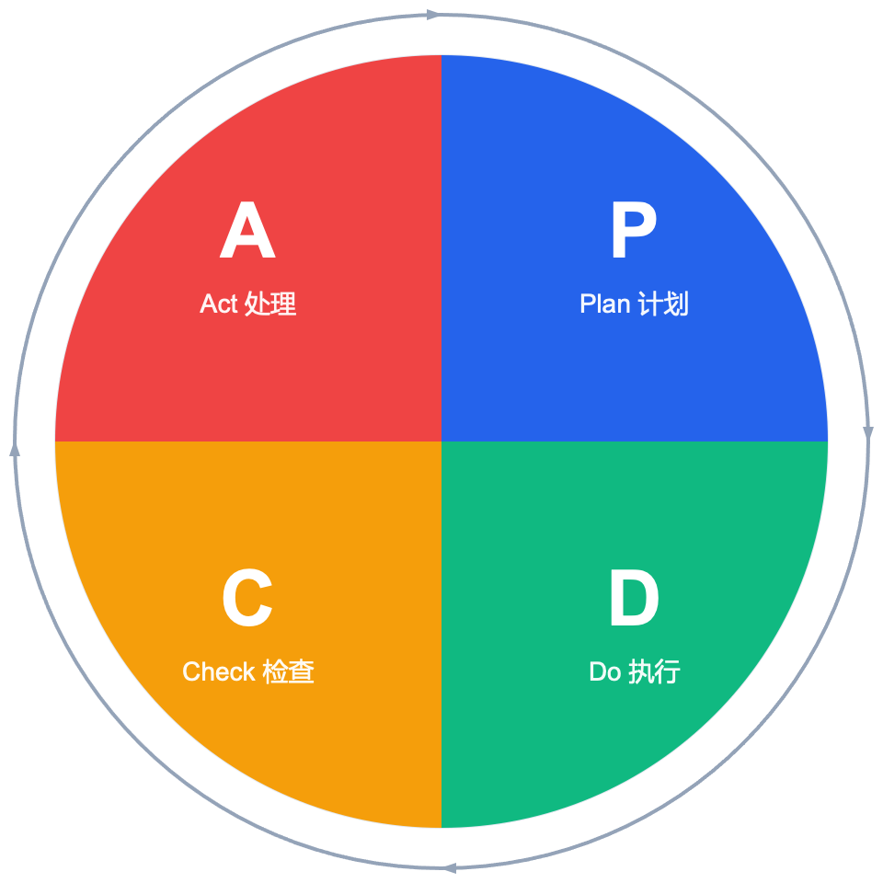
CHAPTER 02 · Quality management system
PDCA cycle —— quality improvement engine
Deming cycle · Deming ring
Detailed explanation in four steps
P
Plan plan
Identify problems, analyze causes, and formulate plans
Output: Improvement Plan
D
Do implement
Implement measures as planned and collect process data
Output: execution record
C
Check examine
Evaluate effectiveness against goals and identify gaps
Output: analysis report
A
Act deal with
Consolidate effective experience and move to the next cycle if unresolved
Output: normalized / new question
Quality management general training
12 / 30

Slide 13
CHAPTER 02 · Quality management system
Internal audit and management review —— systematic"Physical examination"mechanism
HEALTH CHECK
Dimensions
internal audit
management review
System physical examination
Purpose
Check whether the system complies with standards and documents
The suitability, adequacy and effectiveness of the evaluation system
Once the system is established, everything will be fine."Physical examination"To maintain healthy operation
executor
Internal auditor (authorized by training)
Hosted by top management
Frequency
at least every year1times, fully covered as planned
at least every year1times, increase if necessary
"Internal audit is a self-inspection, and management review is a general inspection. Both are indispensable."
enter
Procedural documents, records, on-site observations
Internal audit reports, customer feedback, data analysis
output
nonconformity report + corrective measures
Improve decisions + Resource requirements + policy adjustment
focus
Does it comply? Execute?
Is it valid? Does it need to be adjusted?
internal audit plan
→
Perform review
→
nonconformity
→
corrective measures
→
management review
→
Improve decision-making
Quality management general training
13 / 30

Slide 14




CHAPTER 02 · Quality management system
Certification is not the end, but the starting point
Five major values ​​brought by quality certification
Certification ≠ Approval
01
market access
Certification Certification
Many bidding projects and major customer cooperation willISO 9001Certification as a prerequisite
A third-party organization certifies that the organization meets standard requirements
02
Customer trust
Approval Accreditation
Third-party endorsement enhances customer confidence and reduces communication and verification costs
The authority certifies that the certification body is qualified to carry out certification
03
Management improvement
Three misunderstandings after certification
Establish a systematic and standardized management process to reduce arbitrariness
✗
Get the certificate=Is everything going well? The system needs to continue to operate
04
Risk reduction
✗
Certificate=Good quality? Certification is the bottom line, not the ceiling
Systematically identify and manage quality risks through system operation
✗
review=Going through the motions? Every audit should identify areas for improvement
05
Continuous improvement
PDCAEmbedded mechanisms promote organizational self-improvement and evolution
Certification is systematic"birth certificate"
Continuous improvement is"health certificate"
Quality management general training
14 / 30

Slide 15








CHAPTER 03 · Quality Tools and Methods
Seven tools of quality management —— From data to decisions
QC Seven Tools · Let data speak for itself and make improvements evidence-based
Use data visualization to drive improvements
CHECK SHEET
STRATIFICATION
PARETO CHART
Checklist
layered approach
plato
Record data in a structured way and let the facts speak for themselves
Split data by categories and identify sources of differences
80/20 Rule: Focus on the critical few
FISHBONE
SCATTER
HISTOGRAM
CONTROL
cause and effect diagram
Scatter plot
Histogram
control chart
Systematically sort out root causes of problems
Reveal the correlation between two variables
Show data distribution shape
Is the monitoring process stable?
The seven tools cooperate with each other to form a complete closed loop of problem analysis and improvement.
Quality management general training
15 / 30

Slide 16
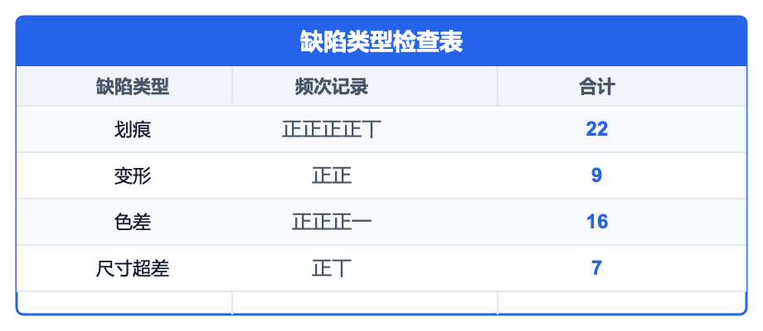
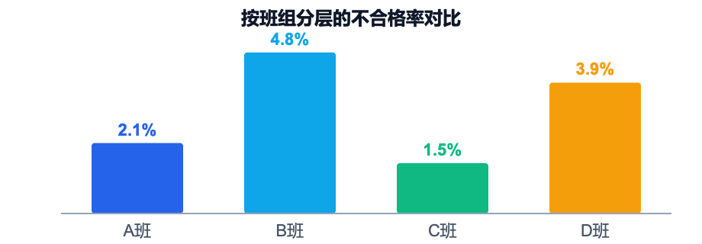
CHAPTER 03 · Quality Tools and Methods
Checklists and Stratification —— The cornerstone of data collection
Checklist Check Sheet
layered approach Stratification
Record data in a structured way and let the facts speak for themselves. It is the starting point for all quality analysis.
Group data by different dimensions to identify sources of variation and find real areas for improvement.
personnel
equipment
Material
method
team/Skill/experience
model/work clothes/state
batch/supplier
Craftsmanship/parameter/SOP
environment
Measurement
temperature/humidity/time period
Measuring tools/method/personnel
Design points: clearly record items, recording methods, and recorders
Clear classification: defect type, frequency, and time period are clear at a glance
Wide range of uses: can be used for defect recording, spot inspection, and process monitoring
Application scenarios
Overall pass rate95%, found after layeringBClass failure rate4.8%much higher thanCclass1.5%——focusBJust improve the class.
Quality management general training
16 / 30

Slide 17


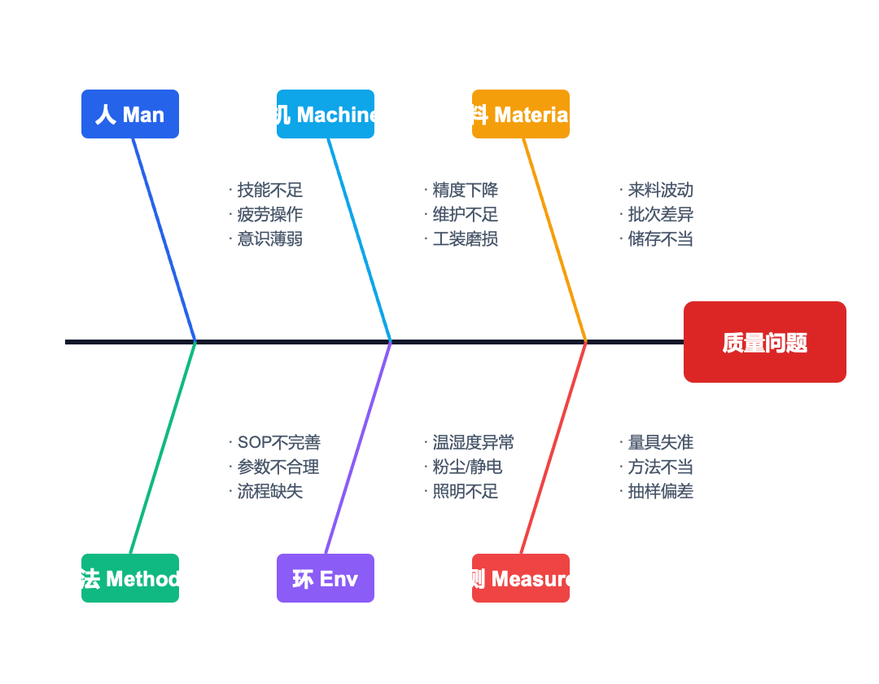
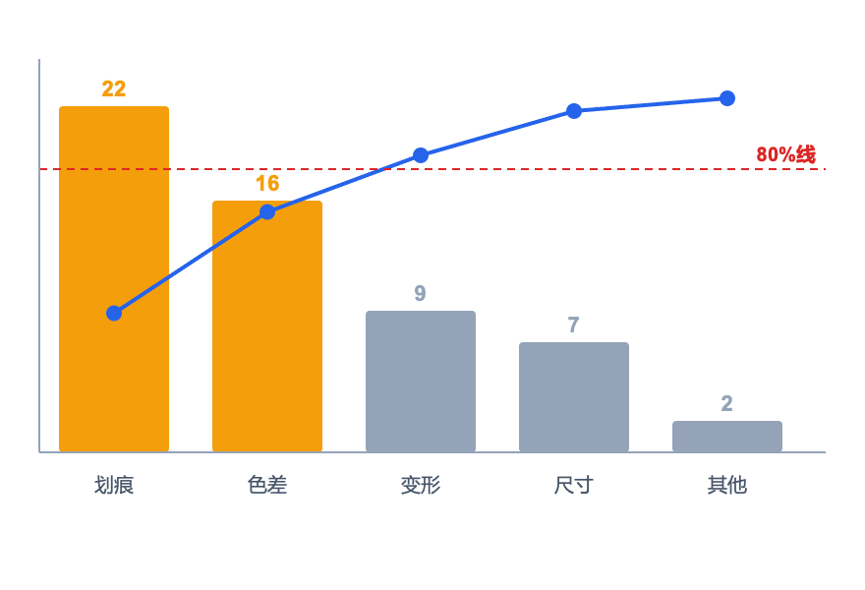
CHAPTER 03 · Quality Tools and Methods
Cause and Effect Diagrams and Plato —— Find the root cause and grasp the key
Cause and Effect Diagram (Fishbone Diagram) · 6Manalyze
plato · 80/20law
80%The question is caused by20%Caused by - focus on the key few
Interpretation
scratches(22pieces) + Color difference(16pieces) = Total defects68%. Solve these two problems and you can eliminate most of the defects.
Quality management general training
17 / 30

Slide 18

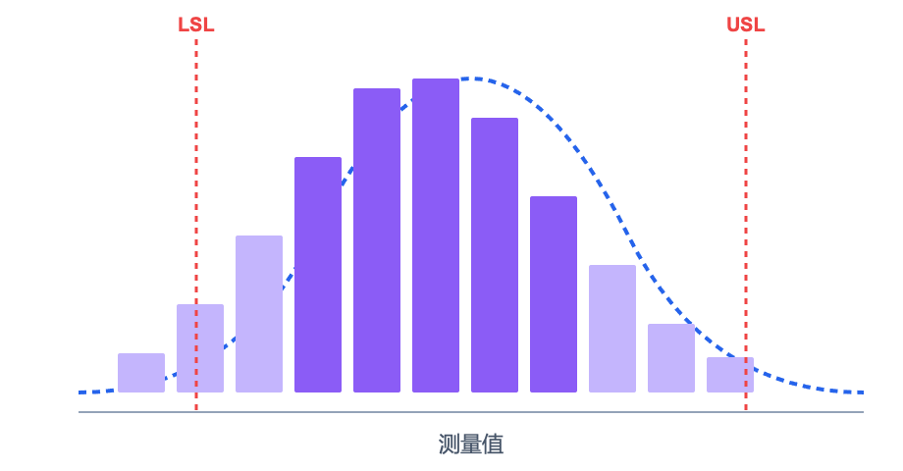
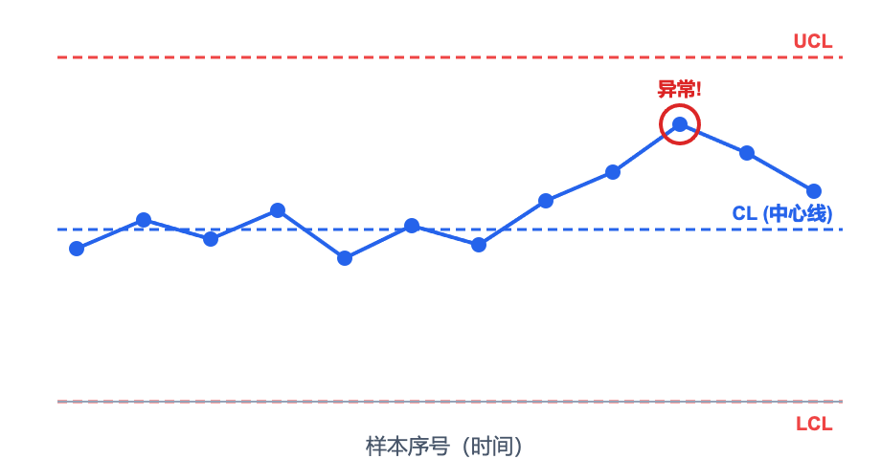
CHAPTER 03 · Quality Tools and Methods
Histograms and Control Charts —— Look at the distribution and control the process
Histogram Histogram
control chart Control Chart
Display the data distribution shape and determine whether the process is normal
Monitor whether the process is under control and detect abnormal fluctuations in a timely manner
Skewed type
bimodal
Flat top type
Island type
Discrepancy rules:
Over limit
continuous rise
alternating fluctuations
Close to limit
center offset
two sources
slow decay
Exceptions mixed in
Quality management general training
18 / 30

Slide 19





CHAPTER 03 · Quality Tools and Methods
5SManagement and visualization —— quality foundation
5S METHODOLOGY
tidy
Seiri · 1S
5S manage
Differentiate between necessary and unnecessary items and eliminate unnecessary items
Only keep the necessary ones and clean up the rest.
From organization to quality, create an orderly, efficient and safe working environment
Rectify
Seiton · 2S
Positioning, quantification, and volume placement of necessary items
Positioning and volume, easy to pick up and place
"5SIt’s not about spring cleaning, it’s about making problems visible, making standards visible, and making improvements visible."
clean
Seiso · 3S
Clean the environment and equipment to find and eliminate sources of pollution
Clean and inspect, if any abnormalities are found
Three principles of visual management
1.
make normal/The exception is clear at a glance
clean
Seiketsu · 4S
2.
Make standards within reach
Before3SStandardization, institutionalization, and continuous maintenance
3.
Let the problem have nowhere to hide
Standardization, institutionalization, normalization
Literacy
Shitsuke · 5S
Develop the habit of obeying rules and improve team quality
Self-discipline and self-improvement, develop habits
Quality management general training
19 / 30

Slide 20







CHAPTER 04 · Quality responsibility of all employees
Quality role for all employees —— Everyone is a quality gatekeeper
EVERYONE
Management
LEADERSHIP
Everyone is responsible
Establish quality policy and goals
Allocate resources and create a quality culture
Participate in management reviews and assume final responsibility
R&D design
R&D / DESIGN
Quality is not exclusive to a certain department, but the basic responsibility of everyone
Source control:DFMEA / FTA analyze
Design standardization, design for manufacturability (DFM)
Verification and confirmation, closed-loop problem management
Manufacturing
PRODUCTION
"Quality is designed, not inspected;
Quality is everyone's business, not just QA thing."
according to SOP Operation, first article inspection
Process monitoring and exception reporting
Equipment inspection and maintenance of working environment
Quality inspection
QUALITY
Incoming materials / process / Factory inspection
monitor SPC Data and Quality Trends
promote 8D / PDCA Improve implementation
functional support
SUPPORT
Manpower: Ability training and assessment
Procurement: Supplier Management and Evaluation
Administration: Service Standards and Continuous Improvement
Quality management general training
20 / 30

Slide 21
CHAPTER 04 · Quality responsibility of all employees
Quality Awareness Self-Check Checklist —— How many have you done?
10 Quality Behavior Self-Check Checklist
SELF CHECK
Quality self-inspection
01
I know the quality responsibilities and output standards of my position
✓
✗
02
I pressSOP/Follow the operation instructions and do not change methods at will
✓
✗
Please check the following10Make a list and do an honest self-examination. Do it every time ✓, failed to hit ✗。
03
If I find an abnormality, I will report it immediately. No"wait and see"
✓
✗
04
I won't let the data"nice"And modify the record
✓
✗
quality habits keywords
Get it right the first time
Report proactively
Trace back to the source
Data speaks
Standard work
05
I will inspect the first piece and confirm it is qualified before mass production.
✓
✗
06
I understand the input requirements of the previous process and also know my own output standards.
✓
✗
Scoring criteria
8-10strip:
excellent
07
I take the initiative to learn quality tools (such as checklists,5Why）
✓
✗
5-7strip:
qualified
0-4strip:
Need to improve
I pay attention to customer feedback and understand customer expectations for quality
✓
✗
08
09
I have made suggestions for quality improvements, even small improvements
✓
✗
10
i believe"Get it right the first time"It is the most time-saving and labor-saving way
✓
✗
Quality management general training
21 / 30

Slide 22







CHAPTER 04 · Quality responsibility of all employees
quality red line · insurmountable
Touch the red line = in trouble with the law / Touch the bottom line of career
0
01
Avoid hiding defects
Any discovered problems must be reported truthfully and must not be covered up or"Private"
02
Put an end to illegal releases
Failure to pass required inspection / Approved products may not leave the factory or be delivered to customers
03
Avoid falsified data
Inspection records and process data must be authentic and traceable, and must not be fabricated or selectively recorded
zero Allow Tolerate
04
Avoid skipping inspections
Never compromise on quality violations
Any skipped inspection, missed inspection, or inspection on behalf of others is the greatest harm to customers and the company.
05
Eliminate blame-shifting
When quality problems arise, solve them as soon as possible instead of pursuing blame first.
Keep the bottom line · It is to protect the lifeline of the enterprise
Quality management general training
22 / 30

Slide 23








CHAPTER 04 · Quality responsibility of all employees
The cost of quality violations —— For businesses and individuals
CONSEQUENCES
Impact on business
Violation penalty
reputational loss
economic loss
legal risks
A quality violation affects far more than just a product—it can destroy years of trust.
Customer trust collapses, brand image suffers, and market share declines
Return compensation, recall costs, order loss, the amount can reach tens of millions
Product Quality Law, Consumer Rights Protection Law, may face administrative penalties
personal impact
warning
"The later a quality issue is discovered, the higher the cost of repair - Present10Double growth."
disciplinary action
legal liability
career impact
Warning, demerit, demotion, termination of labor contract
Major quality accidents may be subject to individual criminal liability
Bad records affect career reputation and development prospects
Increasing cost of defect repair (10doubling rule)
design stage
→
production stage
→
Before leaving the factory
→
in the hands of customers
1x
10x
100x
1000x
Quality management general training
23 / 30

Slide 24
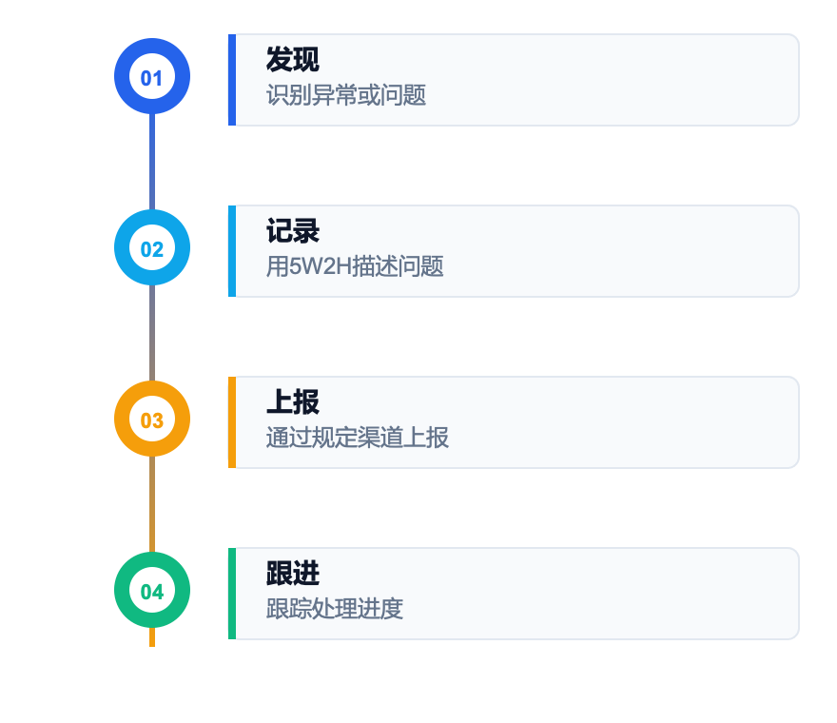


CHAPTER 04 · Quality responsibility of all employees
What should I do if I find a problem? —— Correctly report quality issues
Four-step reporting process
5W2H Problem description template
What
what problem
Why
Why it matters
Describe the problem phenomenon
impact assessment
Where
Where
When
what time
Occurrence location/process
discovery time/batch
Who
Who is involved
How
how happened
Relevant personnel/team
Description of the process
How many
what quantity
Scope of influence/quantity
Reporting channels
direct supervisor
Quality department
anonymous channel
Verbal for the first time/written report
Submit via quality system
Mail/hotline/suggestion box
Take the initiative to report ≠ cause trouble
Taking the initiative to report problems when you discover them is an act of responsibility. Concealing something or not reporting it is the biggest violation. encourage"Report early, resolve early"culture.
Quality management general training
24 / 30

Slide 25
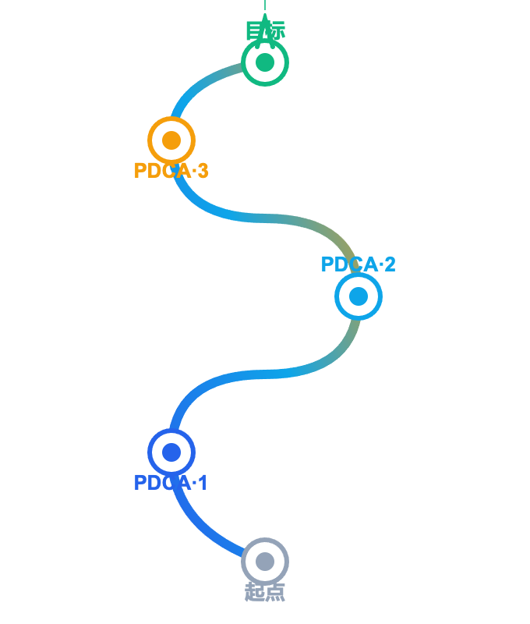


CHAPTER 05 · Continuous improvement and quality culture
Continuous improvement —— Make quality a habit
Continuous improvement is not a slogan, but a three-level progression that permeates daily work:
Improvement is a spiral
01
Found problem · see reality
Identify real issues from customer complaints, process data, and employee suggestions; use 5Why Chase down to the root cause
02
Analyze root causes · find the source
Use fishbone diagram,5Why、FMEA Tools such as systematic attribution; differentiation"symptom"and"Root cause of disease"
03
Implement improvements · Solid results
Run fast in small steps, pilot verification; standardize effective practices / Documentation / Training
Four Keywords of Quality Culture
Customer perspective
Data speaks
Get it right the first time
Continuous iteration
With each cycle, the quality level increases by one level
Quality management general training
25 / 30

Slide 26

CHAPTER 05 · Continuous improvement and quality culture
5Why root cause analysis —— Get to the bottom of it and find the real reason
Classic case: machine shutdown
5 WHY ANALYSIS
5Why analyze
Why 1
Why did the machine stop?
→ Because the fuse blew
Continuously ask a question"Why", until you find the root cause rather than the superficial symptoms.
Why 2
Why did the fuse blow?
→ Because the bearing load is too large
Why 3
Why are bearings overloaded?
→ due to insufficient lubrication
origin
Why not enough lubrication?
It was proposed by Toyota founder Sakichi Toyoda and later popularized by Taiichi Ohno. It is the core tool for root cause analysis in lean production.
Why 4
→ Because the oil pump cannot suck oil
Why 5
Why can't the oil pump suck oil?
→ Because the oil pump shaft is worn and the clearance is too large
Things to note
•
Not necessarily exactly5indivual,3-7Any one is welcome
Root cause: oil pump shaft wear
•
Each answer must be based on facts
Countermeasure: Replace the oil pump shaft + Establish a regular replacement maintenance schedule. If you only replace the fuse (stop atWhy 1), the problem will occur repeatedly.
•
avoid pointing"people"attribution
•
Finally, executable measures should be derived
Quality management general training
26 / 30

Slide 27
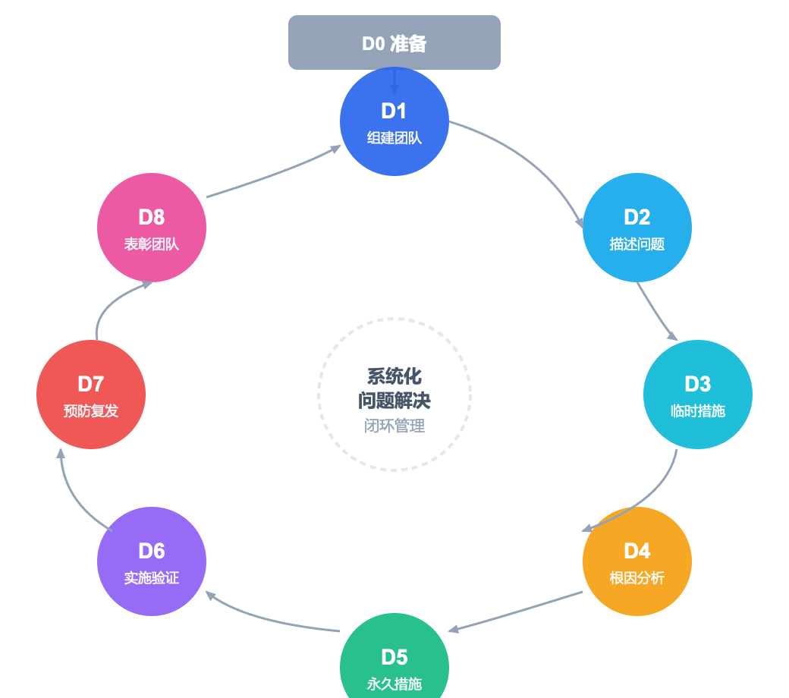
CHAPTER 05 · Continuous improvement and quality culture
8D problem solving —— Overcome problems systematically
Eight Disciplines · Ford Corporation is founded
Detailed explanation in eight steps
D1
Build a team
cross-functional team
D2
Describe the problem
5W2HProblem description
D3
temporary measures
containment/Isolation plan
D4
root cause analysis
5Why/fishbone diagram
D5
permanent measures
corrective action plan
D6
Implementation verification
Effect verification report
D7
Prevent recurrence
SOPrenew/Poka-yoke
D8
Commend the team
Experience sharing/commend
key principles
D3temporary measures"stop loss"、D4-D5root cause+permanent measures"Treat the root cause"、D7Prevent recurrence"Prevent it from happening again"——Both are indispensable.
Quality management general training
27 / 30

Slide 28
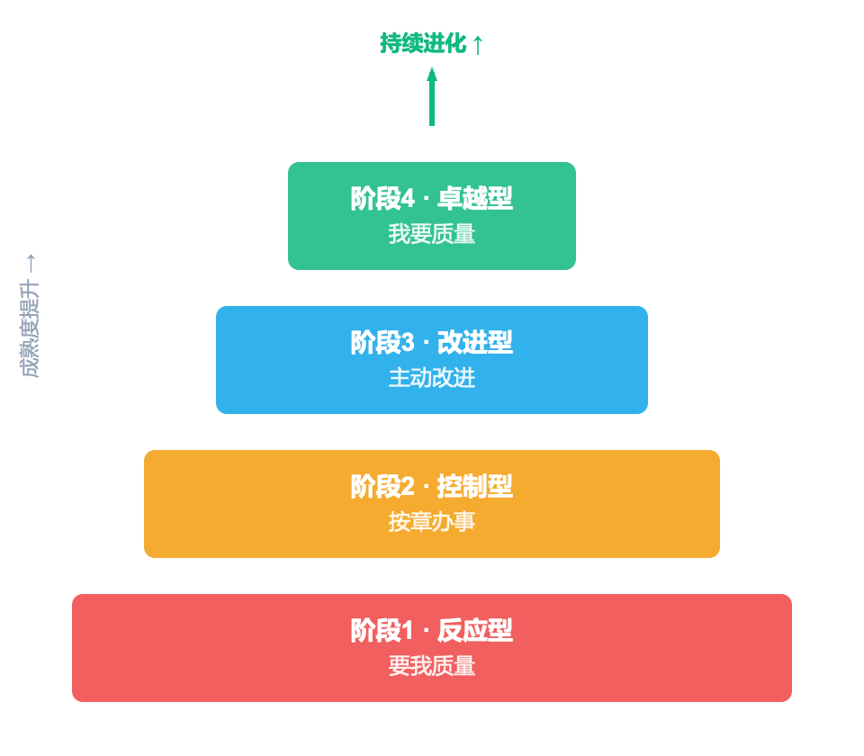



CHAPTER 05 · Continuous improvement and quality culture
The path to building a quality culture —— from"want me"arrive"I want"
Quality Culture Maturity Model
Three major starting points for cultural construction
system gripper
System
Establish clear quality systems and standards so that"do it right"There is evidence to rely on, let"Do something wrong"There are traces to follow
Quality manual and procedure documents
Job quality responsibility system
Quality assessment and reward and punishment system
Training gripper
Training
Continuously carry out quality training to equip every employee with quality awareness and quality skills
Compulsory quality courses for new employees
Job quality skills training
Quality case sharing and discussion
motivational grabber
Incentive
Use positive incentives to guide behavior so that those with excellent quality are respected and rewarded
Quality pacesetter selection
Improvement proposal rewards
quality month/quality competition
quality culture = System guarantee × Training and empowerment × Incentive and guidance
Quality management general training
28 / 30

Slide 29
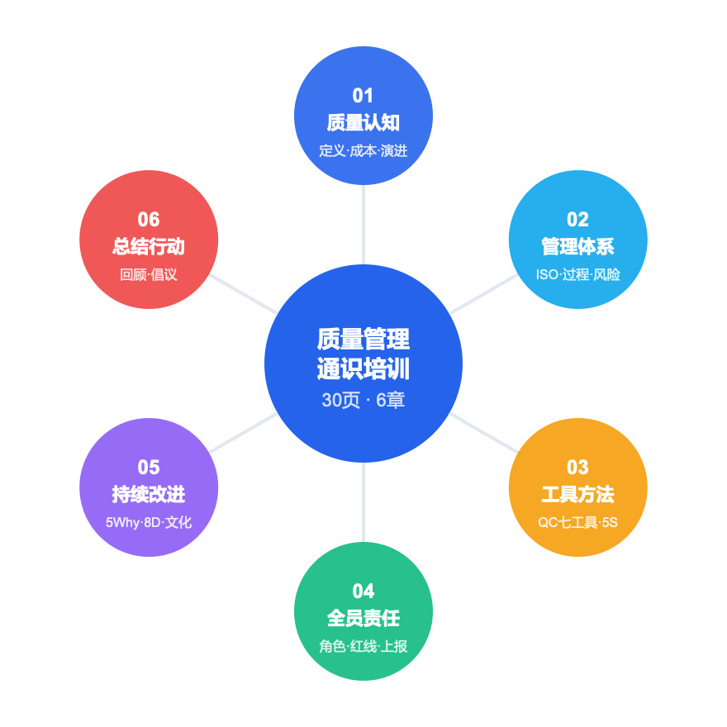


CHAPTER 06 · Summary and Action
Review of key points of the entire course —— One picture to understand quality management
Chapter 6 Knowledge Map
Review of core points
Ch.1
Ch.2
quality=Degree of meeting requirements, cost iceberg70%under water
ISO 9001seven principles+process approach+PDCA+risk thinking
Ch.3
Ch.4
QCSeven Tools from Checklists to Control Charts+5Smanage
All employees are responsible·Zero tolerance for quality red lines·Correct reporting5W2H
Ch.5
5WhyFind the root cause·8DSystem solution·Three starting points of culture
after school action initiative
01
Complete the quality awareness self-check list within this week to identify your weaknesses
02
Identify your position1quality risk points and make suggestions for improvement
03
Share with your team1a quality tool that drives application in daily work
Quality is not something that can be inspected, it is something that everyone makes.
Quality management general training
29 / 30

Slide 30
thanks for listening
qtank.org
QTank
qtank.org

