Slide 1
Supplier Quality Management System Setup
Covers supplier admission, grading, on-site audit, performance evaluation, and continuous improvement; includes audit checklist, scorecard, and improvement tracker
QTank
Knowledge Code 9.1.2 · Supplier Audit & Coaching
qtank.org

Slide 2


Agenda
CONTENTS
01
System framework design
02
Supplier admission mechanism
03
Tiered management implementation
04
On-site audit execution
05
Dynamic performance evaluation
06
Continuous improvement closed loop

Slide 3

PART
01
System framework design

Slide 4
Quality management objectives and principles
Risk prevention
Early identification of potential quality defects and supply risks with preventive measures to reduce shutdown or recall costs.
Continuous improvement
Data-driven decision making
Establish dynamic optimization through regular evaluation and feedback to drive continuous supplier improvement in process, materials, and management.
Use quality data analysis (e.g., defect rate, return rate) to scientifically define supplier grading and resource allocation, avoiding subjective bias.
03
02
04
Quality consistency
Compliance assurance
Ensure supplier products and services meet corporate quality standards, reduce supply chain risk from quality variation, and improve end-customer satisfaction.
Ensure suppliers comply with industry standards (e.g., ISO 9001, IATF 16949) and corporate requirements to mitigate legal and reputational risk.
01
05

Slide 5
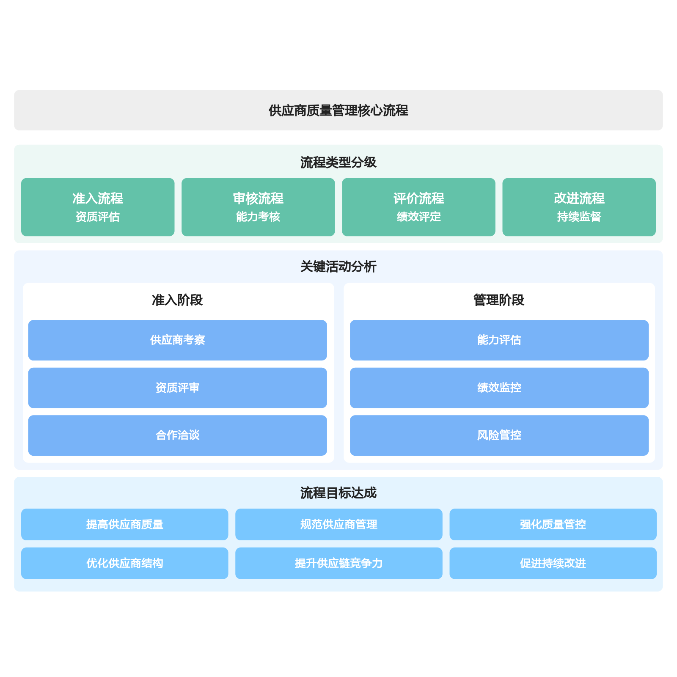
Core process framework (admission – audit – evaluation – improvement)
Admission process focuses on qualification assessment; supplier visits and negotiations ensure source quality control and partnership foundation.
01
Audit and evaluation processes strengthen capability assessment and performance monitoring for dynamic supplier management and optimized resource allocation.
02
Improvement process drives quality uplift through risk control and ongoing oversight, building a closed-loop supply chain optimization mechanism.
03

Slide 6
Key roles and responsibilities
Standard establishment
Metrics
>>>
Process
>>>
Records
Admission
Template
Assessment
Supplier audit
Strategy development
Planning management
Document preparation
Document management
Archiving
Quality assessment
Monitoring
System setup
Improvement
Review
Audit
>>>
Collaboration
>>>
Training
Continuous optimization
Risk control
Performance improvement
Issue handling

Slide 7
PART
02
Supplier admission mechanism

Slide 8
Admission criteria development (qualification / capacity / compliance)
Qualification review
Capacity assessment
Compliance review
Suppliers must provide complete business license, production permit, QMS certification, and other qualification documents to confirm legal operating status and industry admission eligibility.
Conduct on-site assessment of production equipment, processes, and staffing to evaluate stable capacity to meet procurement requirements.
Verify compliance with environmental regulations, labor law, and workplace safety to avoid supply disruption or legal risk.
Technical capability verification
Financial condition analysis
Confirm product specifications and R&D capability against corporate technical standards through sample testing and technical document review.
Review financial statements and credit ratings to assess financial stability and risk resilience, reducing partnership financial risk.

Slide 9
New supplier evaluation process
Initial screening
Risk assessment
Collect supplier information via industry databases, trade shows, and peer referrals for initial screening on basic qualifications and business fit.
Systematically analyze geographic location, raw material sources, alternatives, and other risk factors; develop corresponding risk mitigation plans.
On-site audit
Comprehensive scoring
Deploy cross-functional review teams for on-site factory audits covering production environment, quality control, warehousing, and logistics.
Establish multi-dimensional scoring system covering quality, cost, delivery, and service for quantitative evaluation and grading.
Sample testing
Pilot run phase
Require representative samples; validate product performance and quality stability through lab testing and small-batch trials.
Conduct small-batch orders with approved suppliers to validate overall fulfillment capability in real business scenarios.

Slide 10
Admission approval and file establishment
Tiered admission mechanism
On-site factory verification
Sample testing
Document verification
Risk assessment
Qualification review criteria
01
02
03
04
05
File scope definition
Archiving standard development
File system setup
Data entry standards
File audit mechanism
Approval authority configuration
File classification management
Approval turnaround control
Establish core file directories by supplier type; dynamically update admission qualification documents
Establish electronic approval workflow with clear owners and time limits at each stage
Multi-level joint review

Slide 11
PART
03
Tiered management implementation

Slide 12
Grading dimension definition (quality / delivery / strategic value)
01
02
03
04
05
Quality dimension
Delivery dimension
Strategic value dimension
Cost control capability
Compliance and social responsibility
Supplier quality performance is a core evaluation metric, including product yield, return rate, and quality incident frequency; assessed through historical data analysis and third-party test reports.
Evaluate on-time delivery rate, order response speed, and emergency order handling to ensure supply chain stability and agility, avoiding production schedule disruption from delays.
Measure supplier contribution in R&D, market competitiveness, and long-term partnership potential; prioritize strategic partners with innovation capability or exclusive resources.
Analyze pricing reasonableness, cost-reduction proposal effectiveness, and payment term flexibility using a Total Cost of Ownership (TCO) model.
Assess compliance with industry regulations, environmental standards, and labor rights to avoid supply chain risk or reputational damage from non-compliance.

Slide 14
Differentiated resource allocation strategy
Priority technical support
Order allocation preference policy
Shared risk mechanism
Provide Class A suppliers with in-depth support such as joint R&D and technical training to improve product performance and strengthen the partnership.
Prioritize high-value or critical orders to Class A/B suppliers to ensure capacity utilization while reducing reliance on Class C.
Sign long-term agreements with Class A suppliers and share market forecast data; reduce operational risk through vendor-managed inventory or price locking.
Differentiated audit frequency
Payment terms optimization
Exit buffer design
Class A: comprehensive audit once per year; Class B: every six months; Class C: quarterly; focus on corrective action closure.
Shorten payment terms or provide advance payment for Class A to improve cash flow stability; enforce standard payment terms for Class C.
Allow a 3–6 month transition when phasing out Class C suppliers; gradually transfer orders to new suppliers to avoid supply chain disruption.

Slide 15
PART
04
On-site audit execution

Slide 16
Audit plan development (comprehensive / special / unannounced)
Comprehensive audit scope
Cover all key supplier processes including design, manufacturing, warehousing, logistics, and after-sales service for systematic capability assessment.
Audit frequency setting
Dynamically adjust audit cycle based on supplier grade (A/B/C); shorten interval to quarterly or semi-annual for high-risk suppliers.
Focused special audit
In-depth inspection of high-risk areas (e.g., raw material batch management, critical process control) or frequent customer complaint areas.
Cross-functional collaboration
Form audit teams from quality, engineering, and procurement to evaluate supplier performance from multiple professional perspectives.
Unannounced audit implementation
Use unannounced audits to avoid advance preparation and reflect true daily QMS performance; especially suited for high-sensitivity industries.

Slide 17
On-site verification essentials (equipment / materials / process / inspection)
Equipment status verification
Raw material traceability management
Process control verification
Verify equipment calibration records, maintenance plans, and actual operating parameters (e.g., temperature, pressure) against process requirements.
Review incoming inspection reports, supplier qualification files, and batch traceability systems to ensure end-to-end traceability.
Observe compliance with operating standards at critical processes (e.g., welding, heat treatment); sample real-time process parameter monitoring records.
Inspection capability assessment
Environmental control inspection
Emergency response plan testing
Audit lab equipment accuracy, operator competency, and conformance to test standards (e.g., ISO/ASTM).
Assess whether on-site temperature, humidity, cleanliness, and other environmental indicators meet product requirements (e.g., ESD protection for electronic components).
Randomly simulate sudden quality incidents (e.g., equipment failure) to validate supplier emergency response effectiveness.

Slide 18
Issue logging and corrective action notification
Issue 1: Information discrepancy
Issue 2: Process redundancy
Issue 3: Schedule delay
Issue 4: Insufficient collaboration
Inconsistent audit information communication
Excessive audit process steps
Audit plan execution overdue
Poor cross-functional audit coordination
Corrective action: Communication training
Corrective action: Process optimization
Corrective action: Schedule control
Corrective action: Collaboration mechanism
1
Implement standardized communication training
1
Simplify redundant audit steps
1
Develop audit Gantt chart
1
Clarify interfacing department responsibilities
2
Establish shared audit information platform
2
Enable electronic audit system
2
Implement weekly progress reporting
2
Establish joint audit team
Dedicated corrective action plan developed with effectiveness tracking

Slide 19
PART
05
Dynamic performance evaluation

Slide 20
Evaluation metric design (quality conformance / on-time delivery)
Quality conformance rate
On-time delivery rate
VS
Quality exception frequency: records the number of quality exceptions during supplier deliveries
Order on-time rate: percentage of orders delivered by agreed date
Conformance rate
Batch conformance rate: percentage of delivery batches meeting quality standards
Emergency order response rate: assesses timely delivery capability for urgent orders
On-time rate
Key parameter attainment rate: assesses stability of critical quality parameters
Logistics timeliness attainment rate: percentage of on-time deliveries in logistics
Exception rate
Return rate: proportion of returns due to quality issues vs. total delivered quantity
Variation rate
Capacity fluctuation tolerance: assesses delivery stability under capacity variation

Slide 21
Monthly/quarterly performance scoring
Define supplier performance evaluation objectives and set core KPIs for quality, delivery, and cost.
10%
Metric definition phase
8%
Quantitative and qualitative integration
Develop scoring rules with quantitative criteria such as defect rate and on-time delivery rate.
22%
Scoring design phase
Evaluation organizational structure
Collect monthly/quarterly quality data, delivery records, customer complaints, and other performance evidence from suppliers.
28%
Data collection phase
Objectively rate suppliers per scoring criteria and assign A/B/C/D performance grades.
32%
Scoring execution phase
Apply scoring results to supplier grading, order allocation adjustment, and improvement resource prioritization.
Results application phase

Slide 22
Red/Yellow/Green alert mechanism
01
Intelligent three-zone classification
04
Supporting special audit mechanism
Green zone (85–100): maintain normal cooperation; Yellow zone (60–84): initiate improvement coaching; Red zone (0–59): trigger exit procedure.
Launch unannounced audits for Yellow suppliers covering production floor, test equipment, raw material traceability, and more.
02
Continuous monitoring trigger conditions
05
Risk buffer plan
Auto-downgrade Yellow suppliers with no improvement for three consecutive months; Red suppliers barred from new project bids for six months.
Require alternative sources for Red suppliers to complete development validation within the alert period to ensure supply continuity.
03
Alert response workflow
System automatically sends alerts to relevant buyers, requiring corrective/preventive action report within 48 hours.

Slide 23
PART
06
Continuous improvement closed loop

Slide 24
Joint improvement plan development
Cross-functional collaboration mechanism
Data-driven decision making
Risk tiered management
Establish joint work groups from quality, procurement, and engineering with regular meetings to define improvement goals and responsibilities aligned with business needs.
Use Pareto analysis on key metrics from performance reports (e.g., defect rate, on-time delivery) to identify priority improvements and targeted action plans.
Classify improvement projects as ABC based on material criticality and historical quality severity; allocate differentiated resources and tracking frequency.
SMART principle application
Dual-dimension evaluation criteria
All improvement targets must meet SMART criteria, e.g., "Reduce dimensional defect rate for a component from 5% to 2% within three months."
Define both process metrics (e.g., action completion rate) and outcome metrics (e.g., quality conformance improvement) to comprehensively assess effectiveness.

Slide 25
Improvement action tracking and verification
Method optimization: PDCA cycle
Method optimization: Digital enablement
Effectiveness review: monthly quality meetings to assess actions, update FMEA risk library into standardized documents
Collaboration platform: supplier portal for shared corrective data with electronic SCAR workflow and closed-loop tracking
Collaboration mechanism
Develop tiered verification: full inspection + sampling for critical items; document review + on-site confirmation for routine items
Verification effectiveness
Automated verification: QMS auto-collects inspection data and generates SPC reports to analyze improvement impact
Establish corrective action deadline tracking via Gantt charts to monitor progress and ensure on-time verification
Timeliness control
Digital tracking: SRM system auto-alerts for overdue tasks with real-time corrective status updates

Slide 26
Tool application (audit sheet / scorecard / tracker)
Dynamic audit scoring sheet
Supplier capability radar chart
Design weighted scoring sheet covering QMS, process control, and inspection capability; auto-adjust key item weights by supplier grade.
Use six-dimension radar chart to visualize supplier relative levels in quality, cost, delivery, etc., identifying capability gaps.
Red/Yellow/Green tracking dashboard
Corrective and Preventive Action (CAPA) register
Visual management system displays improvement project progress in real time; overdue items auto-escalate alert level and trigger follow-up workflow.
Standardized tracking form with problem description, root cause, containment, and systemic preventive actions for traceable quality issue management.
Tiered process record forms
Change impact assessment matrix
Develop dedicated checklists for different audit levels (system, process, product) to match audit depth and scope.
Pre-assess potential risks of new improvement measures across technical feasibility, quality impact, and cost change for integrated scoring decisions.

Slide 27
Thank You
qtank.org
QTank
qtank.org

